Slide 1
Week 6 English Lesson 3
Reading Retrieval and vocabulary

Slide 2
25 Years of the internet
Read the text on the following 4 slides. You could write notes in your green home learning book to help you remember important information.

Slide 5
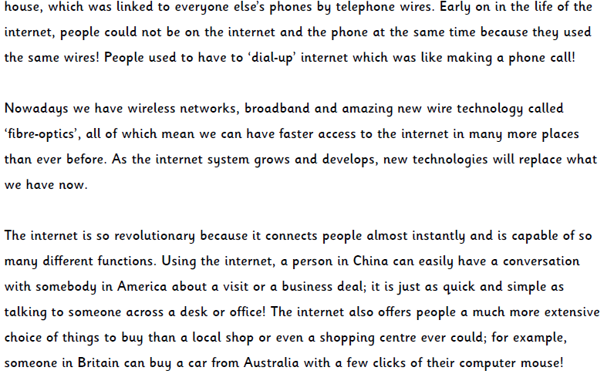

Slide 6
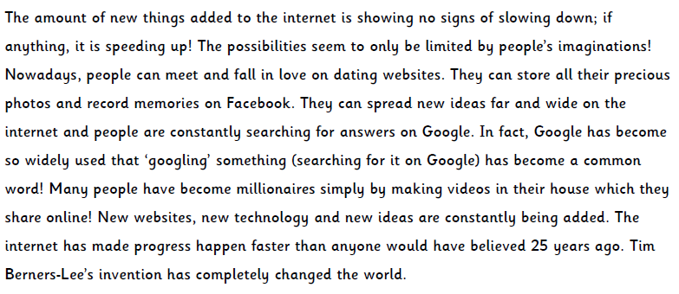

Slide 7
You are now going to answer the question. Use the text to help you.

Slide 8
Answers

