Slide 1
Week 11 English 4
The Girl and the Robot

Slide 2
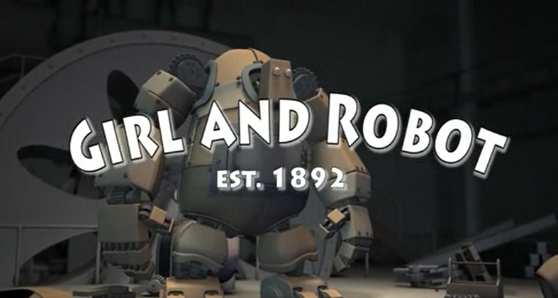
Your story….

Slide 3
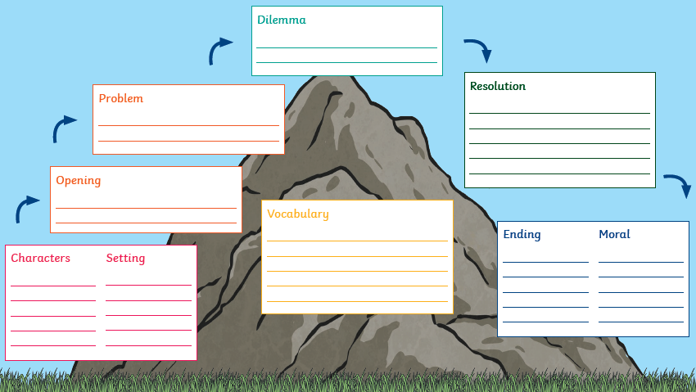
Use your story mountain to write the ending of your story…

Slide 4
Your task…
You are going to write the first part of your story.
Paragraph 4:
Dilemma
Paragraph 5:
Resolution
Paragraph 6:
Ending and Moral of the story

