Slide 1
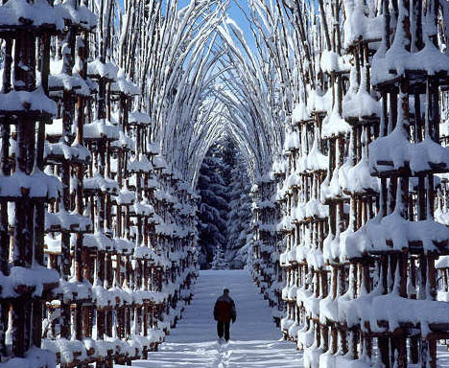
You are going to write a paragraph using the picture above as a stimulus. However… you have got a challenge sheet to try and include! This powerpoint will remind you of all of the terminology.

Slide 2
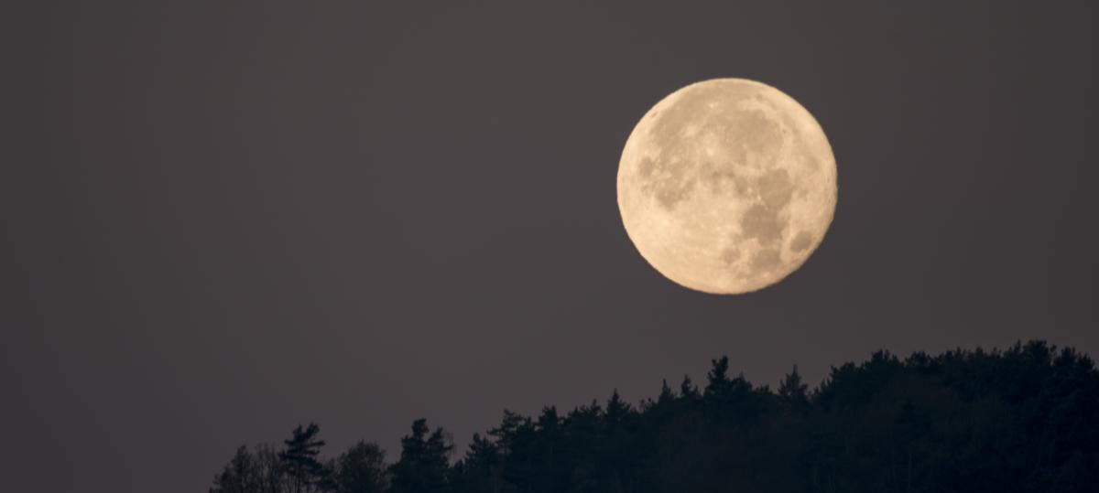
Use well-chosen noun phrases to describe.
The huge, bright moon shone down from the sky.
adjective, adjective noun

Slide 3
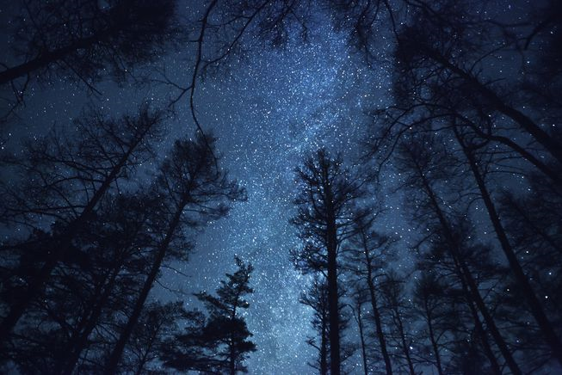
Can you think of a noun phrases to describe.
_____________________________________________________________________________________________________________________________________

Slide 4
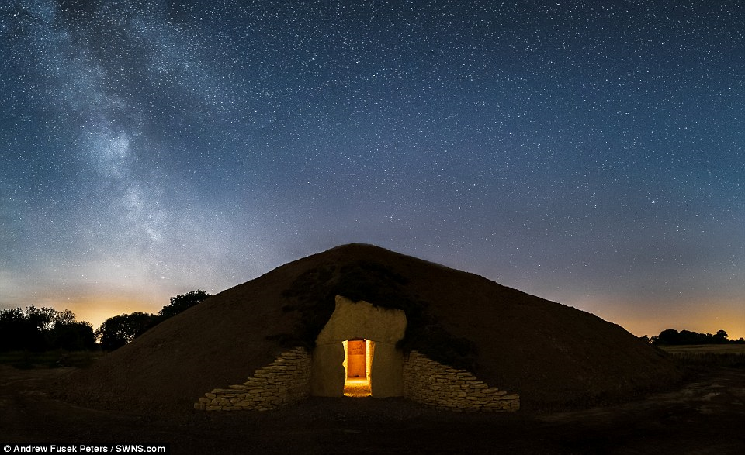
Can you think of a noun phrases to describe.
_____________________________________________________________________________________________________________________________________

Slide 5
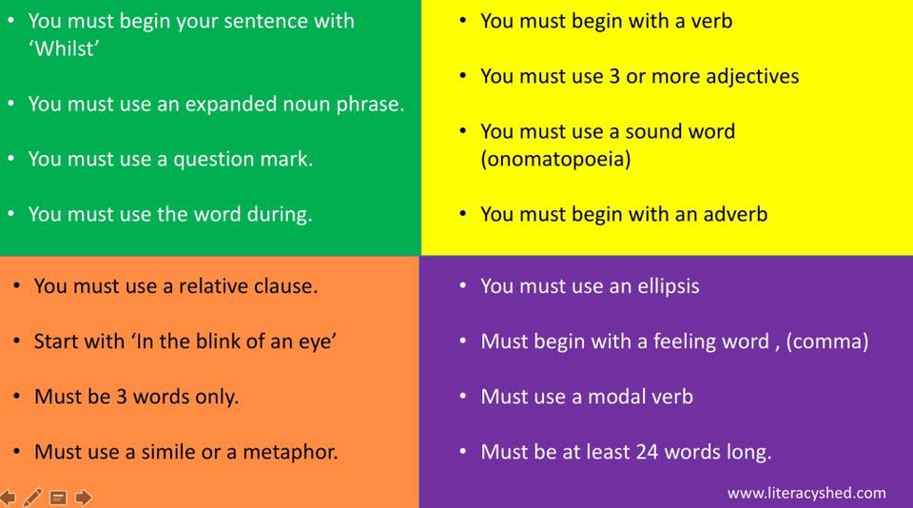
You are going to write a paragraph using the picture above as a stimulus. However… you have got a challenge sheet. See how many of these you can include.

