Slide 1
Maths Week 4 Lesson 2
Comparing the duration of time

Slide 2
Yesterday you measured the duration of time… can you have a go at working out these times?
Lasted for 45 minutes.
Ended at 17:45
Lasted for 1 hour.
Ended at 19:00

Slide 3
You can use a time line to help you calculate the times.
Lasted for 45 minutes.
Ended at 17:45
-45 minutes
17:00
17:45
Started at 17:00

Slide 4
You can use a timeline to help you calculate the times
Lasted for 1 hour.
Ended at 19:00
- 1 hour
18:00
19:00
Started at 18:00

Slide 5
Yesterday you measured the duration of time… can you have a go at working out these times?
Started at 16:30
Ended at 17:15
Started at 16:00
Ended at 17:00

Slide 6
You can use a timeline to help you would out how long each one lasted.
Count how many minutes to the next hour – remember there’s 60 minutes in an hour.
Started at 16:30
Ended at 17:15
+ 30minutes
+ 45 minutes
17:00
Start16:30
End 17:15
30 minutes + 15 minutes = 45 minutes
The football lasted 45 minutes

Slide 7
You can use a timeline to help you calculate how long things take.
Started at 13:00
Ended at 14:20
Count to the next hour to help you.
+ 1 hour
+ 20 minutes
14:00
14:20
Start13:00
1 hour + 20 minutes = 1 hour and 20 minutes
Yoga lasted 1 hour and 20 minutes

Slide 8
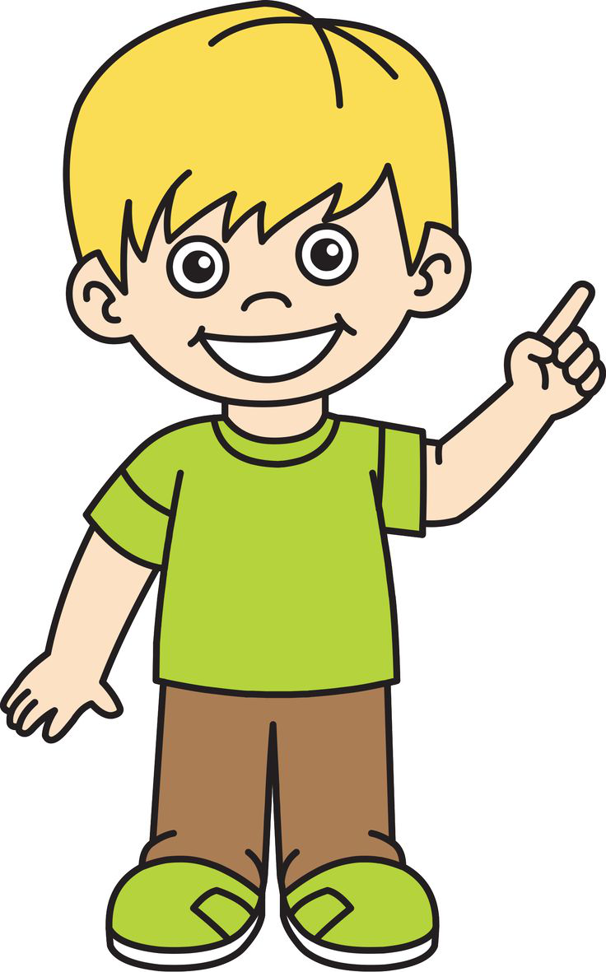
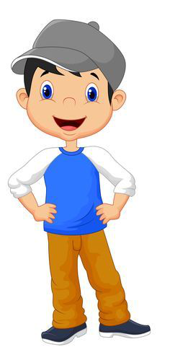
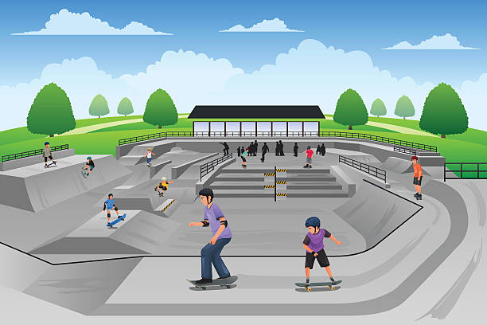
Tom went to the skateboard park at 14:00 and left at 15:30.
Billy went to the skateboard park at 12:00 and left at 14:00.
Who was there for the longest?

Slide 9
Tom went to the skateboard park at 14:00 and left at 15:30.
Tom was there for 1 hour and 30 minutes.
Billy went to the skateboard park at 12:00 and left at 14:00.
Billy was there for 2 hours.
Billy was there for the longest because he was there for 2 hours. Which is half an hour longer than Tom.

Slide 10
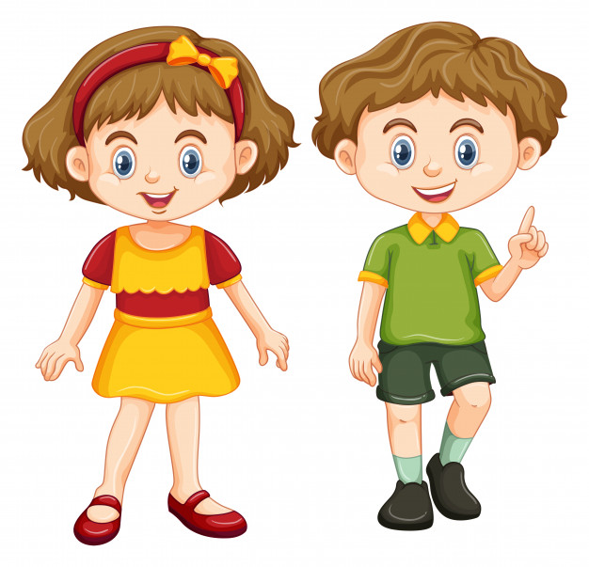
Jessie went to the cinema with her sister at 12:30. She left the cinema at 14:00.
Ellie went to the cinema with her brother at 14:00 and left at 17:15.
Who went to see the longest film?

Slide 11
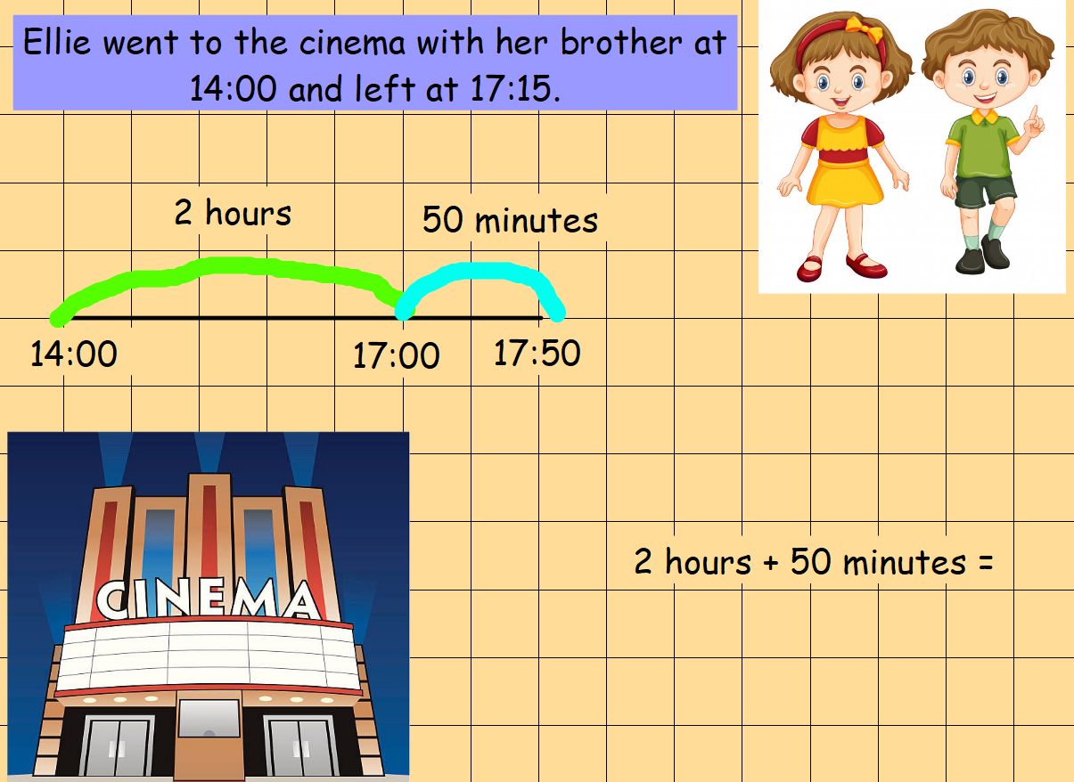

Slide 13
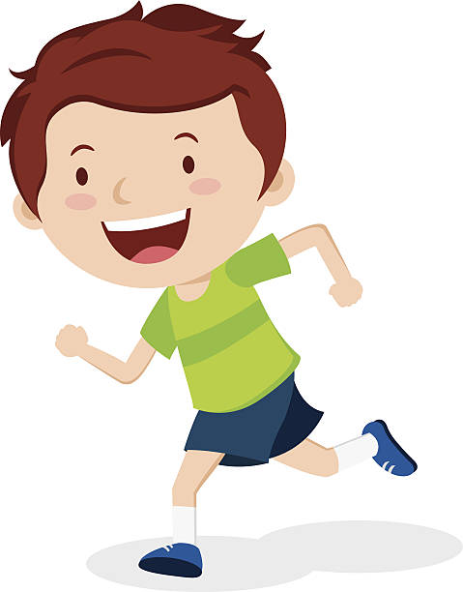
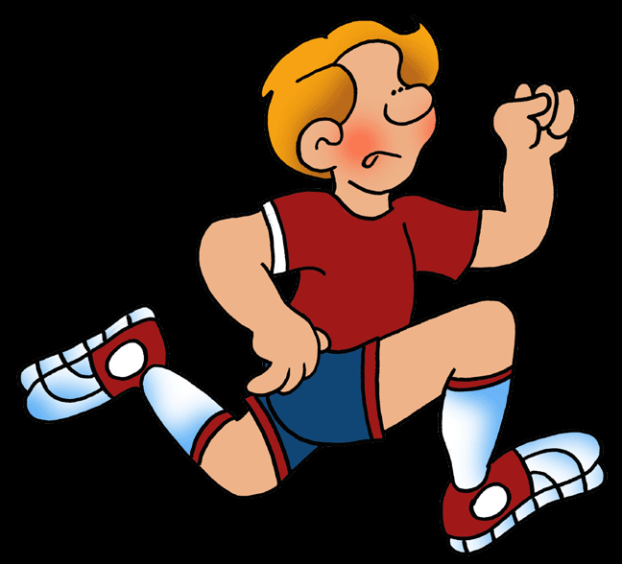
Tom started his 5km run at 14:30 and finished at 16:50. How long did it take him?
Jack started his 5km run at 12:15 and finished at 14:20. How long did it take him?
Who took the least amount of time? Draw a number line like the slides before to help you.

