Slide 1
Week 8 Lesson 4
Creative Writing

Slide 2
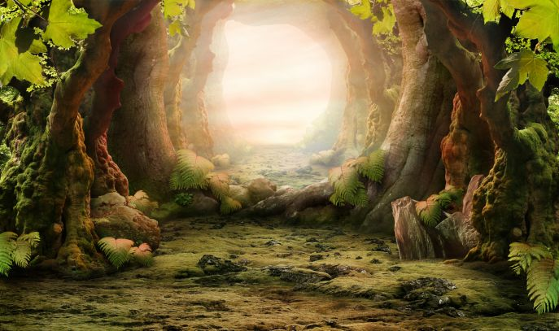
Look at the picture below…. Can you think of some adjectives to describe the image.

Slide 3
Can you think of any noun phrases…

Slide 4
Can you think of any prepositions of place…

Slide 5
You are going to write a piece of creative writing using this picture.

