Slide 1
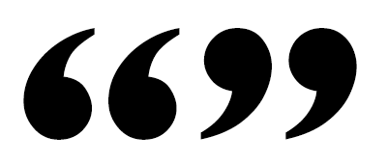
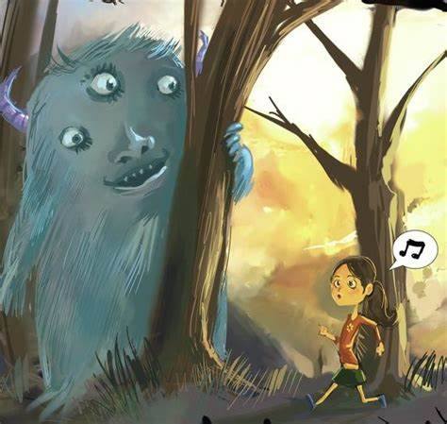
Inverted commas
You are going to write a short paragraph using speech between these two characters.
The powerpoint will help you remember about speech marks.

Slide 2
Inverted commas
Inverted commas are a punctuation mark.
They show speech.
Inverted commas are sometimes called speech marks.
They go around the writing that is being spoken.
You will also know who said the speech too.

Slide 3
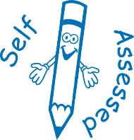

Self-assessment sheet
Do you have “ that sit above the line?
Do you have a capital letter?
Do you have a sentence?
Do you have a comma before the ” ?
Do you have ” that sit above the line?
Do you have who said it?
Do you have a full stop?

Slide 4
Inverted commas
You are going to write a short paragraph using speech between these two characters.
Use the self assessment checklist to help you.

