Slide 1
Week 7 English 3
Reading Comprehension 2

Slide 2
Fighting Fit Reading Activity
Read the following blog. You will then answer some questions about the Blog over the next few lessons.

Slide 3
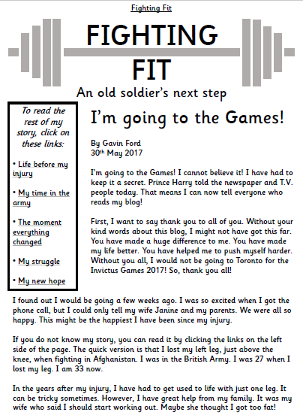
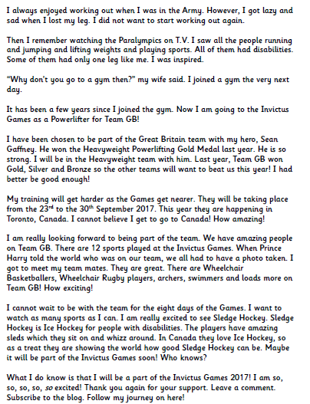

Slide 4
