Slide 1
Year 3 – Money
Session 5 – giving change.
Note: in Year 3 money is written as pounds and pence. Children learn the decimal point for money in Year 4 when they learn decimals.

Slide 2
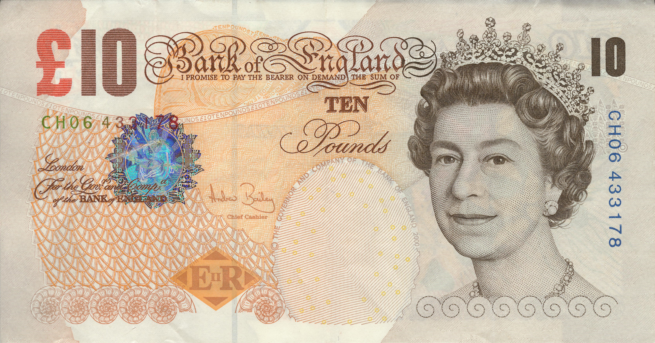
What do we mean by giving change?
When we go shopping we sometimes can pay with notes and coins.
Sometimes we don’t need to spend all our money when we buy something. This means that we have money left over.
This is our change.

Slide 3
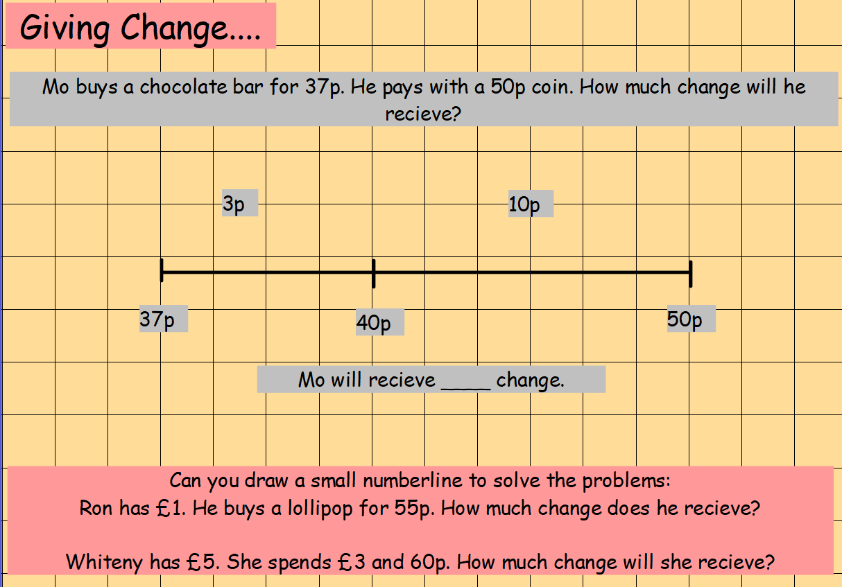
We could use a number line to count backwards and find change.

Slide 4
We could use the method we learnt in the last session.
Lucy has £8 and 50p. She spends £3 and 20p on a book. How much change does she have?
Always take the pence away first.
Start with £8 and 50p.
Take £3 away
Take 20p away
50p – 20p = 30p
£8 - £3 = £5
Lucy has £5 and 30p.

Slide 5
Tim has £5 and 20p. He spends £1 and 35p on some sweets. How much change does he have?
Always take the pence away first.
Start with £5 and 20p.
Exchange £1
Take 35p away.
£4 left
20p – 35p =
We can’t do this yet.
We need to exchange £1
£4 – £1 = £3
120p – 35p =85p
Tim has £3 and 85p left.

Slide 6
There is another method we could use. Look at the example below.
Emma starts with £10. She spends £3 and 80p. How much change does she get?
We can start at £3 and 80p and count up until we get to £10.
£3 and 80p
+20p
Count how many pence to get to the next pound - £4.
£4
Count how many pounds to get to £10.
+ £6
Altogether we have added £6 and 20p
£10

Slide 7
There is another method we could use. Look at the example below.
Lucy starts with £5 she spends £1 and 90p. How much change does she have?
We can start with £1 and 90p and count up until we get to £5.
£1 and 90p
+10p
Count how many pence to get to the next pound - £2.
£2
Count how many pounds to get to £5.
+ £3
Altogether we have added £3 and 10p
£5

Slide 8
There is another method we could use. Look at the example below.
Ryan starts with £20. He spends £8 and 55p on a book. How much change does he have?
We can start with £8 and 55p and count up until we get to £20.
£8 and 55p
+45p
Count how many pence to get to the next pound - £9
£9
Count how many pounds to get to £20.
+ £11
Altogether we have added £11 and 45p.
£20

