Slide 1
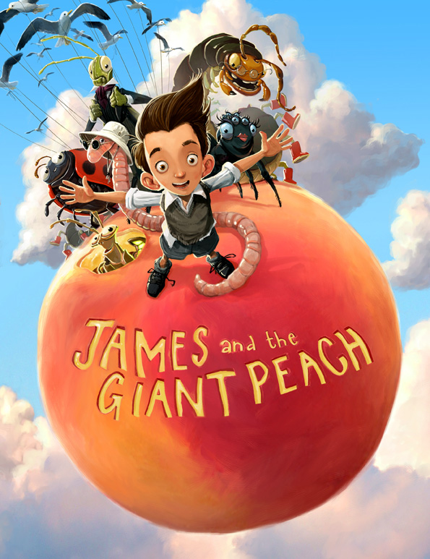
You are going to read a passage from James and the Giant peach and answer some questions.

Slide 2
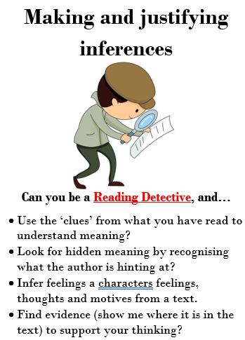

Slide 3
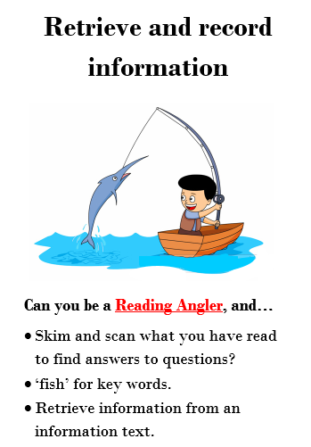

Slide 4
‘Good gracious me!’ Aunt Spiker said, ‘What’s that awful noise?’
Both women swung round to look. The noise, of course, had been caused by the peach crashing through the fence that surrounded it, and now, gathering speed every second, it came rolling across the garden towards the place where Aunt Sponge and Aunt Spiker were standing.
They gaped. They screamed. They started to run. They panicked. They both got in each other’s way. They began pushing and jostling and each one of them was thinking only about saving herself. Aunt Sponge, the fat one, tripped over a box that she’d brought along to keep the money in and fell flat on her face.
Write the answers in full sentences in your green book:
What did the peach crash through?
2. What was the peach rolling towards?
Write 3 things that the Aunts did when they saw the peach rolling.
Which Aunt tripped over a box?
What had the Aunt brought the box along for?
What did Aunt Sponge fall on?

