Slide 1
Monday 1st June
Grammar recap

Slide 2
For the next 2 days we are going to be revising and practising our Year 3 Grammar skills. Each day, we will go over the skills in our Powerpoint and then you will have a mixed bag of grammar questions to answer as your activity.

Slide 3
Year 3 Spellings This week I would like you to practise these 10 spellings. Let’s explore a few in more detail.
Year 3 statutory spelling words
believe
strength
possible
remember
circle
weight
gym
naughty
potatoes
breathe

Slide 4
believe
Click on the word to see the meaning
Syllables: 2 (be-lieve)
Definition: To accept that something is true.
Question Time
Write a question using this word.
Words Within Words
How many other words can you make out of the word?
Notes:
Please make it so that the word in a box is the only thing that comes up at first (except the Week 1: Thursday), then the definition, then each blue activity box one at a time clockwise.

Slide 5
weight
Click on the word to see the meaning
Syllables: 1 (weight)
Definition: Something’s relative mass or the quantity of matter it contains.
News Narration
Write and perform a radio or TV news story of no more than three sentences using this word.
Translate Task
Find out what the word ‘weight’ is in Polish.

Slide 6
Week 21: Tuesday
Sense-sations
What might you think, feel, smell, see and taste whilst eating mashed potatoes?
Noun Phrase Notion
Can you expand the noun into three different noun phrases?
potatoes
Click on the word to see the meaning
Syllables: 3 (po-ta-toes)
Definition: Starchy plant tubers which are cooked and eaten as vegetables.

Slide 7
strength
Click on the word to see the meaning
Syllables: 1 (strength)
Definition: The quality or state of being physically strong.
Simple Sketch
Draw a character showing their strength.

Slide 8
Year 3 Grammar Consonants and vowels Articles - Using a or an

Slide 9
Consonant or Vowel?
Sort the letters of the alphabet into two groups: consonants and vowels.
a
b
c
d
e
f
g
h
i
j
k
l
m
n
o
p
q
r
s
t
u
v
w
x
y
z
Consonants
Vowels
b
c
d
f
g
j
h
k
m
l
a
e
i
o
u
n
p
q
r
t
y
s
v
w
x
z

Slide 10
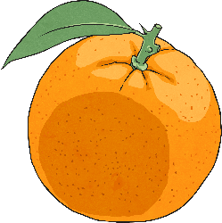
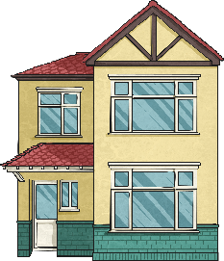
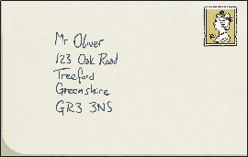
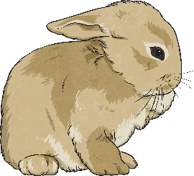
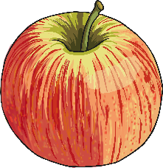
‘a’ or ‘an’?
a
an
house
orange
a
an
pencil
envelope
a
an
rabbit
apple
Usually, we put ‘a’ before words that start with a consonant and ‘an’ before words that start with a vowel.

Slide 11
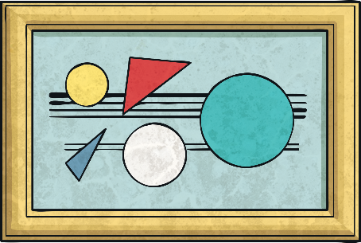
‘a’ or ‘an’?
Which sounds correct?
It was a unique painting.
It was an unique painting.
Although ‘unique’ starts with a vowel, the letter ‘u’ makes the ‘y’ sound, so ‘a’ is used instead of ‘an’.

Slide 12
‘a’ or ‘an’?
Which sounds correct?
It was a honest mistake.
It was an honest mistake.
Although ‘honest’ starts with a consonant, the letter ‘h’ makes the short ‘o’ sound, so ‘an’ is used instead of ‘a’.

Slide 13
Year 3 Grammar Adverbs Prepositions

Slide 14
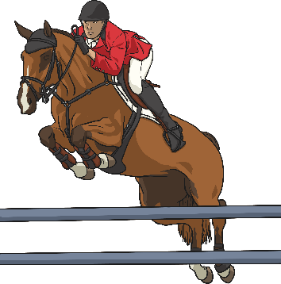
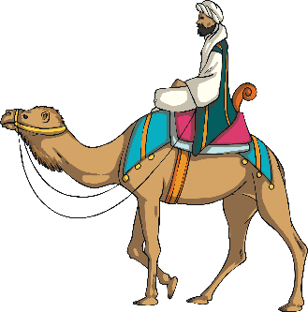
What is an Adverb?
An adverb is something that tells you where, why or how something is done. For example:
Camilla crossed the road safely.
Saffie’s horse bravely jumped over the hurdle.
The Moroccan man rode his camel everywhere.
Many adverbs end in –ly but not all of them. Similarly, not all words which end in –ly are adverbs.

Slide 15
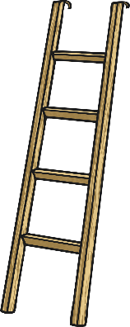
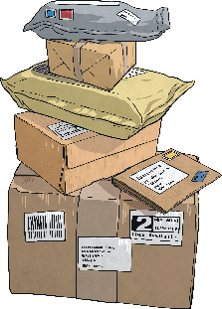
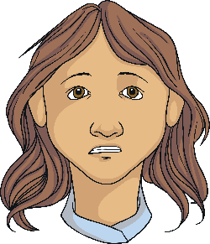
Spot the Adverbs
Did you notice that not all of the adverbs ended in –ly?
Read the sentences below and spot the adverb that says how, why or when the verb was done.
Make sure you climb the ladder safely.
Make sure you climb the ladder safely.
Let’s go to the cinema today.
Let’s go to the cinema today.
Usually my parcels arrive on time.
Usually my parcels arrive on time.
She looked at her friend cautiously.
She looked at her friend cautiously.

Slide 16
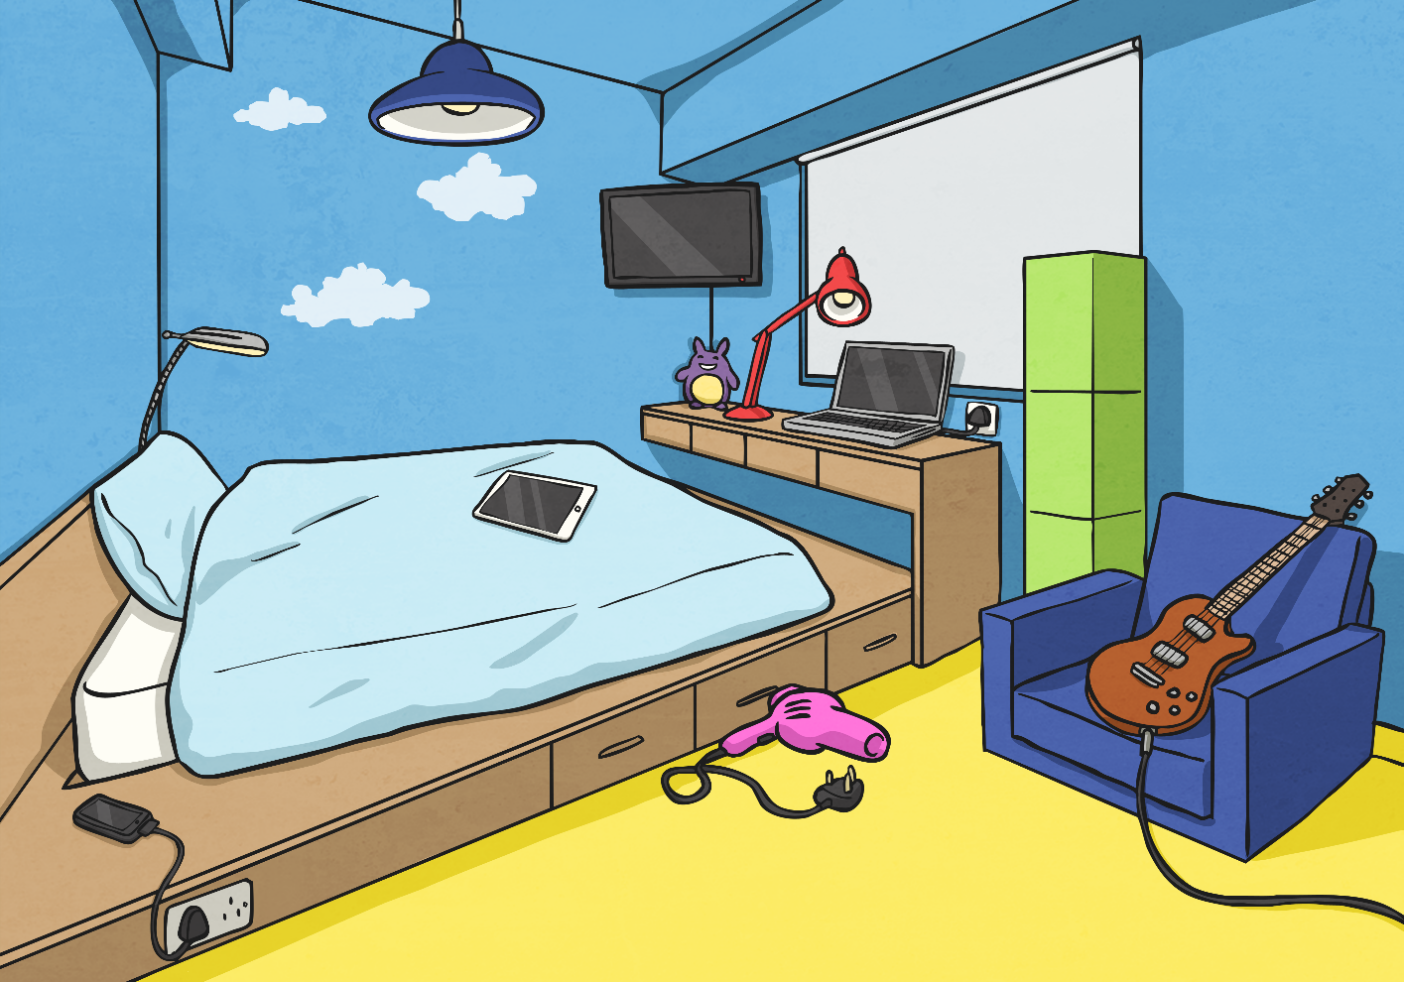
Where Is Everything?
Look at this bedroom scene. Talk to your partner and describe where everything is.

Slide 17
Where Is Everything?
Look at this bedroom scene. Talk to your partner and describe where everything is.
2
×
The lamp is in front of the window
×
3
The desk is under the window
×
4
×
The guitar is on the chair
1
The phone is next to the bed.

Slide 18
Preposition Mind Map
How many different words or phrases (prepositions) can you think of to describe time, place or movement?
across
under
before
below
at six o’clock
through
after
Prepositions
toward
on
in
above
beside
off
above
during
with

Slide 19
Now that we’ve had a quick recap… Can you complete your activity mat?

