Slide 1
You are going to watch a short advert. When you have finished watching you will ask three questions.
https://www.youtube.com/watch?v=_mdgTR5ZyDs

Slide 2
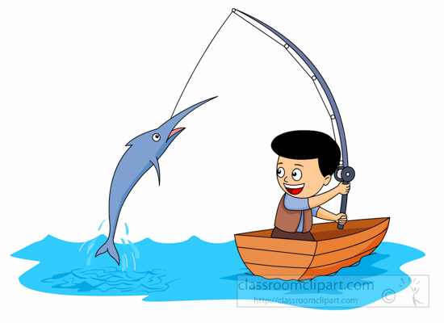
RETRIEVE
Can you find information in the text?
What do certain words mean? (Dictionary)
Look through the text carefully and highlight or underline the words which answer the questions.

Slide 3
INTERPRET
How are the characters feeling?
Why did they do or say that?
What might happen next?
Unlock information from the clues given in the text.

Slide 4
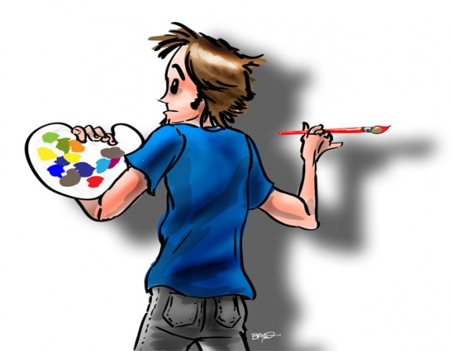
Language choice
Which words help you understand what is happening?
What techniques has the author used to describe?
Think carefully about the author’s choice and what they have done to make the text interesting and enjoyable to read.

Slide 5
Retrieve:
Who are the two men in the clip?
Interpret:
How can you tell the men are determined to play well?
Choice:
Why did Nike choose these two men to appear in the advert?

