Slide 1
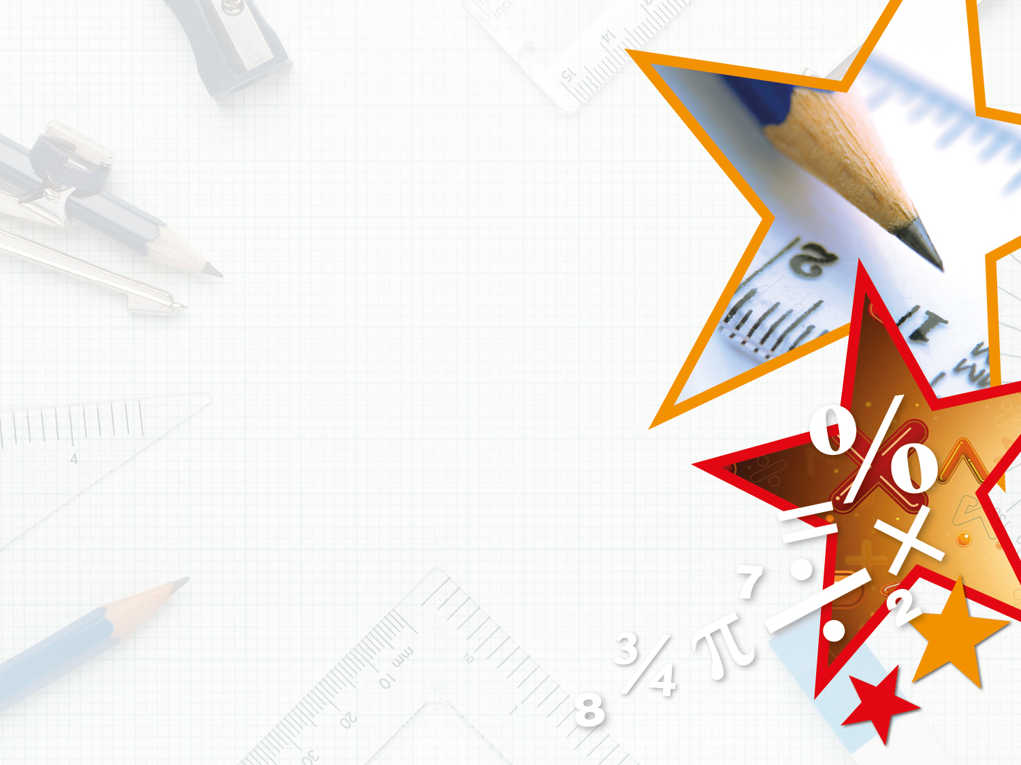
Week 7 Maths Lesson 3
Fractions
Counting in tenths as decimals

Slide 2
Introduction
Circle all the images that show .
4
10

Slide 3
Introduction
Circle all the images that show .
4
10

Slide 4
Varied Fluency 1
Match the fractions to the correct decimal.
eight tenths
0.3
0.8
6
10
three tenths
0.6

Slide 5
Varied Fluency 1
Match the fractions to the correct decimal.
eight tenths
0.3
0.8
6
10
three tenths
0.6

Slide 6
Varied Fluency 2
Use the image to complete the fraction and decimal.
0.1
0.1
0.1
0.1
10
0. | 4

Slide 7
Varied Fluency 2
Use the image to complete the fraction and decimal.
0.1
0.1
0.1
0.1
4
10
0. | 4

Slide 8
Varied Fluency 3
True or false?
The arrow shows 0.7.
0 |  | 0.2 |  | 0.4 |  | 0.6 |  | 0.8 |  | 1

Slide 9
Varied Fluency 3
True or false?
The arrow shows 0.7.
True
0 |  | 0.2 |  | 0.4 |  | 0.6 |  | 0.8 |  | 1

Slide 10
Varied Fluency 4
Complete the part whole model.
0.9
0.2
 | .

Slide 11
Varied Fluency 4
Complete the part whole model.
0.9
0.2
0 | . | 7

Slide 12
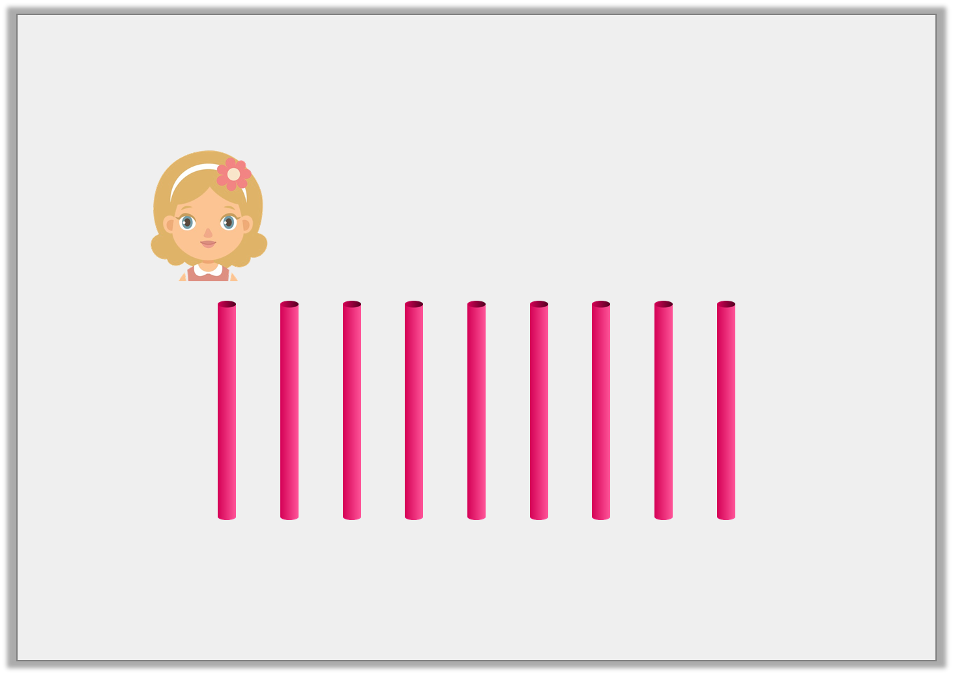
Reasoning 1
Daisy is using straws to represent tenths.
One straw is equal to one tenth.
Is Daisy correct? Explain your answer.
I have made 0.7.

Slide 13
Reasoning 1
Daisy is using straws to represent tenths.
One straw is equal to one tenth.
Is Daisy correct? Explain your answer.
No because…
I have made 0.7.

Slide 14
Reasoning 1
Daisy is using straws to represent tenths.
One straw is equal to one tenth.
Is Daisy correct? Explain your answer.
No because she has used nine straws which would represent 0.9.
I have made 0.7.

Slide 15
Reasoning 2
Which is the odd one out?
Convince me.
A.
7
10
B.
seven tenths
C.
D.
0.7
Ones | Tenths
0.1
0.1
0.1
0.1
0.1
0.1

Slide 16
Reasoning 2
Which is the odd one out?
Convince me.
D is the odd one out because…
A.
7
10
B.
seven tenths
C.
D.
0.7
Ones | Tenths
0.1
0.1
0.1
0.1
0.1
0.1

Slide 17
Reasoning 2
Which is the odd one out?
Convince me.
D is the odd one out because it represents 0.6 and the others represent 0.7.
A.
7
10
B.
seven tenths
C.
D.
0.7
Ones | Tenths
0.1
0.1
0.1
0.1
0.1
0.1

Slide 18
Problem Solving 1
Order these numbers from smallest to largest.
Smallest Largest
seven tenths
3
10
five tenths
9
10

Slide 19
Problem Solving 1
Order these numbers from smallest to largest.
Smallest Largest
seven tenths
3
10
five tenths
9
10
3
10
five tenths
seven tenths
9
10

