Slide 1
Maths Week 5 Lesson 3
Barcharts

Slide 2
Practise 3 x multiplication as a warm up…
1 x 3 = 9 x 3 =
2 x 3 = 10 x 3 =
3 x 3 = 11 x 3 =
4 x 3 = 12 x 3 =
5 x 3 =
6 x 3 =
7 x 3 =
8 x 3 =

Slide 3
Practise 3 x multiplication as a warm up…
1 x 3 = 3 9 x 3 = 27
2 x 3 = 6 10 x 3 = 30
3 x 3 = 9 11 x 3 = 33
4 x 3 = 12 12 x 3 = 36
5 x 3 = 15
6 x 3 = 18
7 x 3 = 21
8 x 3 = 24

Slide 4
Barcharts

Slide 5
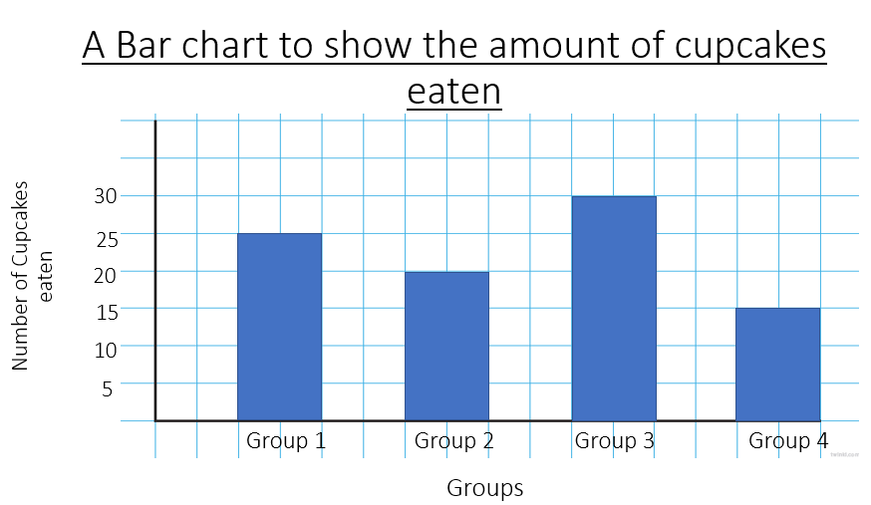

Look at the information below:
Group | Number of cupcakes eaten
1
2
3
4
Key = 5 Cupcakes

Slide 6
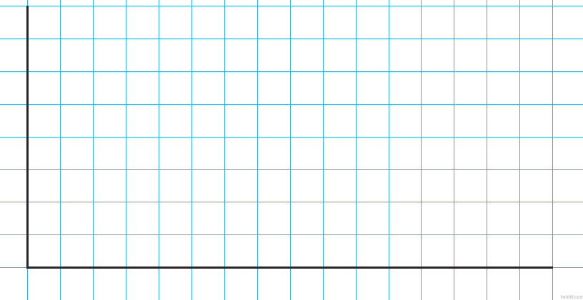
A Bar chart to show the amount of cupcakes eaten
Title
30
25
Number of Cupcakes eaten
20
15
10
5
Amount of…
Group 1
Group 2
Group 3
Group 4
Groups
What is being tested

Slide 7
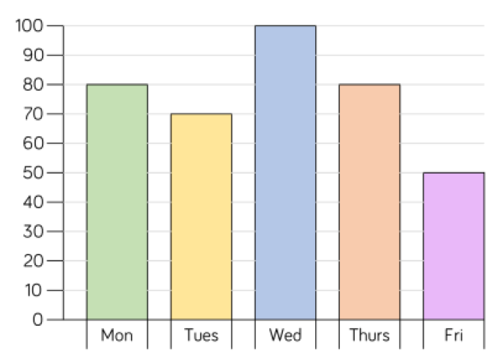
The bar chart below shows how many children attend after school clubs.
Number of children
Days of the Week

Slide 8
Which day is the most popular?
Number of children
Days of the Week

Slide 9
Which day is the least popular?
Number of children
Days of the Week

Slide 10
What is the difference between the number of children attending on Tuesday and Thursday?
Number of children
Days of the Week

Slide 11
Answers

Slide 12
Which day is the most popular?
Wednesday, because 100 children attend.
Number of children
Days of the Week

Slide 13
Which day is the least popular?
Friday because only 50 children attend.
Number of children
Days of the Week

Slide 14
What is the difference between the number of children attending on Tuesday and Thursday?
80children –
70 Children
_________
10 children
Number of children
Days of the Week

