Slide 1

Week 7 Maths Lesson 4
Fractions
Fractions of amounts

Slide 2
Introduction
Match the representation to the statement.
Three equal groups of 5
Two equal groups of 3
Four equal groups of 5
Two equal groups of 8

Slide 3
Introduction
Match the representation to the statement.
Three equal groups of 5
Two equal groups of 3
Four equal groups of 5
Two equal groups of 8

Slide 4
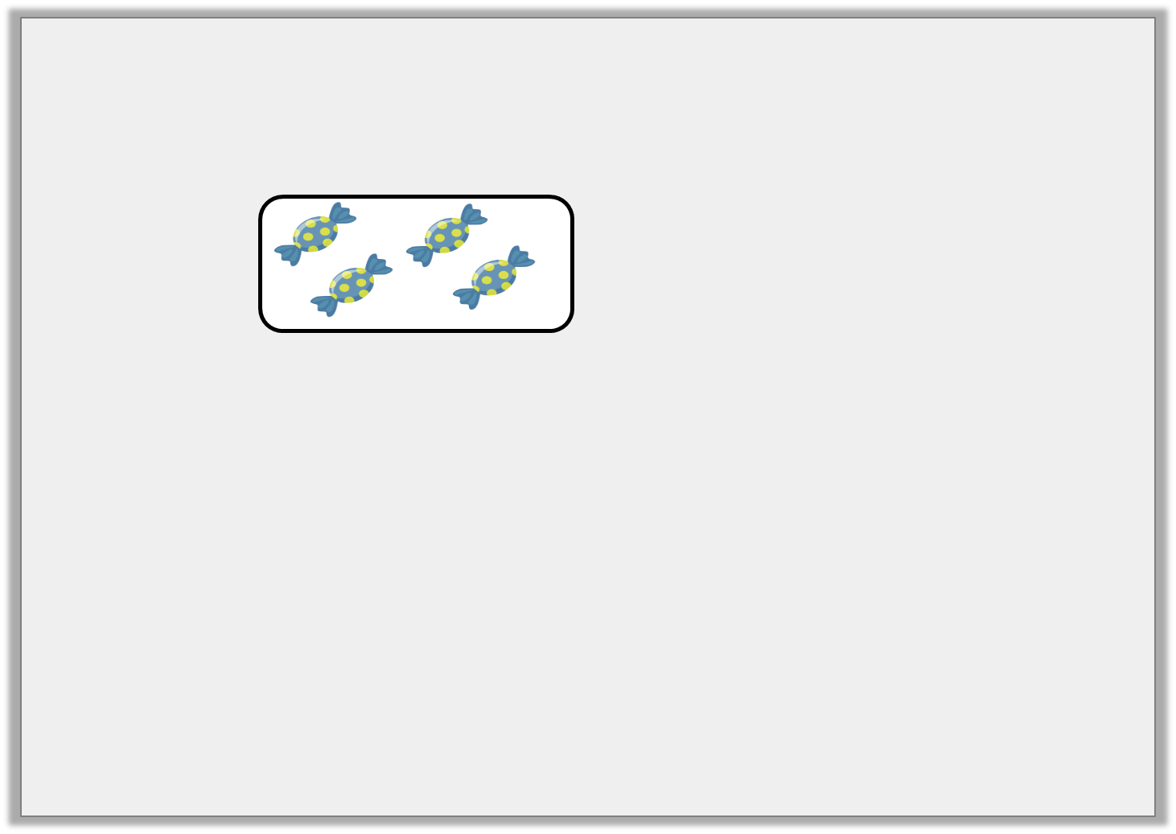
Varied Fluency 1
This is of a bag of sweets.
How many sweets were in the bag?
1
3

Slide 5
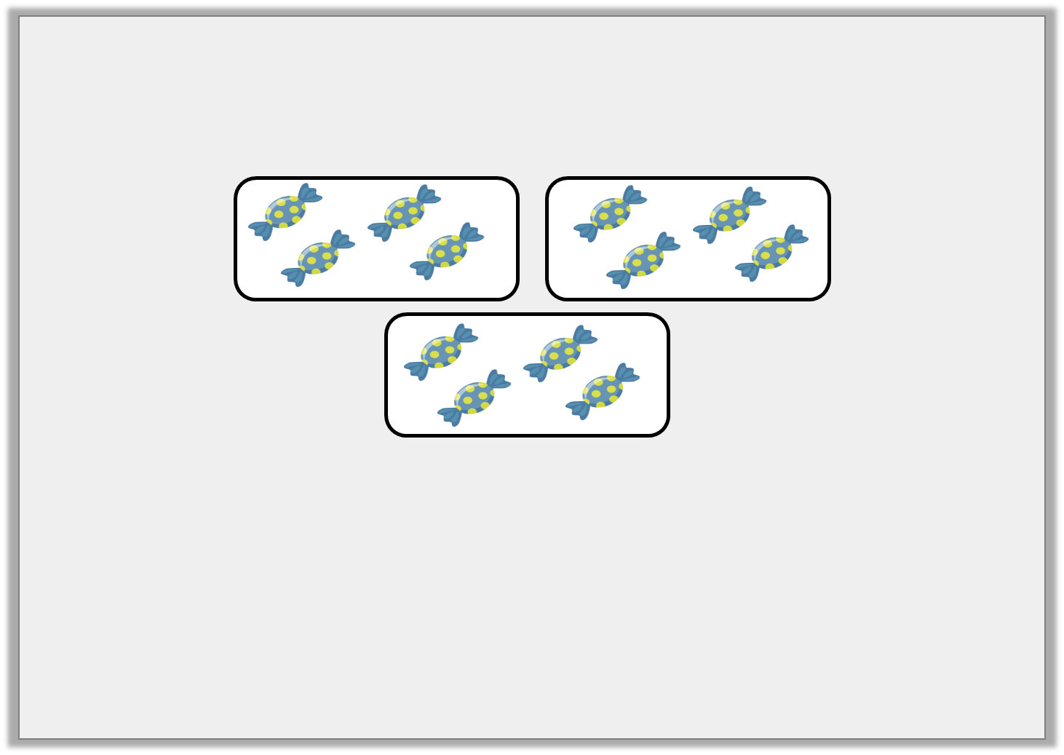
Varied Fluency 1
This is of a bag of sweets.
How many sweets were in the bag?
12 sweets
1
3

Slide 6
Varied Fluency 2
Find of 40 by circling equal groups.
1
10

Slide 7
Varied Fluency 2
Find of 40 by circling equal groups.
4
1
10

Slide 8
Varied Fluency 3
Fill in the gaps to show the calculation this bar model represents.
1
1
1
1
1
1
1
1
1
1
1
1
1
1
1
1
1
1
1
1
1
1
1
1
1
1
1
1
1
1
1
1
1
1
1
1
1 | of 36 =

Slide 9
Varied Fluency 3
Fill in the gaps to show the calculation this bar model represents.
1
1
1
1
1
1
1
1
1
1
1
1
1
1
1
1
1
1
1
1
1
1
1
1
1
1
1
1
1
1
1
1
1
1
1
1
1 | of 36 = | 9
4

Slide 10
Varied Fluency 4
Find of 96 using place value counters.
1
8
10
10
10
10
10
1
1
1
10
10
10
10
1
1
1

Slide 11
Varied Fluency 4
Find of 96 using place value counters.
12 (you need to exchange one of the tens).
1
8
10
1
10
1
1
10
1
10
1
1
1
1
1
1
1
10
10
10
10
1
1
1
1
1

Slide 12
Reasoning 1
D’Angelo thinks he has found of 18 using place value counters.
Is D’Angelo correct? Convince me.
1
3
10
1
1
1
1
1
1
1
1

Slide 13
Reasoning 1
D’Angelo thinks he has found of 18 using place value counters.
Is D’Angelo correct? Convince me.
No because…
1
3
10
1
1
1
1
1
1
1
1

Slide 14
Reasoning 1
D’Angelo thinks he has found of 18 using place value counters.
Is D’Angelo correct? Convince me.
No because he has not exchanged the tens counter for 10 ones. He should have 6 ones counters in each group.
1
3
10
1
1
1
1
1
1
1
1

Slide 15
Problem Solving 1
Fill in the missing box to make the statement true.
1 | of | 24 | > |  | 1 | of
3 |  |  |  |  | 4

Slide 16
Problem Solving 1
Fill in the missing box to make the statement true.
Possible answer:
1 | of | 24 | > |  | 1 | of | 16
3 |  |  |  |  | 4

Slide 17
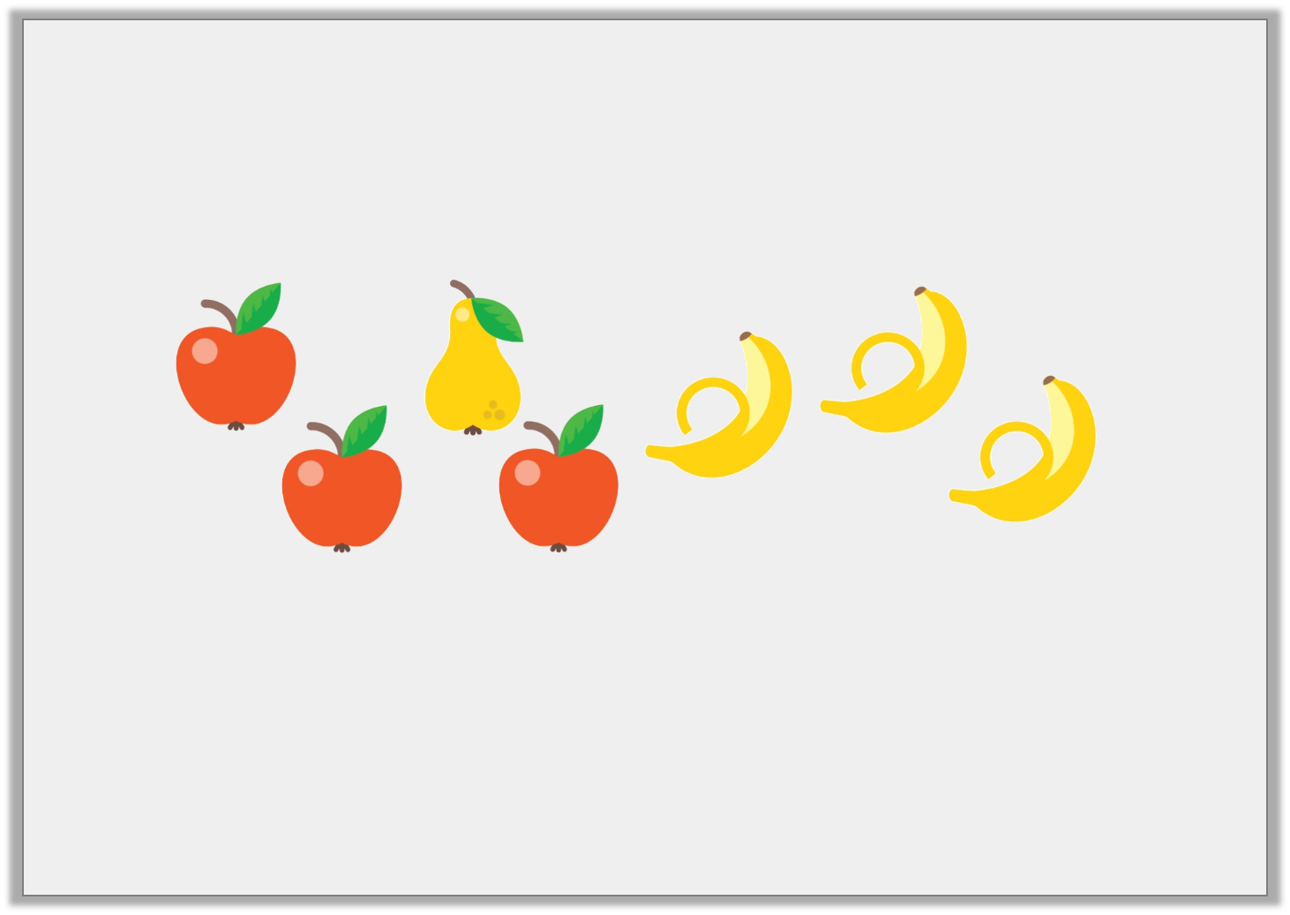
Reasoning 2
Jasmine runs a fruit stall.
She has one tenth of her fruit left.
How much fruit did she start with altogether? Explain your answer.

Slide 18
Reasoning 2
Jasmine runs a fruit stall.
She has one tenth of her fruit left.
How much fruit did she start with altogether? Explain your answer.
70 pieces of fruit because…

Slide 19
Reasoning 2
Jasmine runs a fruit stall.
She has one tenth of her fruit left.
How much fruit did she start with altogether? Explain your answer.
70 pieces of fruit because 7 is one tenth of 70.

