Slide 1
Week 7 English 1
SPAG

Slide 3
To be aware of and be able to recognise different types of sentences.

Slide 4

Statements
1
Statements are sentences which tell you something.
They end with a full stop.
Example:
A rainbow has 7 colours.
They are beautiful to look at.

Slide 5
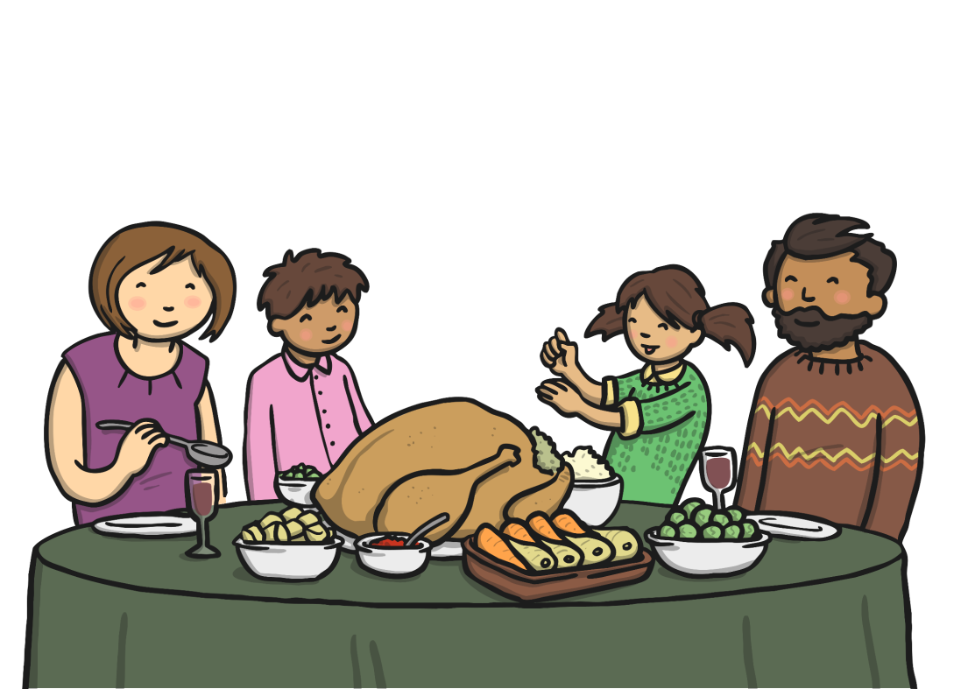
Questions
2
Questions are sentences that ask you something.
They usually end with a question mark.
Example:
What did you have for dinner?

Slide 6
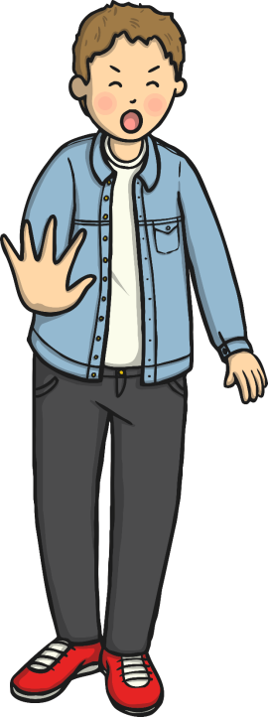

Commands
3
They are often urgent or angry, can be very short and contain
an imperative verb. Commands Imperative verbs are also known
as ‘bossy verbs’- they tell people what to do.
Example:
Help me! Stop it.

Slide 7

Exclamations
4
An exclamation is used when someone is surprised.
It always starts with ‘How’ or ‘What’ and contains a noun and
a verb.
Example:
What big feet you have!

