Slide 1
Year 3 – Maths
Time #1 Months and Days

Slide 3
The months of the year in order – check if you got them right.
January
February
March
April
May
June
July
August
September
October
November
December

Slide 4
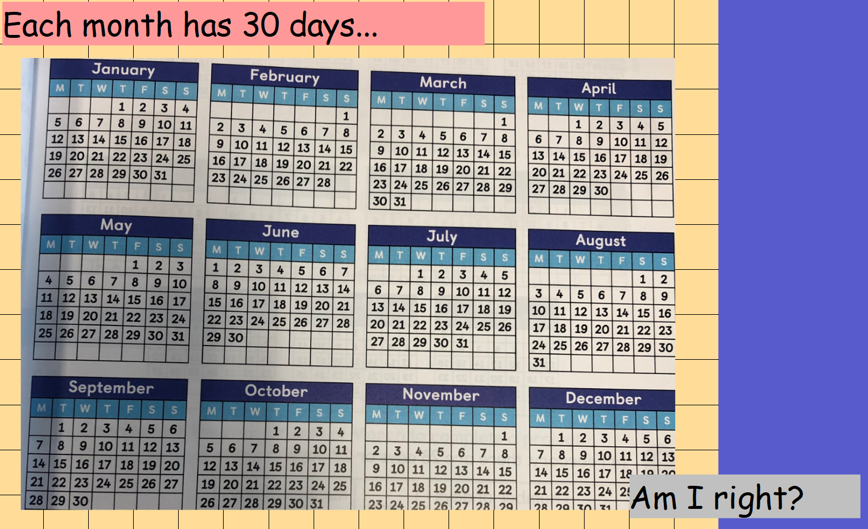

Slide 5
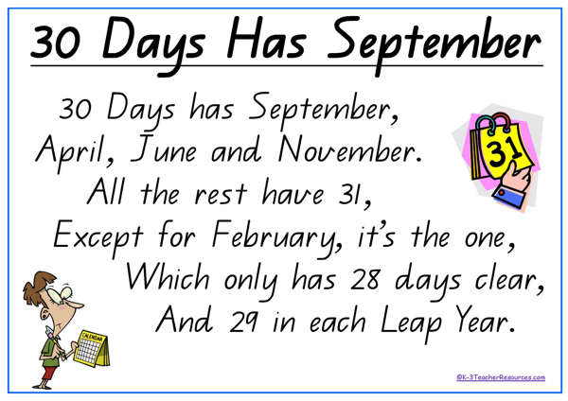
No each month does not have 30 days.
Some months have 30 and some months have 31 except for February.
We can use this rhyme to help us remember.

Slide 6
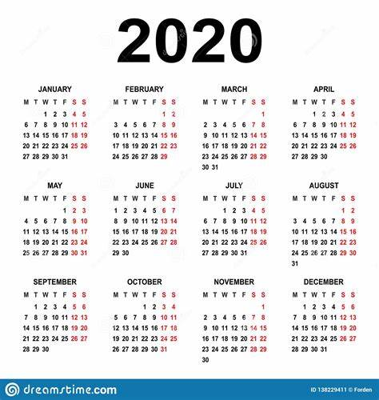
This is the calendar for this year.
These are the days of the week.
These are the dates

Slide 7
What day is April 3rd?
Find April then find the 3rd of April.
Look above the date to find the day.
It is on a Friday.
What day is September 8th?
Find September and then find the 8th.
Look above the date to find the day.
It is on a Tuesday

Slide 8
It is July 15^{th.} How many days is it until the end of the month?
There are 31 days in July.
31-15 = 16.
There are 16 days left till the end of the month.
It is February 24th. How many days is it until the end of the month?
There are 29 days in February.
29 – 24 = 5
There are 5 days left till the end of the month.

Slide 9
My birthday is on November 18th. I’m having my part on the Saturday after.
What date is my party on?
Find November 18th
Look across to the Saturday after.
My party will be on Saturday 21st.

