Slide 1
Week 8 English Lesson 1

Slide 2

You are going to read chapter 1 of the Rise of the Slippery Sea.

Slide 3
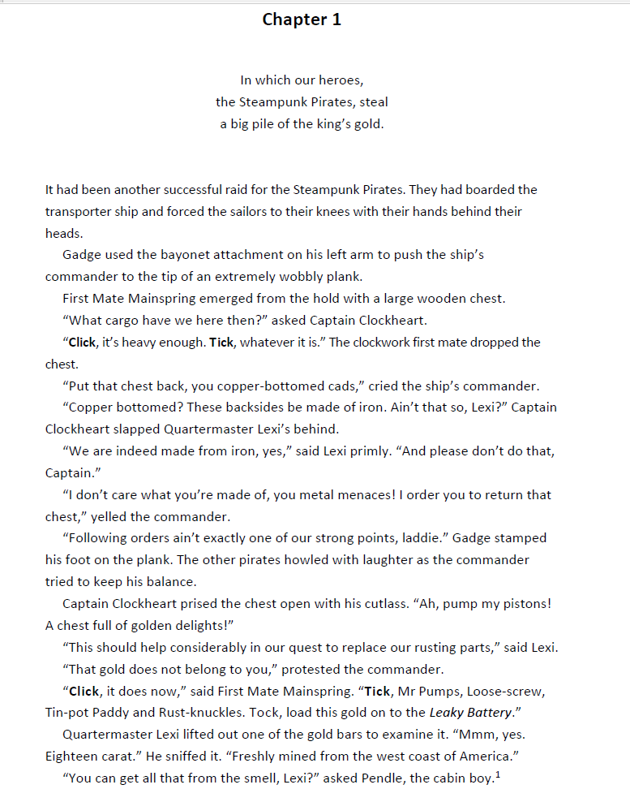

Slide 4

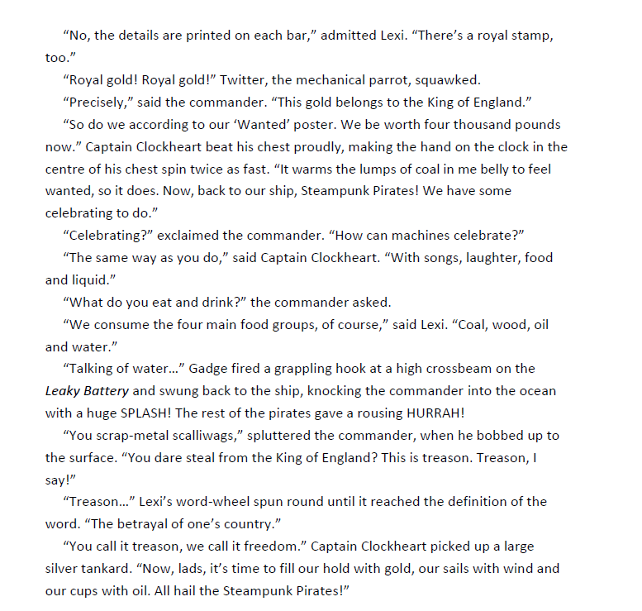

Slide 5
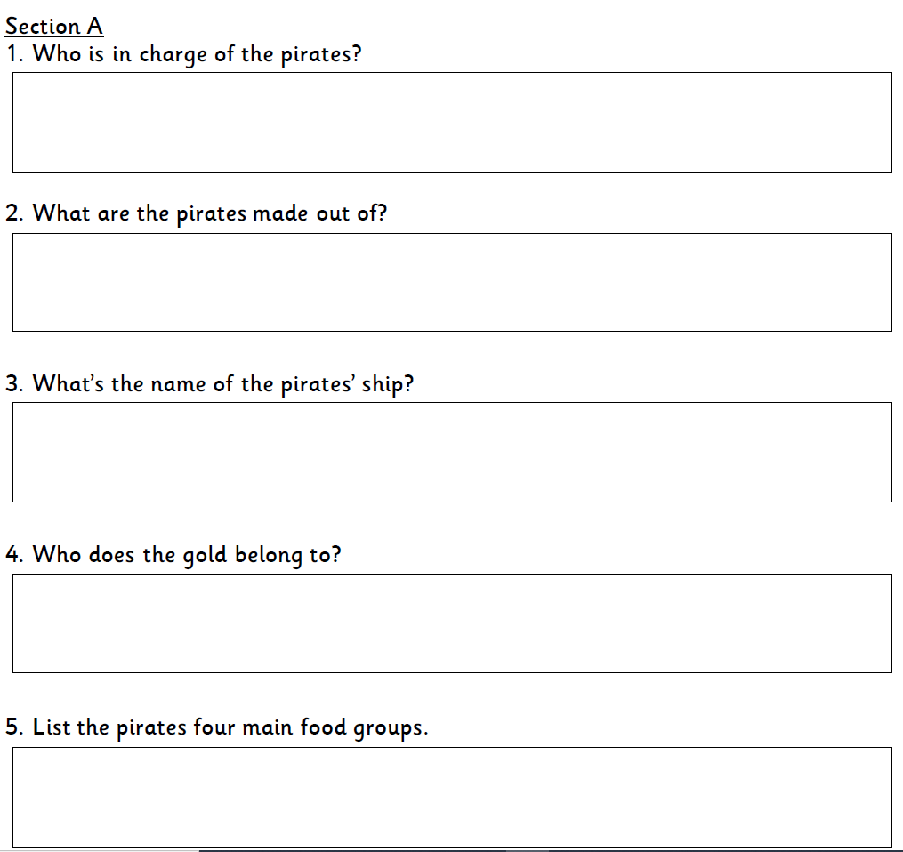
Today you are going to answer comprehension 1.

