Slide 1
Week 3 Maths Lesson 4
Time – Telling the time to 5 minutes

Slide 2
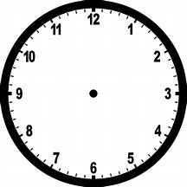
Alfie says that this is 1 minute past 12.
Meg says that this is 5 minutes past 12.
Who is correct?

Slide 3
Well done if you said Meg was correct.
We know that there are 60 minutes in an hour.
When the minute hand (the longer hand) points at each number this represents 5 minutes.
Let’s see what this means in more detail

Slide 4
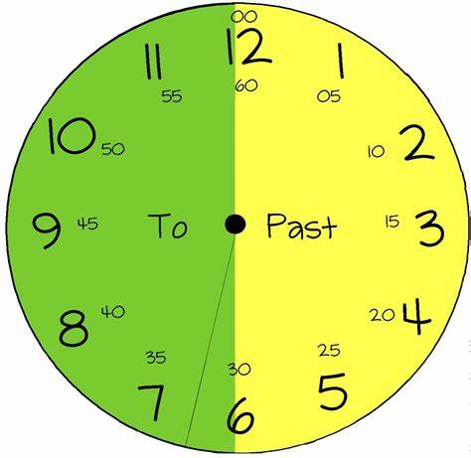
This side of the clock shows how many minutes to the next hour.
This side of the clock shows how many minutes past the hour.
On the hour
5 to
5 past
10 to
10 past
Quarter to
Quarter past
20 past
20 to
25 past
25 to
Half past

Slide 5
What time does this show?
Look at the hour hand first.
It is pointing at 11.
Now look at the minute hand
It is pointing to the 1 which means it is 5 past.
The time is 5 past 11.
11.05

Slide 6
What time does this show?
Look at the hour hand first.
It is pointing at 10.
Now look at the minute hand
It is pointing to the 3 which means it is quarter past
The time is quarter past 10.
10.15

Slide 7
What time does this show?
Look at the hour hand first.
It is pointing at 2.
Now look at the minute hand
It is pointing at the 5 which means it is 25 past
The time is 25 past 2.
2.25

Slide 8
What time does this show?
Look at the hour hand first.
It is pointing between 3 and 4.
Now look at the minute hand
It is pointing at the 7 which means it is 25 to the next hour which is 4.
The time is twenty five minutes to four.
3.35

Slide 9
What time does this show?
Look at the hour hand first.
It is pointing between 9 and 10.
Now look at the minute hand
It is pointing at the 8 which means it is 20 to the next hour which is 10.
The time is twenty to ten.
9.40

Slide 10
What time does this show?
Look at the hour hand first.
It is pointing between 11 and 12.
Now look at the minute hand
It is pointing at the 10 which means it is 10 to the next hour which is 12.
The time is ten to twelve.
11.50

