Slide 1
Week 6 English Lesson 4
Author choice, Vocabulary and retrieval

Slide 2
25 Years of the internet
Read the text on the following 4 slides again.
Today, lots of our questions will be about the structure of the writing and the choices the author has made.

Slide 5
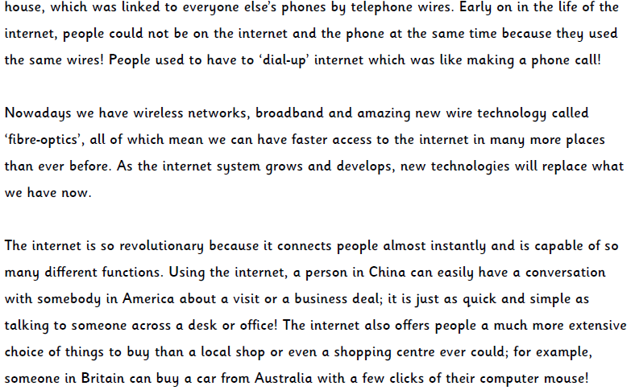

Slide 6
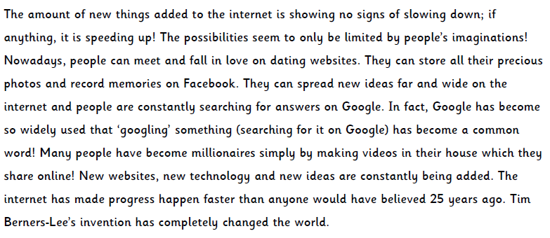

Slide 7
You are now going to answer the question. Use the text to help you.

Slide 8
Answers

Slide 9
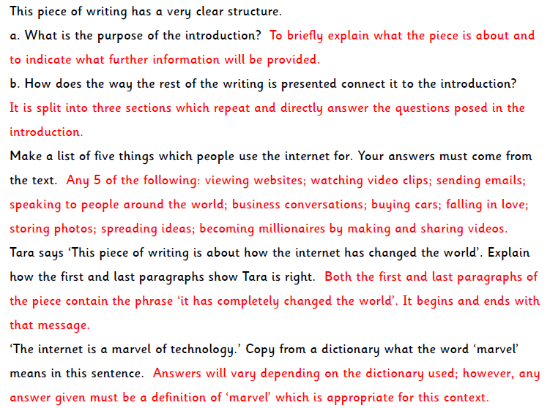

Slide 10
