Slide 1
Week 10 English 4
Reading

Slide 2
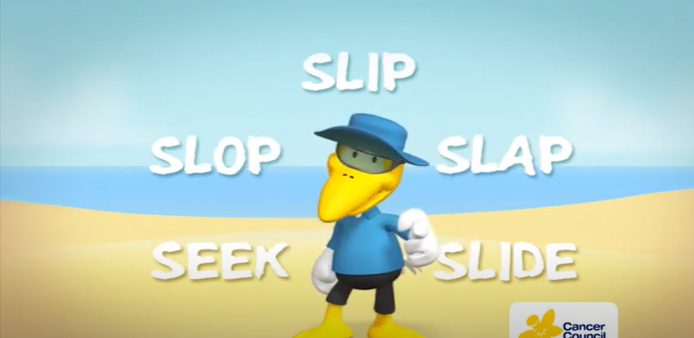
You are going to watch a short clip from a sun safe advert. When you have finished watching you will ask three questions.
https://www.youtube.com/watch?v=YzYHwzSE1VY

Slide 3
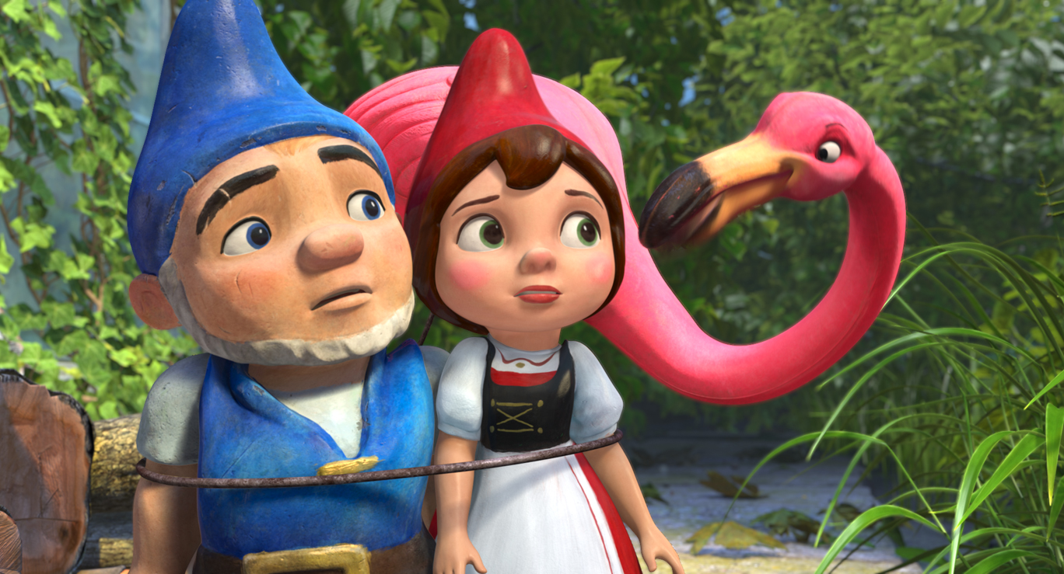

RETRIEVE
Can you find information in the text?
What do certain words mean? (Dictionary)
Look through the text carefully and highlight or underline the words which answer the questions.

Slide 4

INTERPRET
How are the characters feeling?
Why did they do or say that?
What might happen next?
Unlock information from the clues given in the text.

Slide 5

CHOICE
Which words help you understand what is happening?
What techniques has the author used to describe?
How has the author organised or presented the text?
Think carefully about the author’s choice and what they have done to make the text interesting and enjoyable to read.

Slide 6
Retrieve:
What do the 5 S words instruct people to do?
Interpret:
Who do you think this advert is aimed at? Why?
Choice:
What have the makers done to make it successful?

