Slide 1
Week 11 Lesson 3

Slide 2
Which 3D shapes do we know?
Sphere
Cone
Cylinder
Cube
Cuboid
Triangular prism
Square based pyramid

Slide 3
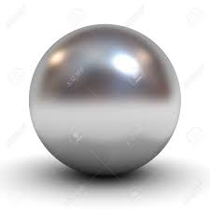
What does 3D mean?
3D shapes are solid
They have faces, corners (vertices) and edges
This is a sphere
It has one face
It has no edges or corners

Slide 4
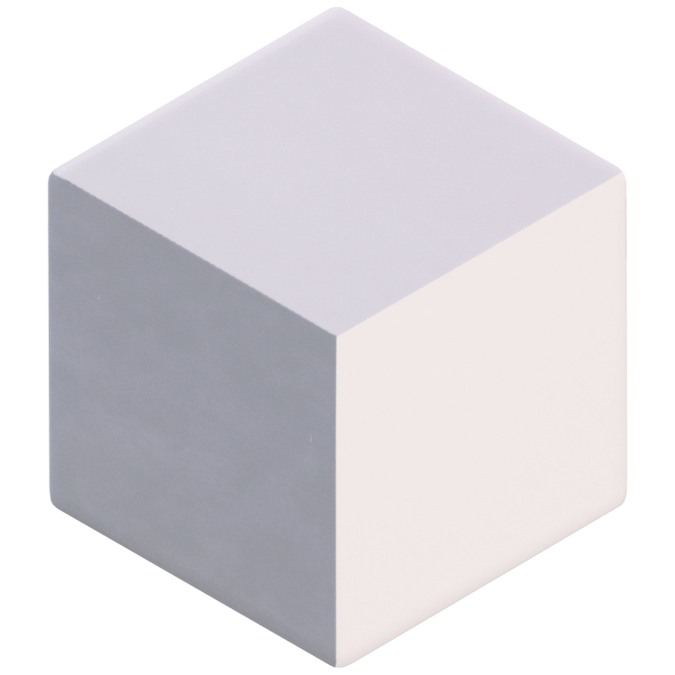
How about this shape?
What is this called?
How many faces?
How many corners?
Does it have any vertical
lines?

Slide 5
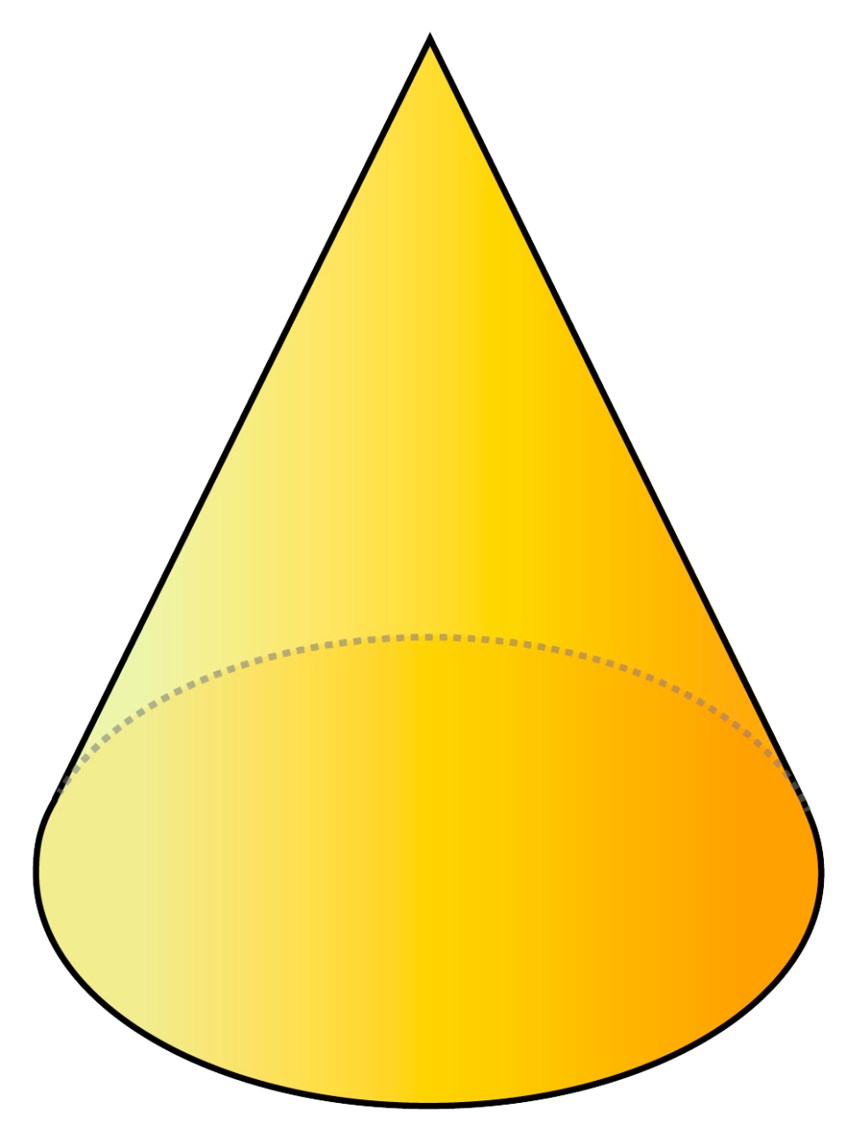
How about this shape?
What is this called?
How many faces?
How many corners?
Does it have any vertical
lines?
How about horizontal lines?

