Slide 1
Maths Week 9 Lesson 2
Comparing Fractions 2

Slide 2


Reasoning 1
Jason has used a bar model to compare two fractions.
He says that one fifth is less than one eighth.
Is he correct? Explain your answer.
© Classroom Secrets Limited 2019

Slide 3
Reasoning 1
Jason has used a bar model to compare two fractions.
He says that one fifth is less than one eighth.
Is he correct? Explain your answer.
Jason is incorrect because…
© Classroom Secrets Limited 2019

Slide 4
Reasoning 1
Jason has used a bar model to compare two fractions.
He says that one fifth is less than one eighth.
Is he correct? Explain your answer.
Jason is incorrect because he has not shared his bars into eight equal sections. One fifth is more than one eighth.
© Classroom Secrets Limited 2019

Slide 5
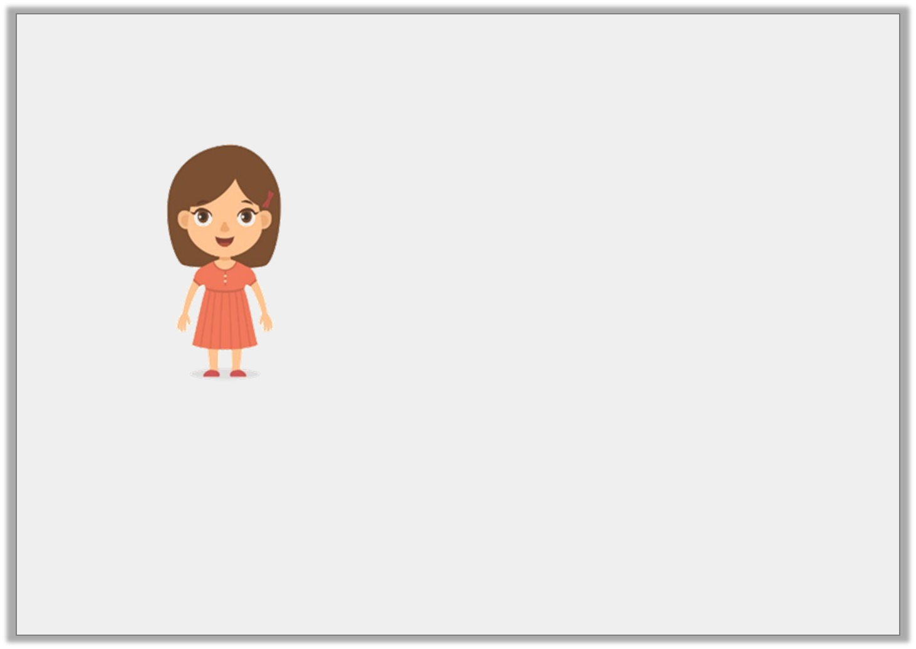
Reasoning 2
Marla is sharing a pizza with her friends. She says,
Is Marla correct? Explain your answer.
You could draw a picture to help you.
If I eat one twelfth of the pizza, I will have more than if I eat four sixths of the pizza, because 12 is more than 6.
© Classroom Secrets Limited 2019

Slide 6
Reasoning 2
Marla is sharing a pizza with her friends. She says,
Is Marla correct? Explain your answer.
You could draw a picture to help you.
Marla is incorrect because…
If I eat one twelfth of the pizza, I will have more than if I eat four sixths of the pizza, because 12 is more than 6.
© Classroom Secrets Limited 2019

Slide 7
Reasoning 2
Marla is sharing a pizza with her friends. She says,
Is Marla correct? Explain your answer.
You could draw a picture to help you.
Marla is incorrect because four sixths is larger than one twelfth. Four sixths is the same as eight twelfths.
If I eat one twelfth of the pizza, I will have more than if I eat four sixths of the pizza, because 12 is more than 6.
© Classroom Secrets Limited 2019

Slide 8
Problem Solving 1
Use the digit cards to find three possible answers.
1
1
2
3
5
A | < | B
5 |  | C
© Classroom Secrets Limited 2019

Slide 9
Problem Solving 1
Use the digit cards to find three possible answers.
Some possible answers include:
1
1
2
3
5
A | < | B
5 |  | C
1 | < | 2 | , | 1 | < | 3 | , | 1 | < | 1 | , | 1 | < | 1 | , | 2 | < | 3
5 |  | 5 |  | 5 |  | 5 |  | 5 |  | 2 |  | 5 |  | 3 |  | 5 |  | 5
© Classroom Secrets Limited 2019

