Slide 1
Maths Week 3 Lesson 4
Telling the time on a 24 hour clock Pt 2

Slide 2
Before you start… Warm up with your times tables. BEAT YESTERDAY!
1 x 5 =
2 x 5 =
3 x 5 =
4 x 5 =
5 x 5 =
6 x 5 =
7 x 5 =
8 x 5 =
9 x 5 =
10 x 5 =
11 x 5 =
12 x 5 =
1 x 4 =
2 x 4 =
3 x 4 =
4 x 4 =
5 x 4 =
6 x 4 =
7 x 4 =
8 x 4 =
9 x 4 =
10 x 4 =
11 x 4 =
12 x 4 =
1 x 3 =
2 x 3 =
3 x 3 =
4 x 3 =
5 x 3 =
6 x 3 =
7 x 3 =
8 x 3 =
9 x 3 =
10 x 3 =
11 x 3 =
12 x 3 =
1 x 8 =
2 x 8 =
3 x 8 =
4 x 8 =
5 x 8 =
6 x 8 =
7 x 8 =
8 x 8 =
9 x 8 =
10 x 8 =
11 x 8 =
12 x 8 =
Use our rolling number song to help you….
https://www.youtube.com/watch?v=jf2BHuSbt_Y

Slide 3
Before you start… Warm up with your times tables. BEAT YESTERDAY!
1 x 5 =5
2 x 5 =10
3 x 5 = 15
4 x 5 =20
5 x 5 =25
6 x 5 = 30
7 x 5 =35
8 x 5 =40
9 x 5 =45
10 x 5 =50
11 x 5 =55
12 x 5 =60
1 x 4 =4
2 x 4 =8
3 x 4 = 12
4 x 4 =16
5 x 4 =20
6 x 4 = 24
7 x 4 =28
8 x 4 =32
9 x 4 =36
10 x 4 =40
11 x 4 =44
12 x 4 =48
1 x 3 =3
2 x 3 =6
3 x 3 = 9
4 x 3 =12
5 x 3 =15
6 x 3 = 18
7 x 3 =21
8 x 3 =24
9 x 3 =27
10 x 3 =30
11 x 3 =33
12 x 3 =36
1 x 8 =8
2 x 8 =16
3 x 8 = 24
4 x 8 =32
5 x 8 =40
6 x 8 = 48
7 x 8 =56
8 x 8 =64
9 x 8 =72
10 x 8 =80
11 x 8 =88
12 x 8 =96
Use our rolling number song to help you….
https://www.youtube.com/watch?v=jf2BHuSbt_Y

Slide 4
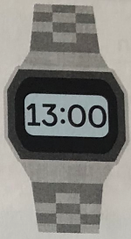
Yesterday we looked at am and pm times. Today we are going to look at times that go beyond 12.
This watch shows 13:00. What time do you think this may be?
On a number line… which number comes before 13?

Slide 5
When we look at p.m times (after noon) which is after 12… the numbers go up.
12 noon
1pm = 13:00
2pm = 14:00
3pm = 15:00
4pm = 16:00
5pm = 17:00
6pm = 18:00
7pm = 19:00
8pm = 20:00
9pm = 21:00
10pm = 22:00
11pm = 23:00

Slide 6
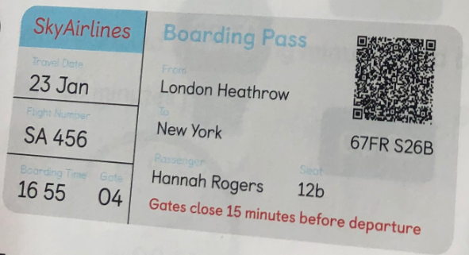
Hannah has a boarding pass to travel to New York. She is unsure what time the plane is leaving.
Noon is 12… let’s count on to 16.
13,14,15,16… so 4:55.

Slide 7
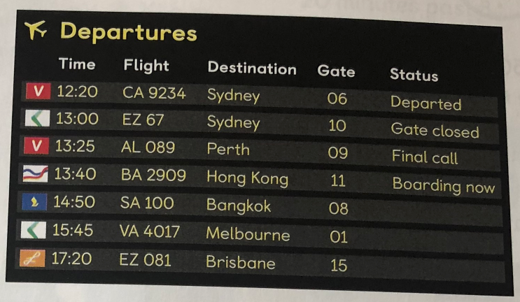
The plane to Bangkok is leaving at 14:50. Let’s work out what time that will be….
13, 14 = 2
2:50pm

Slide 8
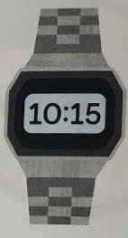
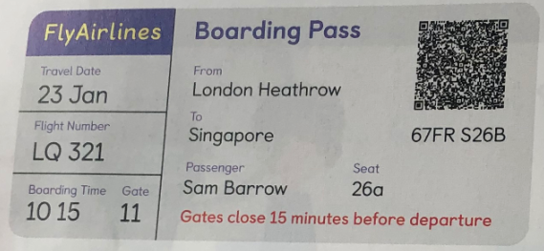
Sam is flying to Singapore at 10:15 in the evening. What time would this be using a 24 hour clock?
13,14,15,16,17,18,19,20,21,22 = 10
22:15

