Slide 1
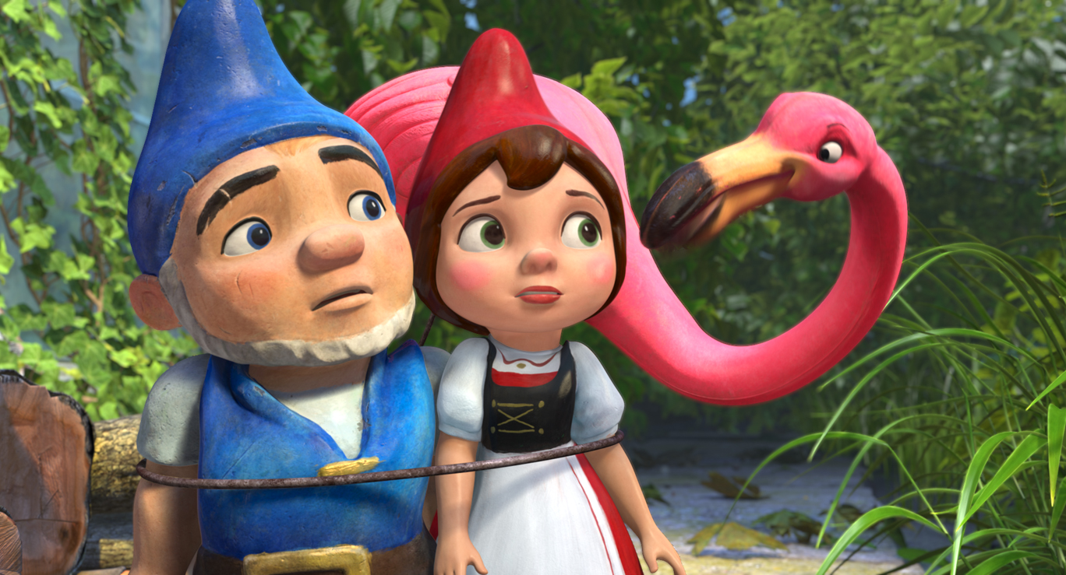
You are going to watch a short clip from Gnomeo and Juliet. When you have finished watching you will ask three questions.
https://www.youtube.com/watch?v=D6HpUndEtP8

Slide 2
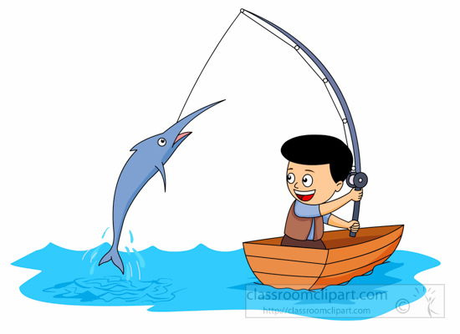
RETRIEVE
Can you find information in the text?
What do certain words mean? (Dictionary)
Look through the text carefully and highlight or underline the words which answer the questions.

Slide 3

INFER
How are the characters feeling?
Why did they do or say that?
What might happen next?
Unlock information from the clues given in the text.

Slide 4
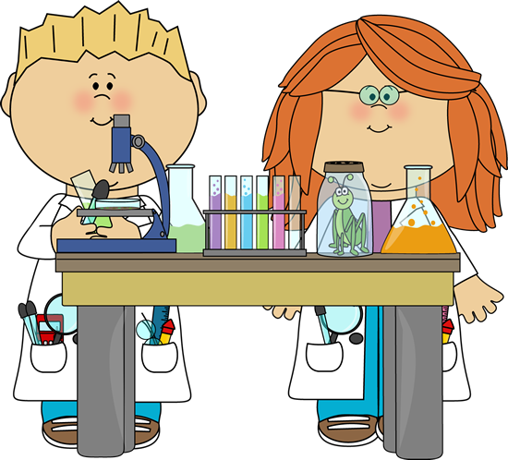
WORD CHOICE
Which words help you understand what is happening?
What techniques has the author used to describe?
How has the author organised or presented the text?
Think carefully about the author’s choice and what they have done to make the text interesting and enjoyable to read.

Slide 5
Retrieve:
Who wears red and what items are that colour in the clip?
Infer:
What is Juliet’s character like? How do you know?
Choice:
Why do you think the director chose from Gnomeo’s middle name to be stealth?

