Slide 1
Tuesday 30th June 2020
Reading and comprehension

Slide 2
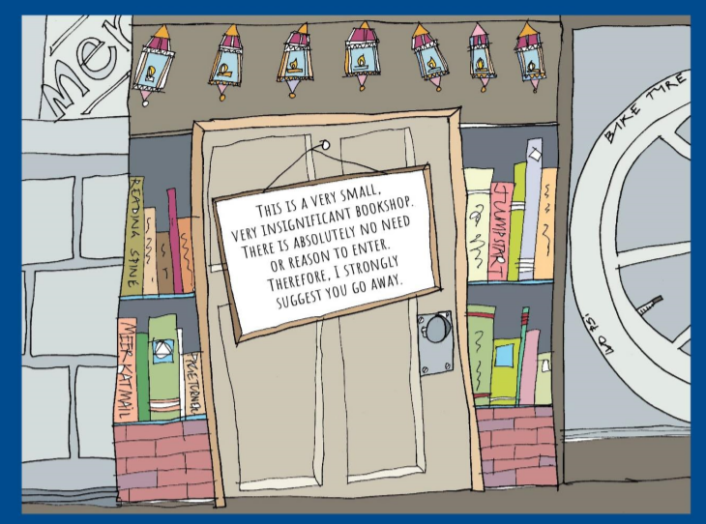
For the next few days we will be
reading….
The impossibly possible bookshop
By Kat Pennington

Slide 3
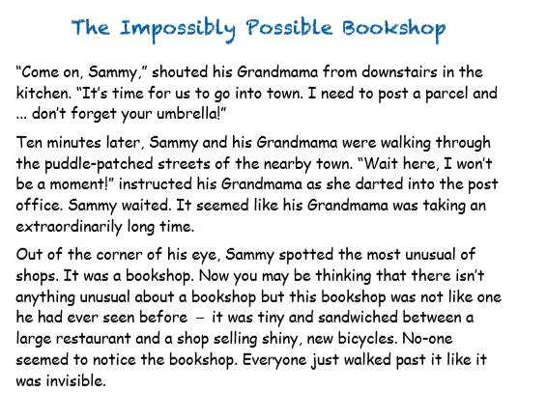

Slide 4
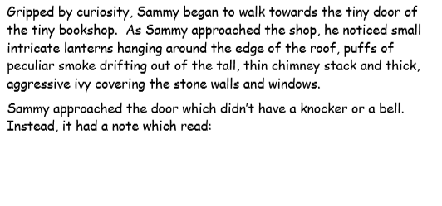

Slide 5
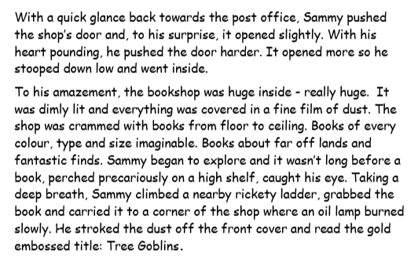

Slide 6
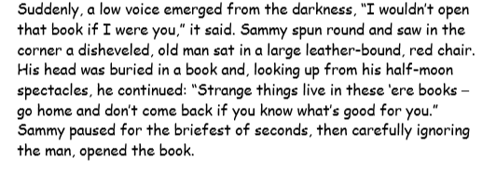
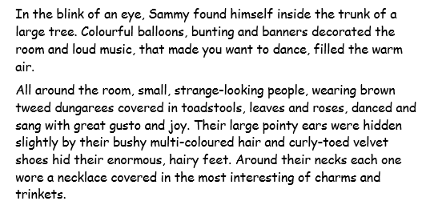

Slide 7
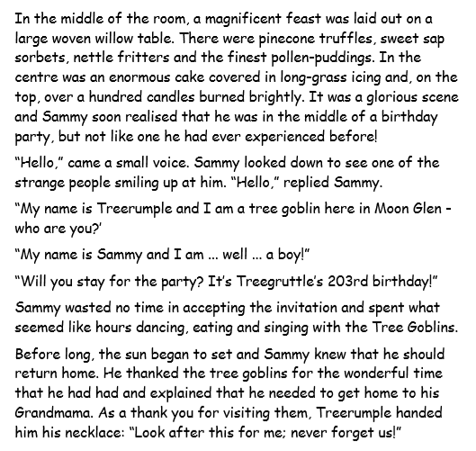

Slide 8
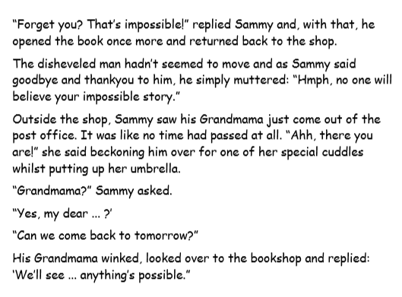

Slide 9
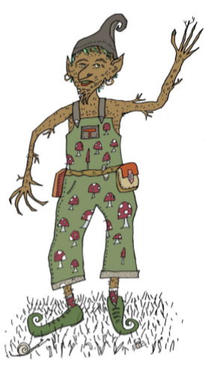
This is Treerumple. He is
going to be helping guide
use through our learning
for the next few days.
He is going to ask us some questions today
about the story for us to answer in
full sentences.

Slide 10
Answer Treerumple’s questions in full sentences
Use the text to help you.

