Slide 1
Tuesday 9th June 2020
Reading

Slide 2

Today, you will be reading an extract from a new text.
This is the first chapter from a book
called
The Dentist of Darkness by David O’Connell
In it, we meet our main character Archie McBudge and he discovers his summer is not going to go as planned.
https://www.worldbookday.com/wp-content/uploads/2019/02/Primary-Extract-Dentist-of-Darkness.pdf
Notes:
What do you think the text will be about? Why do you think the boy might have what looks like fire in his hand? Who do you think the smirking man by the tree might be?

Slide 6
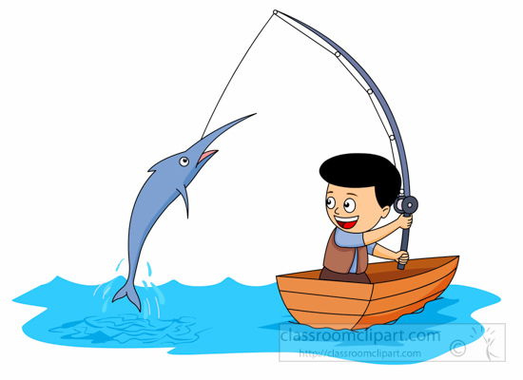
Today we are going to focus on our retrieval skills.
Retrieve and record information
Can you be a Reading Angler, and…
Skim and scan what you have read to find answers to questions?
‘Fish’ for key words?
Select important details from a text and show me where you found it?
This is Reggie. Our reading character for
Retrieval. He helps us to fish out the answer as it is right there in the text.

Slide 7
Tips from Reggie
Once you’ve read the text, you can skim and scan for key words to help you find the answer.
For example: Who was the pizza menu actually addressed to?
I would scan for the words pizza menu and addressed. These then sign post me to the answer.
In the whole of his entire, actual life, Eric Doomsday had never got anything through the post. No letters, no postcards, no parcels, no nothing.
He did get a pizza menu once, although, as it had been addressed to a Mrs Eric Dumsday, he didn’t think it counted.
Answer: The pizza menu was addressed to Mrs Eric Dumsday.

Slide 8
Use your copy of the extract to answer these retrieval questions.
Write the answers in full sentences in your green book.
1. What could be heard in the hills? (page 1)
2. Name the two children in chapter one. (page 1)
3. What day did the children watch the creatures? (page 2)
4. In what season did Fliss meet Blossom? (page 3) Circle one.
Spring Summer Autumn Winter
5. Where was Billy whilst his friends were out in the sun? (page 3)
6. Identify two types of books Billy liked reading about. (page 3 and 4)
7. What item did the odd character give to Archie? (page 5)

