Slide 1
Year 4 Decimals
Money #1
Writing money as decimals
Note: Up until Year 3 children have written money as separate pounds and pence e.g. £2 and 63p.

Slide 2
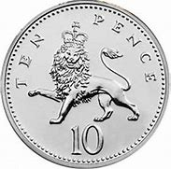
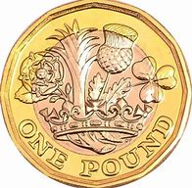
How much money do I have?
Count the pounds
Count the pence
£1 and 50p

Slide 3
How else can we write £1 and 50p.
£1 and 50p
We can write this amount using decimals.
£1 and 50p
=
£1.50
But why?

Slide 4
We know that there are 100p in £1
£1 ÷ 100 = 0.01
1p
=
£0.01
2p
=
£0.02
3p
=
£0.03
4p
=
£0.04
5p
=
£0.05

Slide 5
16p
=
£0.16
This is 16p/100p = 0.16
31p
=
£0.31
This is 31p/100p = 0.31
62p
=
£0.62
This is 62p/100p = 0.62

Slide 6
£1 and 86p
=
£1.86
£2 and 27p
=
£2.27
£4 and 14p
=
£4.14

