Slide 1
Year 4 Geometry
Lesson 36 Geometry Angles Lesson #2
Comparing and ordering angles

Slide 2
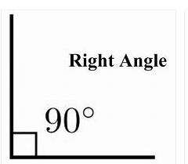
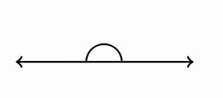
Let’s recap the four angles that we know.
Acute angle
Obtuse angle
Right Angle
90º
Straight line angle
180º
An acute angle is any angle that is smaller than a right angle.
An obtuse angle is bigger than a right angle but smaller than a straight line angle.

Slide 3
Why comparing/ ordering angles we want to put them in order of size.
Which angle is larger?
Angle A
Angle B
Angle A is an obtuse angle.
Angle B is an acute angle.
Angle A is bigger than angle B

Slide 4
Why comparing/ ordering angles we want to put them in order of size.
Which angle is larger?
Angle A
Angle B
Angle A is an obtuse angle.
Angle B is a straight line angle.
Angle A is smaller than angle B

Slide 5
Why comparing/ ordering angles we want to put them in order of size.
Put the angles in order starting with the smallest.
Angle A
Angle B
Angle C
Right angle
Acute angle
Obtuse angle
Angle B
Angle A
Angle C
Smallest

Slide 6
Why comparing/ ordering angles we want to put them in order of size.
Put the angles in order starting with the largest.
Angle A
Angle B
Angle C
Acute angle
Straight line angle
Obtuse angle
Angle B
Angle C
Angle A
Largest

