Slide 1
Tuesday 16th June 2020
Reading

Slide 2
The extract for today’s reading comprehension is taken from ‘The Worst Witch ’by Jill Murphy.
Here is what www.lovereading4kids.co.uk has to say about it.
The trials and tribulations of a disastrous new girl at Miss Cackle’s Academy for Witches, a gloriously witchy boarding school, The Worst Witch has magic galore. Unfortunately for Mildred Hubble, most of it has a habit of going badly wrong. Her broomstick won’t fly straight, her cat is tabby not black and she manages to turn her arch-enemy into a toad.
'Mildred Hubble chews on her plaits, wears her hat back to front and her shoe laces trail on the floor. She is worst witch in her school but it isn't her fault. ' - Jemima Foyster.
Today’s extract is already included in this Powerpoint.
‘I love Mildred Hubble!’ – Miss Lacey

Slide 3
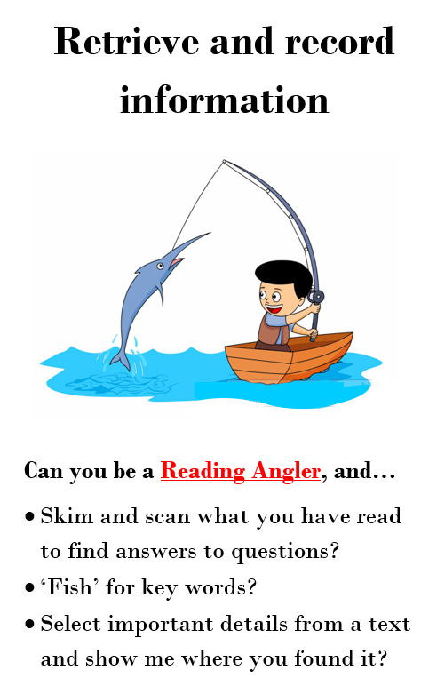
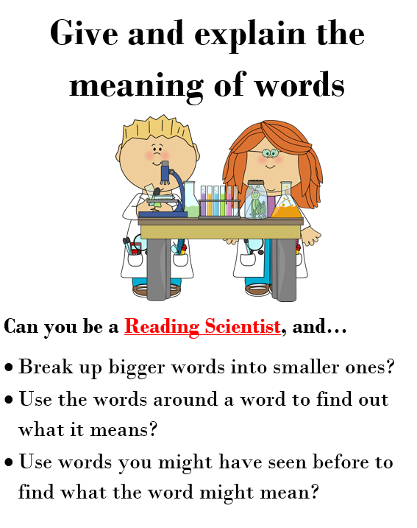
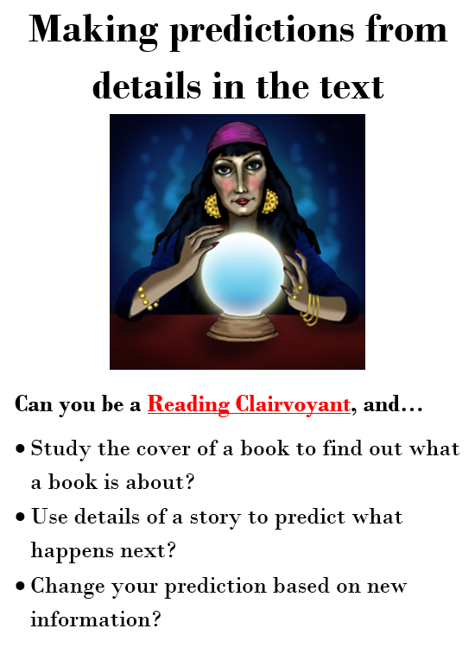
Today we are going to use a range of skills to explore 2 extracts from The Worst Witch. You will need these skills today.

Slide 4
There were so many rules that you couldn’t do anything without being told off and there seemed to be tests and exams every week.
Mildred Hubble was in her first year at the school. She was one of those people who always seem to be in trouble. She didn’t exactly mean to break rules and annoy the teachers, but things just seemed to happen whenever she was around. You could rely on Mildred to leave her hat on back-to-front or her bootlaces trailing along the floor.
Page 1

Slide 5
She couldn’t walk from one end of a corridor to the other without someone yelling at her, and nearly every night she was writing lines or being kept in (not that there was anywhere to go if you were allowed out). Anyway, she had lots of friends, even if they did keep their distance in the potion laboratory, and her best friend Maud stayed loyally by her through everything, however hair-raising.
Page 2

Slide 6
They made a funny pair, for Mildred was tall and thin with long plaits which she often chewed absent-mindedly (another thing she was told off about), while Maud was short and tubby, had round glasses and wore her hair in bunches
Page 3

Slide 7
Jill Murphy gives us lots of information about Mildred in this extract. Go back to the text and find information to fill in this fact file about Mildred.
Question | Answer
What year is Mildred in?
What is Mildred like at school?
What does Mildred look like?

Slide 8
What does hair-raising mean in this sentence?
Anyway, she had lots of friends, even if they did keep their distance in the potion laboratory, and her best friend Maud stayed loyally by her through everything, however hair-raising.

Slide 9
Now read the second extract from The Worst Witch. As you read, focus on the characters of Mildred and Ethel

Slide 10
“I think Miss Cackle gave you that cat on purpose,” Ethel sneered. “You’re both as bad as each other.”
“Oh, be quiet,” said Mildred, trying to keep her temper. “Anyway, it’s not a bad cat. It’ll learn in time.”
"Like you did?” Ethel went on. “Wasn’t it last week that you crashed into the dustbins?”
“Look, Ethel,” Mildred said, “you’d better be quiet, because if you don’t I shall…”
“Well?”
“I shall turn you into a frog and I don’t want to do that.”
Ethel gave a shriek of laughter.
“That’s really funny!” she crowed. “You don’t even know the beginners’ spells, let alone ones like that."
Mildred blushed and looked very miserable.
“Go on then!" cried Ethel. "Go on then, if you’re so clever. Turn me into a frog. I am waiting.”

Slide 11
It just so happened that Mildred did have an idea of that spell (she had been reading about it in the library). By now, everyone had crowded round, waiting to see what would happen, and Ethel was still jeering. It was unbearable.
Mildred muttered the spell under her breath - and Ethel vanished. In her place stood a small pink and grey pig.
Cries and shouts rent the air.
“Oh no!”
“That’s torn it!”
“You’ve done it now, Mildred!”
Mildred was horrified. “Oh, Ethel,” she said, "I’m sorry, but you did ask for it.”
The pig looked furious.
“You beast, Mildred Hubble!” it grunted, "Change me back!”

Slide 12
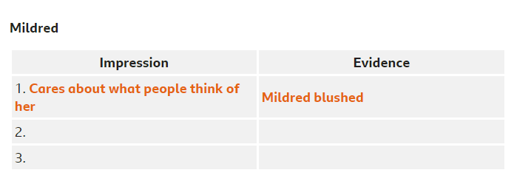
What impression did you get of Mildred and Ethel? What did you learn about the characters in this extract?
Make a point about a character and then find evidence in the text to support your point. Aim to make at least two points of your own.
Organise your answers in tables like below.

Slide 13
Extract 2 ends with a real cliff-hanger. As a reader, we really want to know what will happen next.
Will Mildred be able to reverse the spell?
Will a teacher come and discover what Mildred has done?
Will the 'pig’ run away?
Write down 4 predictions
You might like to use some of these sentence starters to help you.
I think...
I wonder if...
I don’t think..

