Slide 1
^{Wednesday 3rd June 2020}
^{Expanded Noun Phrases}
English –Reading
Notes:
© Copyright Showeet.com – Free PowerPoint Templates. Photo credits: Pixabay (CC0 Public DomainFree for commercial use No attribution required)

Slide 2
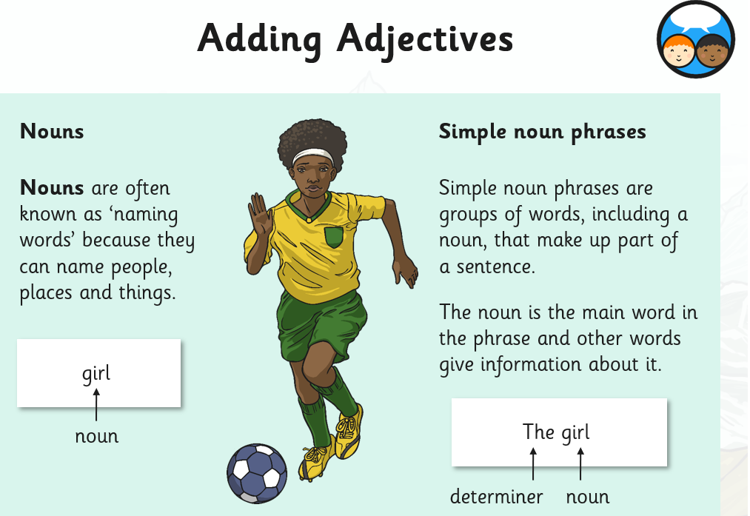

Slide 3
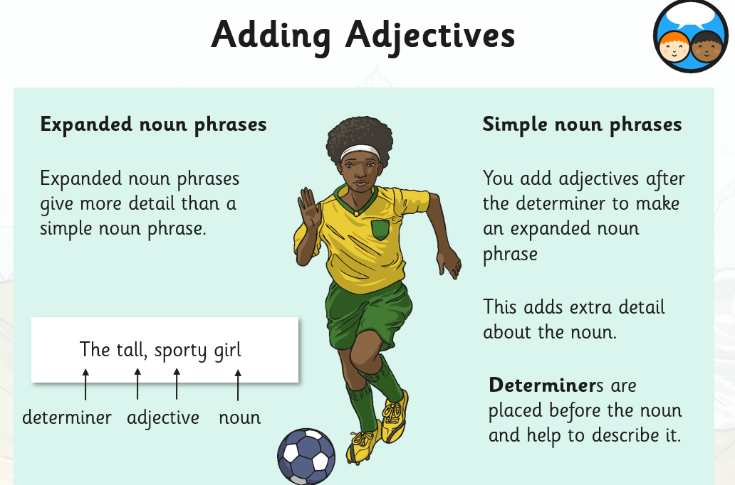

Slide 4
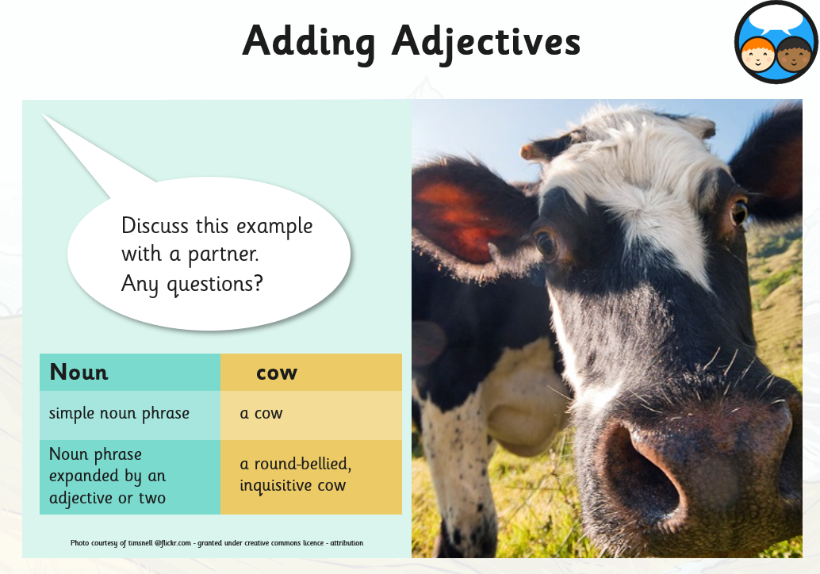

Slide 5
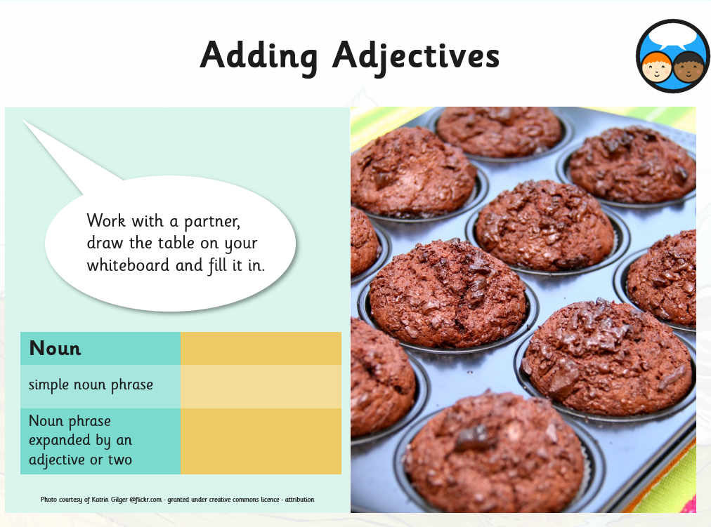

Slide 6
Tasks
Use what you have learned to attempt the challenges on the next slides

Slide 7
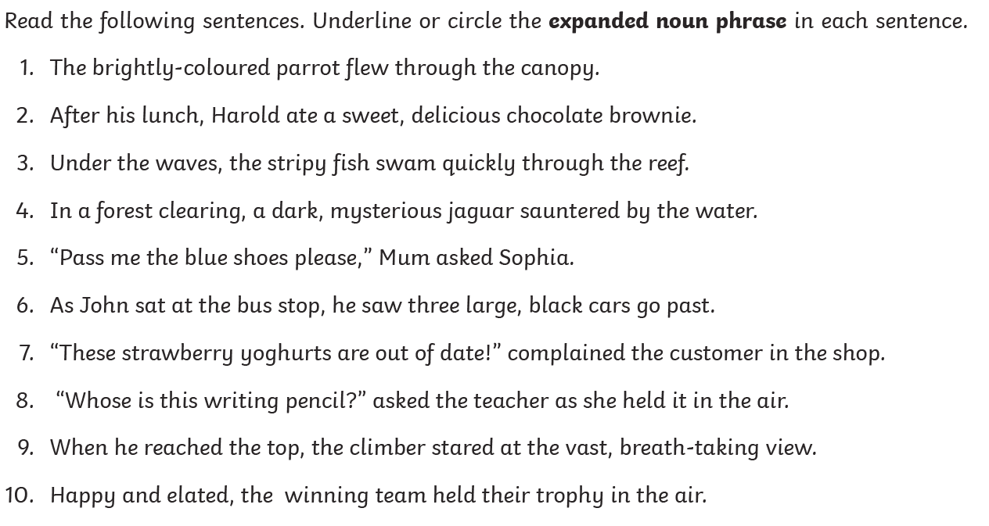

Slide 8
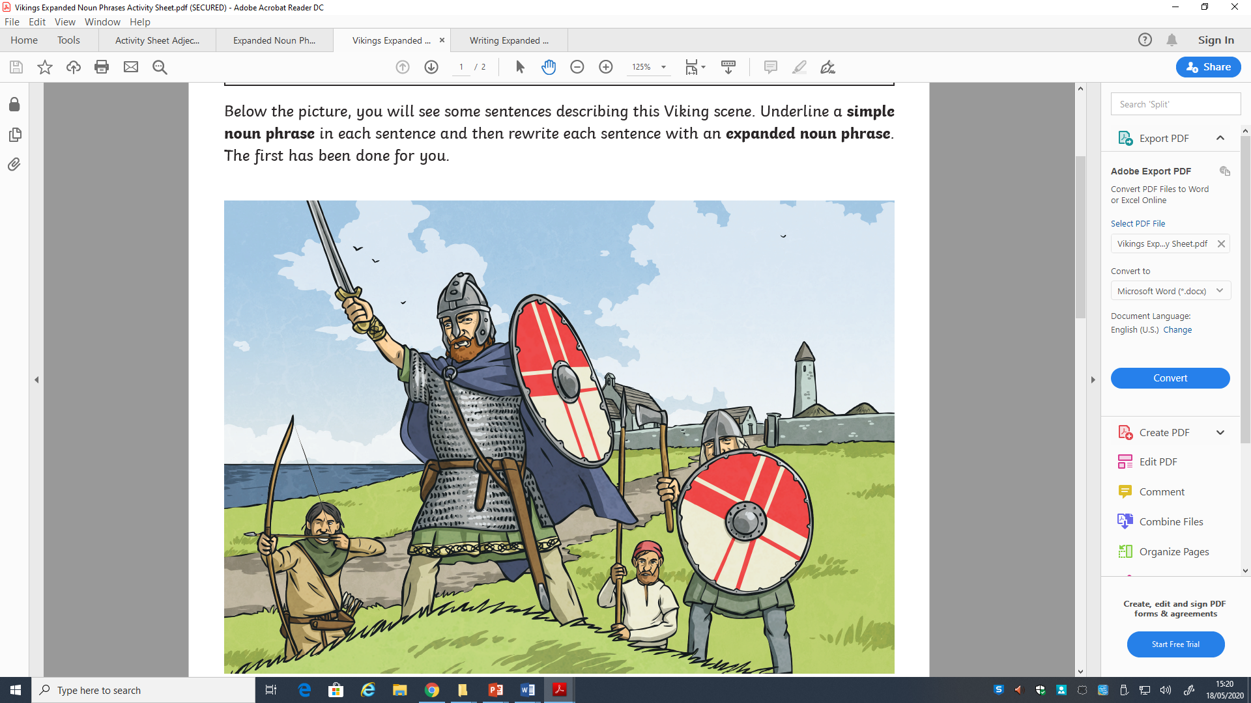

Slide 9
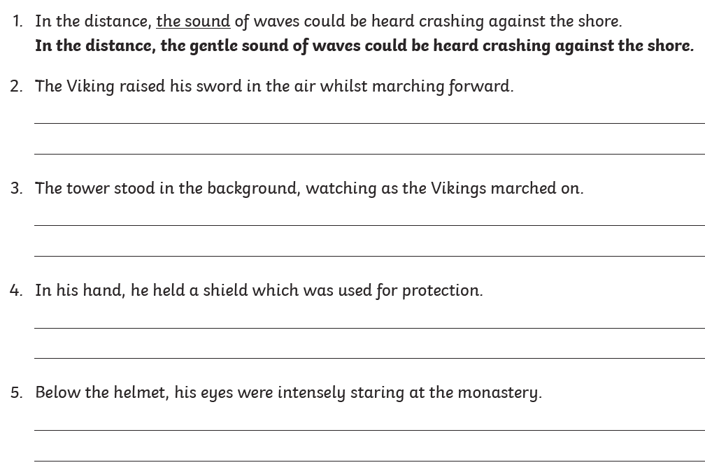

Slide 10
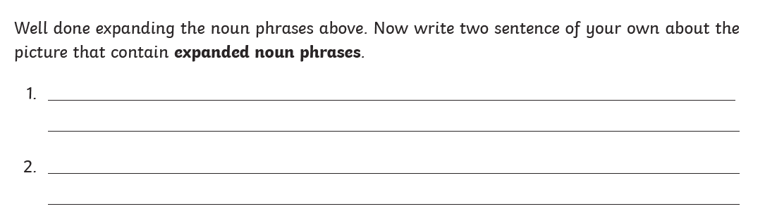

Slide 11
Good job! Now you should be able to use what you’ve learned to include expanded noun phrases in some of your own writing tomorrow.

