Slide 1
Wednesday 1st July 2020
Vocabulary

Slide 2
Today we are going to be thinking about vocabulary.
We are going to be unpicking words and thinking about what they mean.

Slide 3
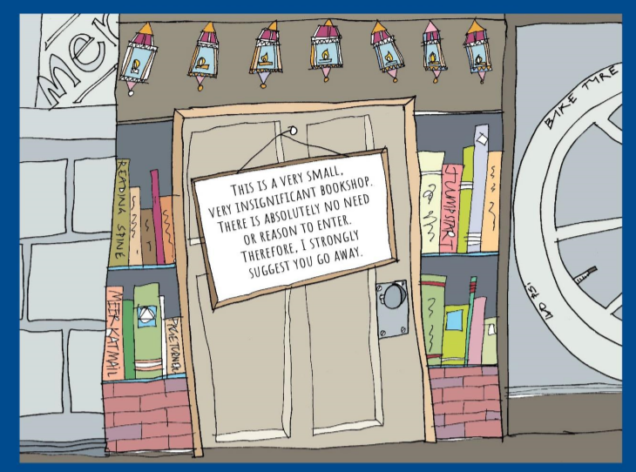
Start by re-reading our story from yesterday.

Slide 4
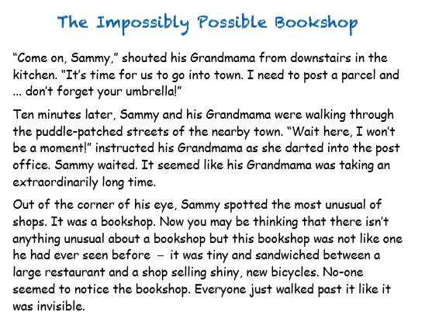

Slide 5
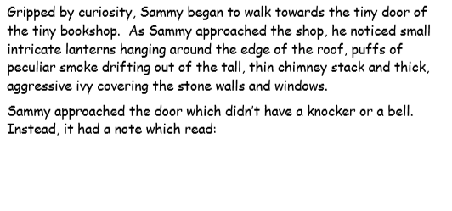

Slide 6
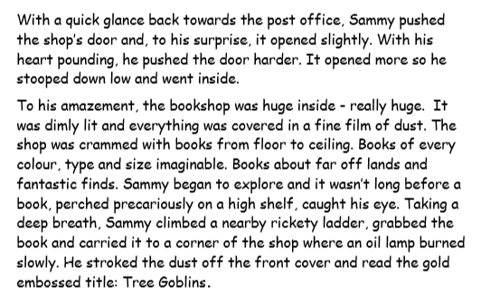

Slide 7
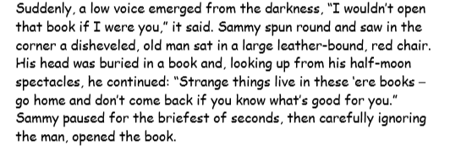
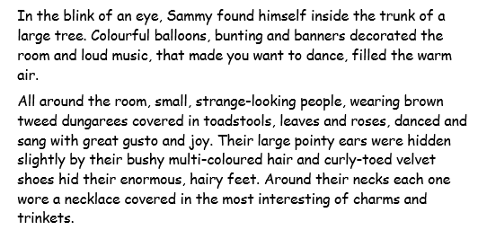

Slide 8
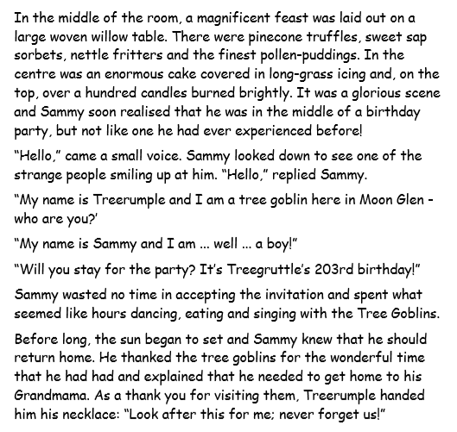

Slide 9
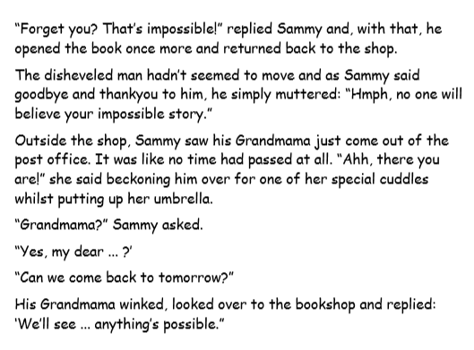

Slide 10
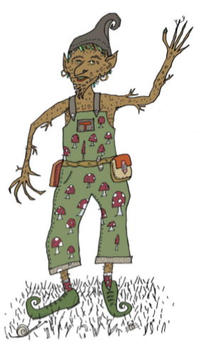
Treerumple is back with
some new challenges today.

Slide 11
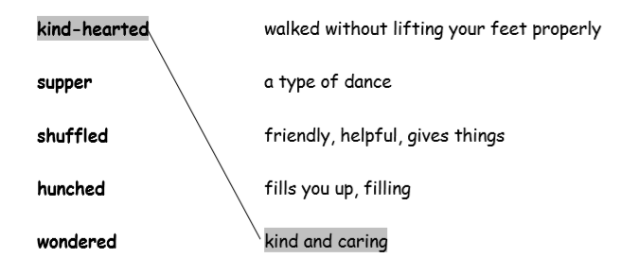
In Treerumple’f first exercise, we are going to think about what
words mean.
To do this, we need to find the
word in the text by skimming and scanning
with our eyes.
Then we need to read the sentence to help
us work out the meaning.
Finally, we will make a matching pair on our
work sheet, like this:

Slide 12
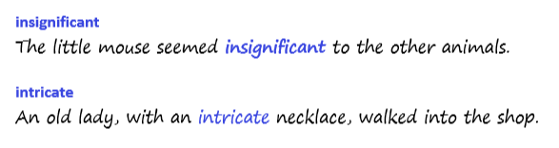
In Treerumple’s second job, we are
going to be using the new words that
We have explored in our own sentences.
Like this:

