Slide 1
Tuesday 28th April 2020
Reading

Slide 2
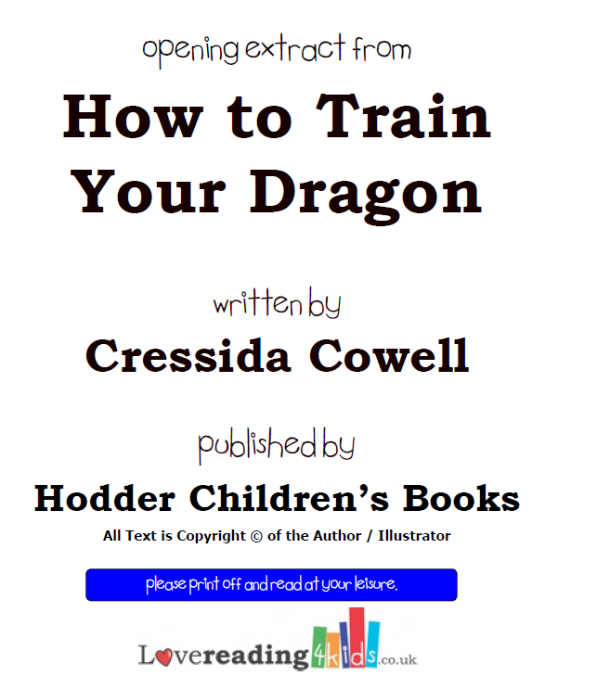
The extract for today’s reading comprehension is taken from
www.lovereading4kids.co.uk
This really is a fantastic website for
ideas for new books to read. Most books
allow you to download a small extract to see if you like it. You do
have to sign up but it is completely free.
This is what I did for today’s session.
Top tip for
eager readers from Miss Lacey!
Today’s extract is already included in this Powerpoint.

Slide 3
To start with, let’s read the extract.
This is the first chapter from How to train your dragon by Cressida Cowell.
This is the book you would have been studying this half term in school ☺
If you like our extract/lessons, you could always order yourself a could always order yourself a copy.

Slide 4
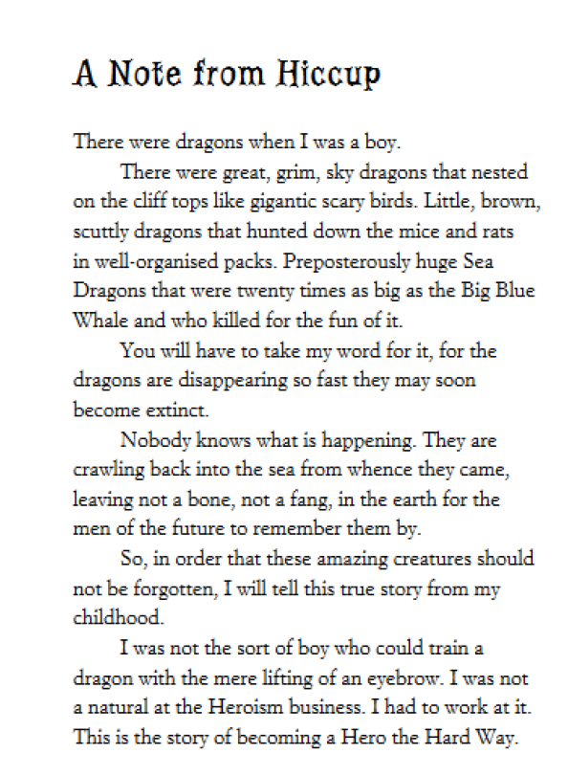
Page 1

Slide 5
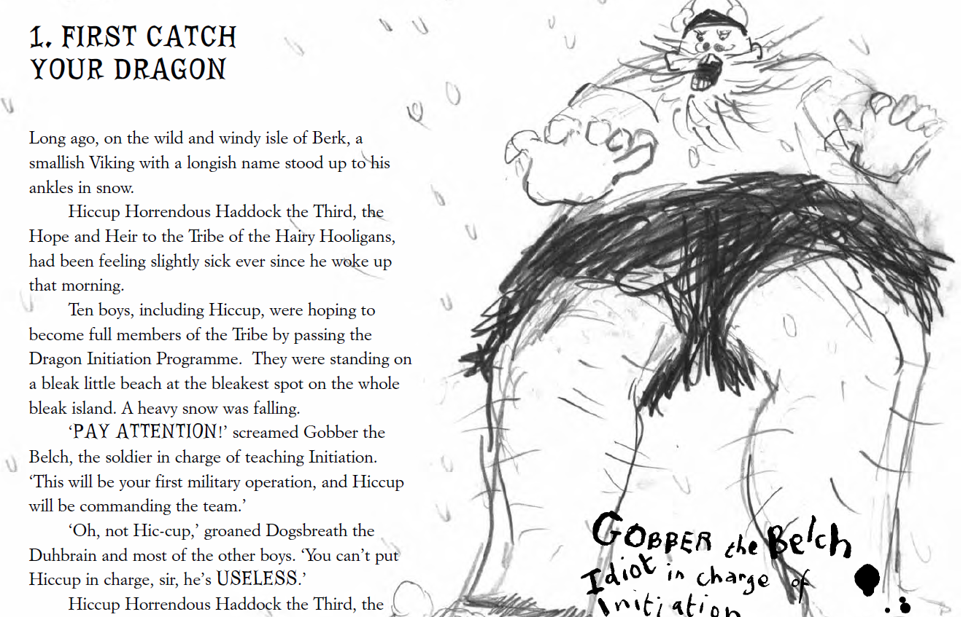
Page 2

Slide 6
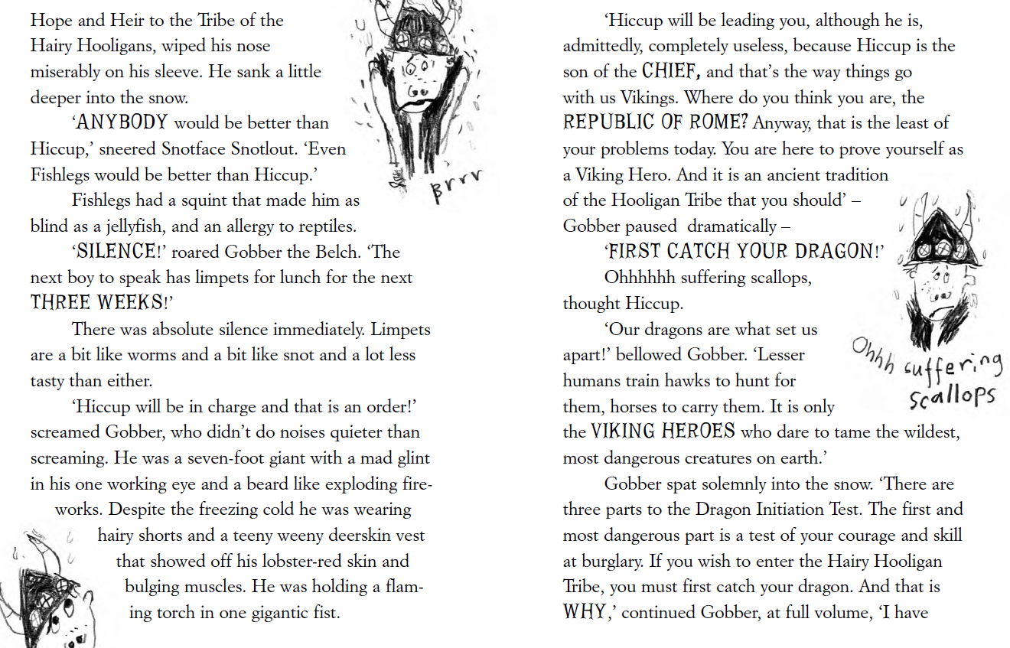
Pages 3 and 4

Slide 7
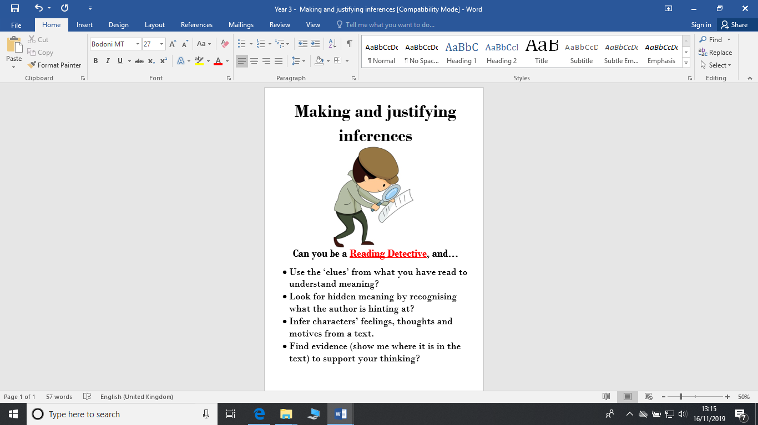
Today we are going to focus on our inference skills.
This is Derek. Our reading character for
Inference. He is a detective, he helps us to search deeper for clues. The answer is there, you just have to think a little deeper.

Slide 8
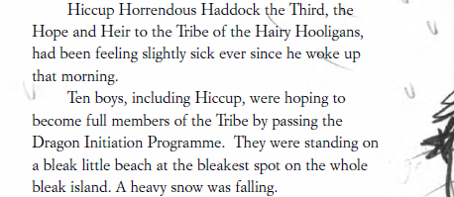

Tips from Derek
Once you’ve read the text, you can skim and scan for key words to help you find the right area for you answer like we did last week..
For example: Why was Hiccup feeling sick?
I would scan for the words Hiccup and sick.. These then sign post me to the section I need to focus on.
Answer: Hiccup felt sick because he was about to take part in
The Dragon Initiation Programme and he felt scared.
Now I need to think a little deeper..
What reasons do people usually
feel sick.
Illness? Nervousness?
Does anything in the text link to this?

Slide 9
Use your copy of the extract to answer these inference questions.
Write the answers in full sentences in your green book.
The other boys do not like Hiccup. Find 2 pieces of evidence that support this view. (Pages 2 and 3)
How can you tell that Gobbler is a fearsome, intimidating Viking? (Page 3)
3) Hiccup is scared of catching his dragon. How can you tell? (Page 4)
4) Why is catching a dragon so important to the Hooligan tribe?
(Page 4)

