Slide 1
Thursday 16th July2020

Slide 2
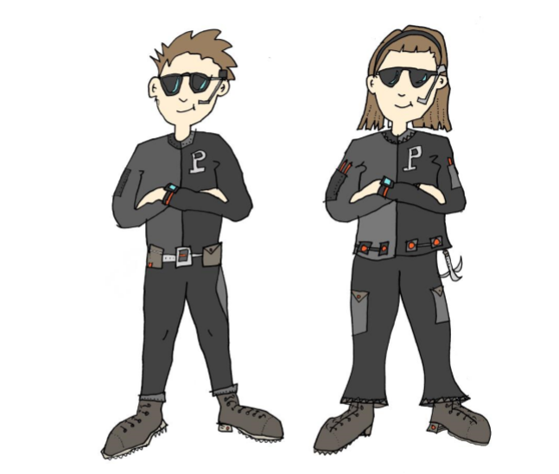
Today, we are going to use our plans to write our own adventure stories.

Slide 4
Take a minute to read through your story sequence from yesterday.

Slide 5
It is time to write your adventure.
Remember to look back at the original story if you need
extra guidance.
Take your time and really think carefully
about your word choices.
Try to use a range of sentence types
(exclamation, command, question).
Use our guidance from yesterday to punctuate direct speech properly.
When you’ve finished a section, go back....read it
and check that you are totally happy with
it before moving on. If you’re not, change the
elements you don’t like, improve your word choices.
This type of editing and proof reading is an important
writing skill.

Slide 6
Year 4, Thank you for sending me your
work over the least few weeks.
It has been a joy to read.
This is the last lesson I will be sending you.
I’d love to read your stories.
Thank you for joining in and using these
Resources. I hope you have enjoyed them.
Have a good holiday and please keep safe.
Miss Lacey x
(My email address is on lots of letters but it is definitely on the letter you have received about collecting books).

