Slide 1
Wednesday 24th June 2020
Reading

Slide 2
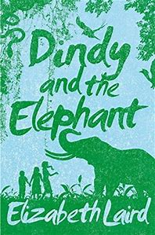
The extract for today’s reading comprehension is taken from ‘Dindy and the Elephant’ by Elizabeth Laird.
Here is what www.lovereading4kids.co.uk has to say about it.
Dindy’s way of life is about to change for ever. She’s grown up on a tea plantation in Kerala but independence is coming, and the British, including Dindy’s family, are getting ready to leave India. Frightened at the prospect, Dindy takes her little brother out for an adventure, one that will put them both in real danger, and reveal all sorts of truths and secrets about the lives they have been living. Elizabeth Laird describes colonial life very well indeed, and Dindy is a real and sympathetic character. A beautifully written and ultimately uplifting story about a fascinating period of history. ~ Andrea Reece
Today’s extract is already included in this Powerpoint.
I’ve not read this book but now I think I might NEED to! Miss Lacey

Slide 3
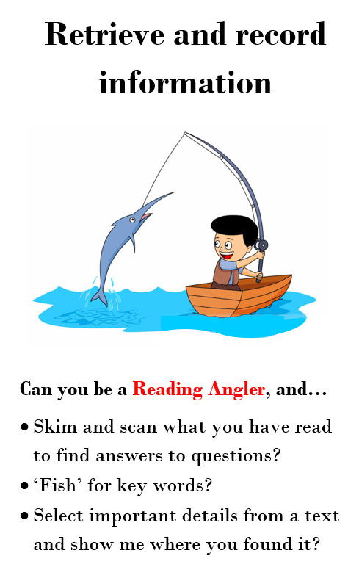
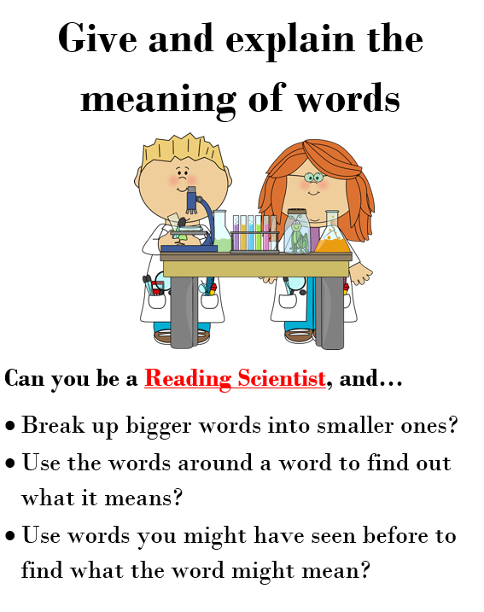
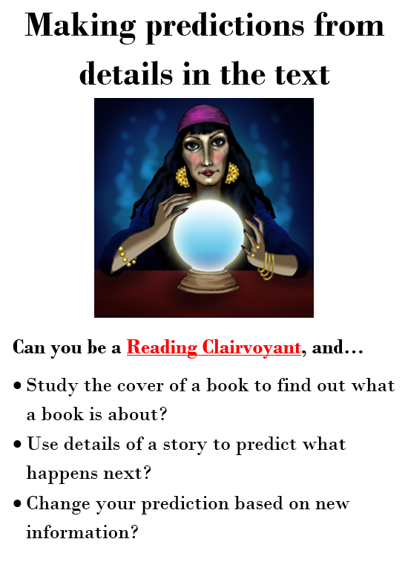
Today we are going to use a range of skills to explore 2 extracts from Dindy and the elephant. You will need these skills today.

Slide 4
Something was moving on the ground behind him, across the very bit of the path we had just come down. Something long and thin and grey, that slithered from one side of the path to the other.
I grabbed Pog’s hand.
‘Come on! Run!’
He tried to snatch his hand away.
‘I won’t. I’m going home.’
He turned as if to go back up the path. ‘Pog, you can’t! There’s a snake. A cobra! I saw it!’
Page 1

Slide 5
And then we were both running, crashing through the bushes, tearing our clothes, scratching our bare legs, until we almost fell out on to the wide track below that ran down to the stream.
Pog was crying. ‘I told you we shouldn’t have come. I told you! I hate you, Dindy! We might have been bitten to death!’
‘Yes, but we weren’t, were we?’ I was feeling so guilty that I needed to sound extra brave to cover it up. ‘And it mightn’t have been a cobra. It might have been one of the harmless ones.’

Slide 6
How do you think Pog is feeling in this extract? How do you know. Find evidence.
Why are the children running away?
Do you think they will go home
now? Why? Why not?

Slide 7
The four working elephants were standing in the shade. They were chained by the back legs to huge posts. They stood quite still, their trunks limp and drooping, as if they were resting. Only their ears flapped from time to time as they tried to shake off the flies that buzzed around their eyes.
Pog and I had seen the estate’s tame working elephants quite often before. They weren’t usually at this end of the tea plantation, but sometimes, when they were, Daddy would drive us down in his car as a treat to look at them.

Slide 8
We’d even ridden on an old one once. I’d been a bit scared of falling off, but Pog had loved it. He’d shouted so loudly that the mahout (the man who looked after the elephants) had to tell Daddy to keep him quiet in case the elephant got upset.
'Why don’t we shout and see if anyone will come?’ I said.
‘You don’t want to scare the elephants,’ said Nikhil. ‘And, anyway, we don’t shout. It’s rude.’
I bit my lip. Daddy was always shouting at people. Mother shouted at Sunderam all the time too.

Slide 9
The writer tells you lots of information about the elephants.
When you heard that this book was called Dindy and the Elephant, what were you expecting?
How did you feel when you read this section about the elephants? Did it match your expectation?
Write a short paragraph about how you feel about this description of the elephants.
You might want to use some of these sentence starters to help you.
I felt ...................... when I read the description because ...................... .
It made me feel ...................... because ...................... .
This part of the text ...................... made me feel ...................... .
I liked the part when ...................... because ...................... .
I did not like the part when...................... because ...................... .
I was surprised because I thought ...................... .

