Slide 1
Thursday 14th May 2020
English – Poetry skills
Notes:
© Copyright Showeet.com – Free PowerPoint Templates. Photo credits: Pixabay (CC0 Public DomainFree for commercial use No attribution required)

Slide 2
Yesterday, we started to explore a different form of poetry called Haiku.
Let’s remind ourselves of the rules for Haiku.
Notes:
© Copyright Showeet.com – Free PowerPoint Templates

Slide 3
What is a haiku?

Slide 4
Haiku is a form of poetry which originated in Japan
A haiku represents a single idea or feeling
Most haiku are about nature or natural things
What subjects could a haiku be written about?

Slide 5
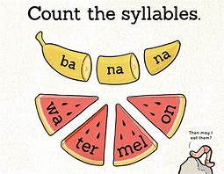
Haiku have very strict rules to follow!
They must have 3 lines.
Each line must have a given amount of syllables.
Line one = 5 syllables
Line two = 7 syllables
Line three = 5 syllables
Remember: A syllable is a single unit of
Speech.
Not sure? Put your hand under your chin.
Say a word. How many times did your chin
Go down?

Slide 6
The red dots show the syllables.
Butterflies in flight (5)
Brilliant rainbow colours (7)
ripple past the pond (5)
Butterflies in flight
Brilliant rainbow colours
ripple past the pond

Slide 7

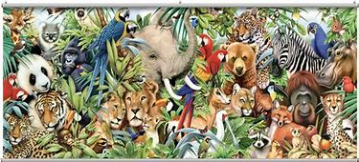
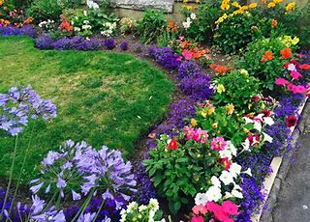
Today, we are going to write our own Haiku. We are going to do this step by step together.
Start by choosing your theme or idea.
Remember, most Haiku are about something natural.
What are you going to write about?

Slide 8
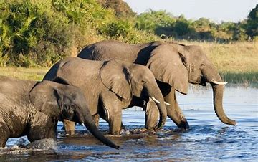
I’m going to write about an elephant.

Slide 9
Tips for writing lines in haiku poems!
Start by writing a good sentence or two – don’t worry about syllables yet
An elephant has a long trunk like a snake, which it uses to drink water from a river.
Write yours now.

Slide 10
An elephant has a long trunk like a snake, which it uses to drink water from a river.
Split your idea into three parts (for three lines)
An elephant has a long trunk
like a snake
which it uses to drink water from a river.
Split yours now.

Slide 11
An elephant has a long trunk
like a snake
which it uses to drink water from a river.
Delete, change or add words to get the right number of syllables for each line
Elephant’s long trunk
a weaving snake reaching down
To drink some water.
Edit your sentences to make a Haiku now.

Slide 12
Now, repeat the process to write another Haiku.
Go back through the steps if you need to.

