Slide 1
Tuesday 2nd June 2020
English –Reading
Notes:
© Copyright Showeet.com – Free PowerPoint Templates. Photo credits: Pixabay (CC0 Public DomainFree for commercial use No attribution required)

Slide 2
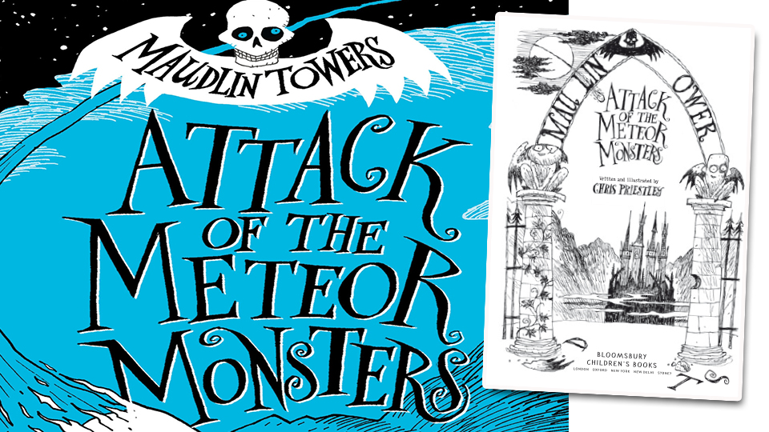
Discover the weird and wonderful world of Maudlin Towers – a school that blackened, gloom-laden and gargoyle-infested!

Slide 3
Read chapter 1 of ‘Attack of the Meteor Monsters’.
Notes:
© Copyright Showeet.com – Free PowerPoint Templates

Slide 4
Now, use chapter 1 to answer the following questions.
1. How did the rest of the boys travel down Pig’s Pike?
2. What impression do you get of the thing that crashed into Pig’s Pike? Why do you think this?
3. What do Mildew and Sponge think about all the activities that Mr Gruntforth makes them do? Explain your point or use evidence from the text.
4. ‘The faint rays of the rising sun leaking out from under the blanket of cloud.’ What does this tell you about the sunshine?
5. Summarise the key events of chapter 1 in under 50 words.
Notes:
© Copyright Showeet.com – Free PowerPoint Templates

