Slide 1
Year 4 Geometry
Lesson 35 Geometry Angles Lesson #1
Identifying angles

Slide 2
We are going to be investigating and learning about angles.
But what are angles?
An angle can be described as the measure of a turn from one point.
It is the space between two lines.
This is an angle it Is the amount of space between these two lines.

Slide 3
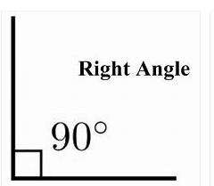
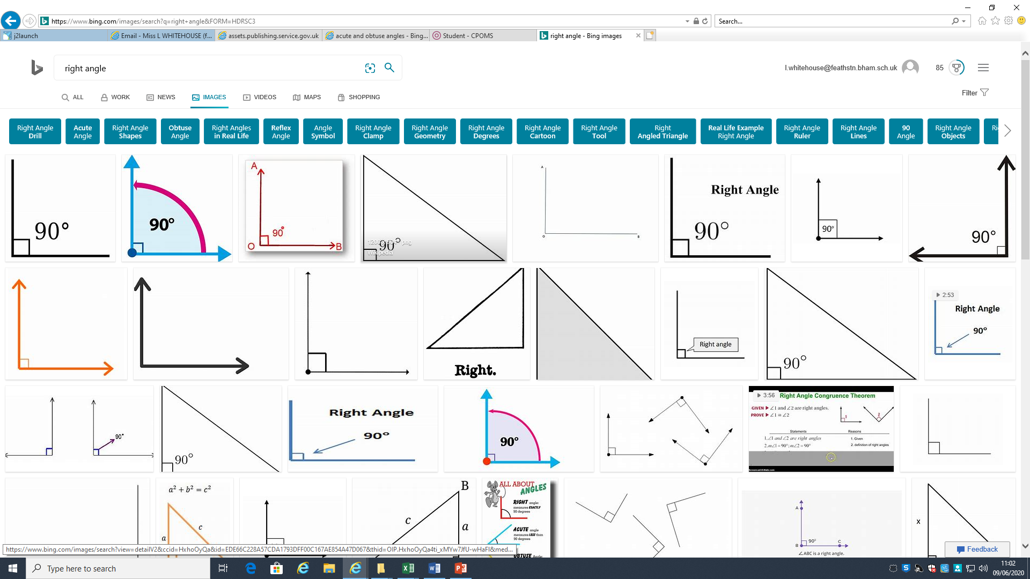
There are different types of angles depending on their size.
We are going to look at 4 types of angles.
These are the two we need to learn about first.
These are all right angles regardless of which way round it is
This is a right angle. It measures 90º exactly.

Slide 4
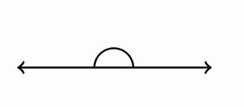
There are different types of angles depending on their size.
We are going to look at 4 types of angles.
These are the two we need to learn about first.
These are all right angles regardless of which way round it is
This is a straight line angle. It measures 180º. It is the same size as 2 right angles.

Slide 5
Now we know about these 2 angles we can learn about our last two as these help us.
Acute angle
Obtuse angle
Right Angle
90º
Straight line angle
180º
An acute angle is any angle that is smaller than a right angle.
An obtuse angle is bigger than a right angle but smaller than a straight line angle.

