Slide 1
Tuesday 7th July 2020
Planning narratives

Slide 2
Today we are going to carry on adapting the story to make our own.
We are going to be planning our own narrative.

Slide 3
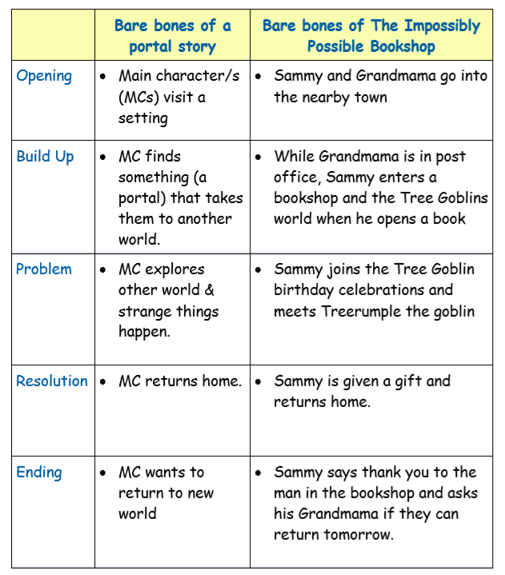
Before we plan our own story, let’s unpick the structure of the original story to help us. ‘The Impossibly Possible Book Shop’ is a portal story.
Can you unpick The impossibly possible book shop by saying how each of the structure steps is represented in the story?
I’ve left the opening uncovered to get you started.

Slide 4
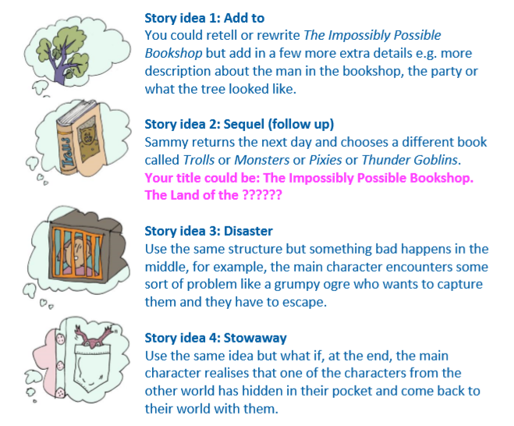
Now that we understand the structure of a portal story. We can begin to plan our own. You could use the characters and settings that you have created over the past few days
or you can make new ones if you have different ideas now.
Or… Use the structure steps for a portal story and create an entirely new narrative that is not linked to ‘The Impossibly Possible
Bookshop’.

Slide 5
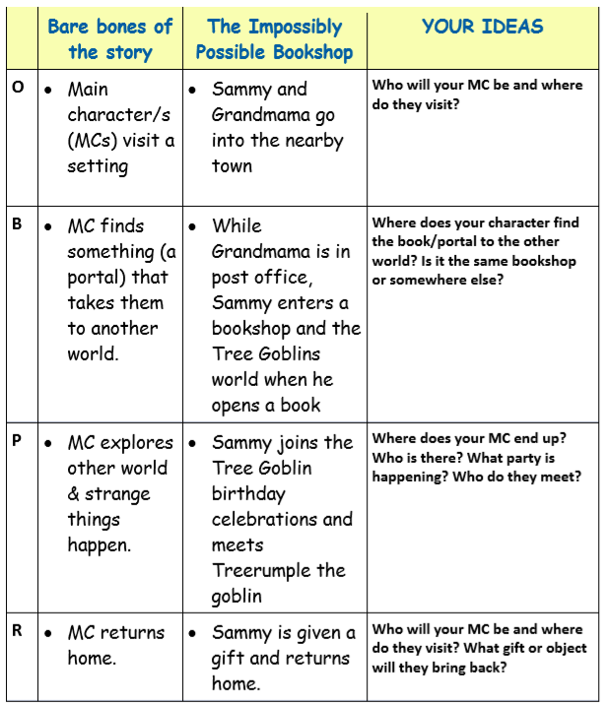
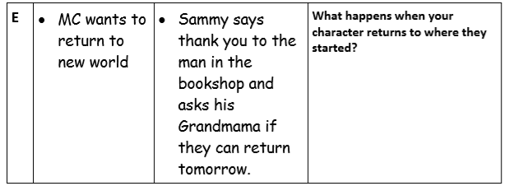
Use the ‘Your Ideas’ section to plan your own
Portal story ready for tomorrow.
I’ve left both sets of ‘Bare Bones’ notes to help you.

