Slide 1
Year 4 Decimals
Money #2 Comparing money
Look back at the comparing decimals lesson if you are struggling.

Slide 2


Which is the most expensive?
£3.58
£3.32
Use a place value grid to compare
T | O | . | t | h
 | 3 | . | 3 | 2
 | 3 | . | 5 | 8
5 tenths are bigger than 3 tenths so…
The burger costs more than the pizza.

Slide 3


Which is the most expensive?
£0.72
£0.76
Use a place value grid to compare
T | O | . | t | h
 | 0 | . | 7 | 6
 | 0 | . | 7 | 2
6 hundredths are larger than 2 hundredths so
The lollipop costs more than the chocolate.

Slide 4





Circle all the fruit that are less than 80p
£0.81
£0.73
£0.64
We are looking for the fruits that are less than £0.80
£0.79
£0.89

Slide 5




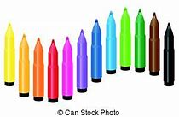
Circle all the objects that are more than two pound
£1.89
£2 and 16p
£1.50
We are looking for all the items that are more than £2.00
£3.68
£2.90

Slide 6
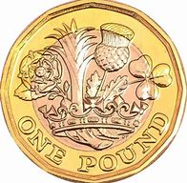
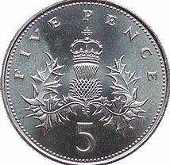
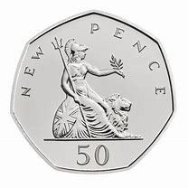
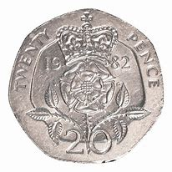
Which is more?
£2.86
OR
Count the coins
£2.65

Slide 7
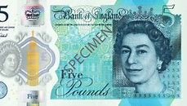
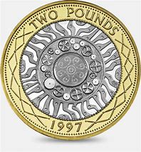
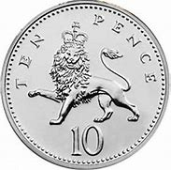
Which is more?
£8.15
OR
Count the coins
£8.30

