Slide 1
Wednesday 15th July2020

Slide 2
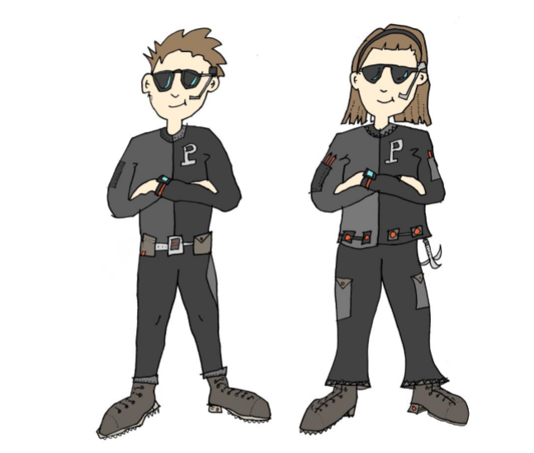
Today, we are going to think about how characters speak to each other in stories.
In stories, characters often
speak to each other so we
need to make sure that we
punctuate the way they speak so we know who says what and how they say it.

Slide 3
There are some golden rules for speech:
Put the inverted commas (“..”) around what is actually
said.
2) Begin a new line for each new speaker.
Always begin a new piece of speech with a capital
letter.
Always put some punctuation at the end of the speech.
It could be . , ! Or ? Depending on what you have
written.

Slide 4
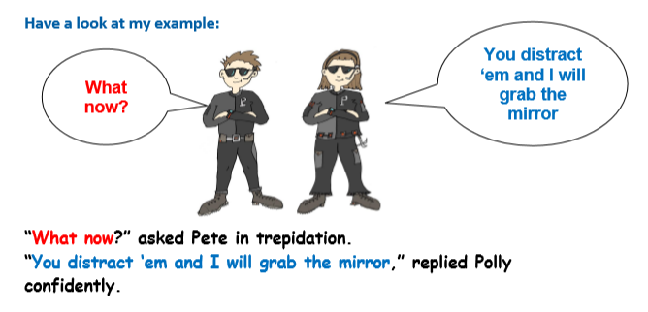

Slide 5
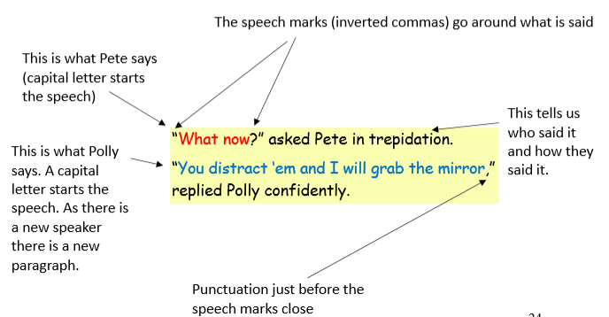

Slide 6
Using the golden rules, can you write out what the characters are saying using the correct punctuation?

Slide 7
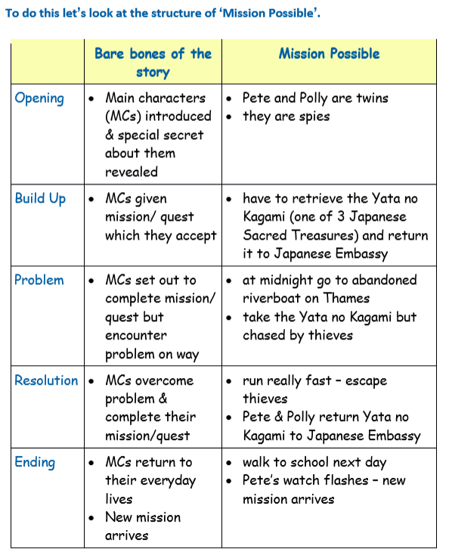
Now, let’s plan our own adventure story.

Slide 8
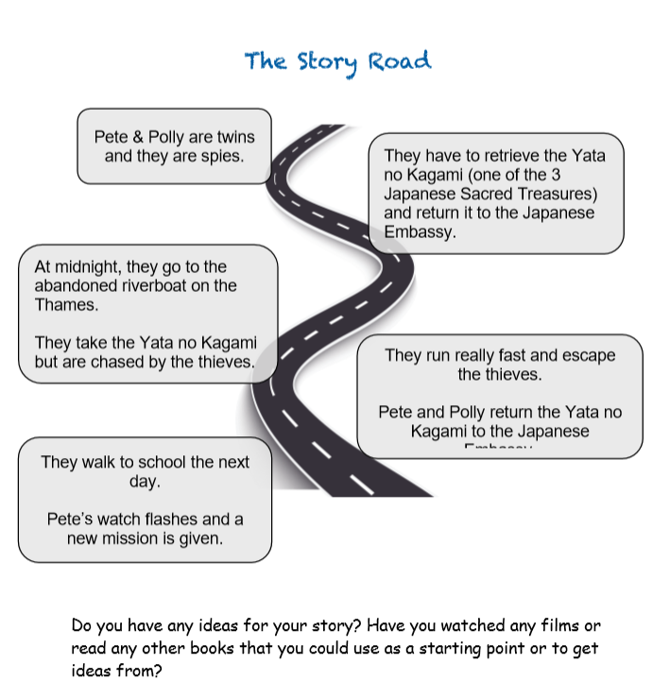

Slide 9
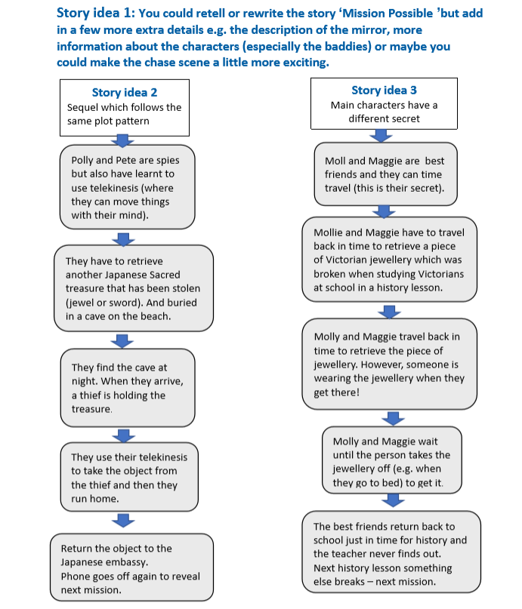

Slide 10
Use the story road to plan ideas for your own adventure story.

