Slide 1
Wednesday 29th April
Grammar

Slide 2
Determiners
Today, we are going to recap what we learnt last week in our grammar lesson and delve a little deeper into determiners.

Slide 3
Determiners
Determiners are one of the eight main word classes.
You will always find a determiner before a noun (unless an adjective sneaks in first!)
For example:
Children is a noun – it is the name of a group of young people.
The children went outside.
The children went outside.
The children went outside.
The is a determiner – it introduces the noun.

Slide 4
Determiners
There are five main types of determiner. All introduce nouns but each has a slightly different role:
Type of Determiner | Role
Articles | Show whether the noun being referred to is general or specific.
Demonstratives | Tell you which noun
Interrogatives | Ask which noun
Possessives | Show who the noun belongs to.
Quantifiers | Specify how many
Type of Determiner | Role
Articles | Show whether the noun being referred to is general or specific.
Demonstratives | Tell you which noun
Interrogatives | Ask which noun
Possessives | Show who the noun belongs to.
Quantifiers | Specify how many
Type of Determiner | Role
Articles | Show whether the noun being referred to is general or specific.
Demonstratives | Tell you which noun
Interrogatives | Ask which noun
Possessives | Show who the noun belongs to.
Quantifiers | Specify how many
Type of Determiner | Role
Articles | Show whether the noun being referred to is general or specific.
Demonstratives | Tell you which noun
Interrogatives | Ask which noun
Possessives | Show who the noun belongs to.
Quantifiers | Specify how many
Type of Determiner | Role
Articles | Show whether the noun being referred to is general or specific.
Demonstratives | Tell you which noun.
Interrogatives | Ask which noun
Possessives | Show who the noun belongs to.
Quantifiers | Specify how many
Type of Determiner | Role
Articles | Show whether the noun being referred to is general or specific.
Demonstratives | Tell you which noun.
Interrogatives | Ask which noun
Possessives | Show who the noun belongs to.
Quantifiers | Specify how many
Type of Determiner | Role
Articles | Show whether the noun being referred to is general or specific.
Demonstratives | Tell you which noun.
Interrogatives | Ask which noun.
Possessives | Show who the noun belongs to.
Quantifiers | Specify how many
Type of Determiner | Role
Articles | Show whether the noun being referred to is general or specific.
Demonstratives | Tell you which noun.
Interrogatives | Ask which noun.
Possessives | Show who the noun belongs to.
Quantifiers | Specify how many
Type of Determiner | Role
Articles | Show whether the noun being referred to is general or specific.
Demonstratives | Tell you which noun.
Interrogatives | Ask which noun.
Possessives | Show who the noun belongs to.
Quantifiers | Specify how many
Type of Determiner | Role
Articles | Show whether the noun being referred to is general or specific.
Demonstratives | Tell you which noun.
Interrogatives | Ask which noun.
Possessives | Show who the noun belongs to.
Quantifiers | Specify how many
Type of Determiner | Role
Articles | Show whether the noun being referred to is general or specific.
Demonstratives | Tell you which noun.
Interrogatives | Ask which noun.
Possessives | Show who the noun belongs to.
Quantifiers | Specify how many.
It may seem tricky but don’t panic! The most important thing is that you can recognise determiners.

Slide 5
Articles

Slide 6
Articles
Articles are the most common determiner and the easiest to recognise.
There are only three articles: a, an and the.
Article | Type | Used...
a / an | Indefinite article | When the person or thing being introduced is general or has not been mentioned before (unknown).
the | Definite article | When you are talking about something specific which has already been mentioned

Slide 7
Demonstratives

Slide 8


Demonstratives
Demonstratives tell you which noun is being referred to.
They are the words you might say when pointing to something you’d like.
For example:
Cupcake is a noun
Can I have that cupcake?
Can I have that cupcake?
Can I have that cupcake?
That is a demonstrative – it specifies which one.

Slide 9
Demonstratives
Can you identify the demonstratives in these sentences?
Would you prefer this pair of Nikes or those new Adidas trainers?
Would you prefer this pair of Nikes or those new Adidas trainers?
“Could Jack and I please have these raspberry doughnuts for pudding?” asked Lyra politely.
“Could Jack and I please have these raspberry doughnuts for pudding?” asked Lyra politely.
REMEMBER: An adjective may sometimes sneak in between the noun and the determiner.

Slide 10
Interrogatives

Slide 11
Interrogatives
To interrogate someone means you ask them lots of questions...
Interrogative determiners ask which noun is being referred to.
For example:
Sandwich is a common noun
Which sandwich would you like?
Which sandwich would you like?
Which sandwich would you like?
Which is an interrogative determiner – it helps specify which one, out of a range of sandwiches, is being referred to.

Slide 12
Interrogatives
There are three main interrogative determiners:
Interrogative Determiner | Example
Which | Which sandwich would you like?
What | What is for dinner?
Whose | Whose PE kit is this?
Interrogative Determiner | Example
Which | Which sandwich would you like?
What | What is for dinner?
Whose | Whose PE kit is this?
Interrogative Determiner | Example
Which | Which sandwich would you like?
What | What is for dinner?
Whose | Whose PE kit is this?
Interrogative Determiner | Example
Which | Which sandwich would you like?
What | What is for dinner?
Whose | Whose P.E. kit is this?
***BE CAREFUL***
Don’t confuse whose with who’s ← this is a contraction of who is and NOT a determiner!

Slide 13
Possessive Pronouns

Slide 14
Possessive Pronouns
Although pronouns have their own separate word class, possessive pronouns can also sometimes act as determiners.
The possessive pronouns are:
her
my
its
their
your
his
our

Slide 15
Possessive Pronouns
Possessive pronouns tell you what or who something belongs to.
For example:
Can you spot the other determiner in this example?
The is a definite article – it identifies the particular animal we are talking about.
The gorilla itched his nose.
The gorilla itched his nose.
The gorilla itched his nose.
His is a possessive – it shows that the nose belongs to the gorilla.

Slide 16
Possessive Pronouns
Can you identify the possessive pronouns acting as determiners in these sentences?
Our puppy is coming home on Saturday.
Our puppy is coming home on Saturday.
Come and look at my new scooter!
Come and look at my new scooter!
Hattie and Keira forgot their swimming kit.
Hattie and Keira forgot their swimming kit.
James accidently dropped his homework in the mud.
James accidently dropped his homework in the mud.

Slide 17
Quantifiers

Slide 18
Quantifiers
Quantifiers tell you how many of something is being referred to.
For example:
Pancakes is a noun
Georgia ate four pancakes!
Georgia ate four pancakes!
Georgia ate four pancakes!
Four introduces the noun and also tells you the number (quantity) of pancakes Georgia ate.

Slide 19
Quantifiers
Can you identify the quantifiers in these sentences?
Would you like some sugar in your tea?
Would you like some sugar in your tea?
Please collect in every pencil.
Please collect in every pencil.
I bought three croissants and five Danish pastries.
I bought three croissants and five Danish pastries
Each pupil received a scented sticker.
Each pupil received a scented sticker.
REMEMBER
A quantifier comes before a noun and tells you how much or how many.

Slide 20
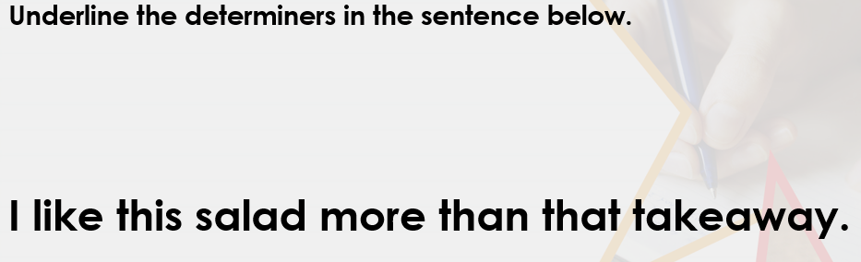

Let’s try some questions together.
This and that are demonstrative determiners.

Slide 21
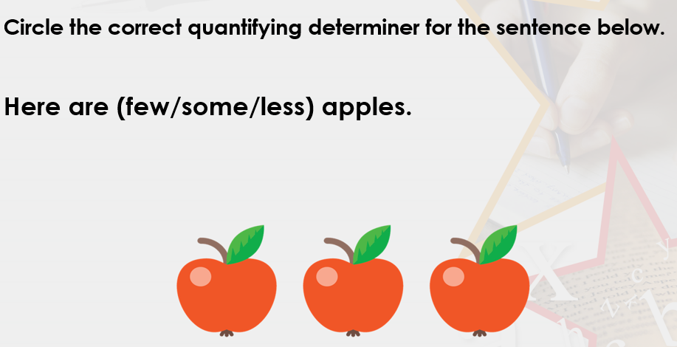

Slide 22
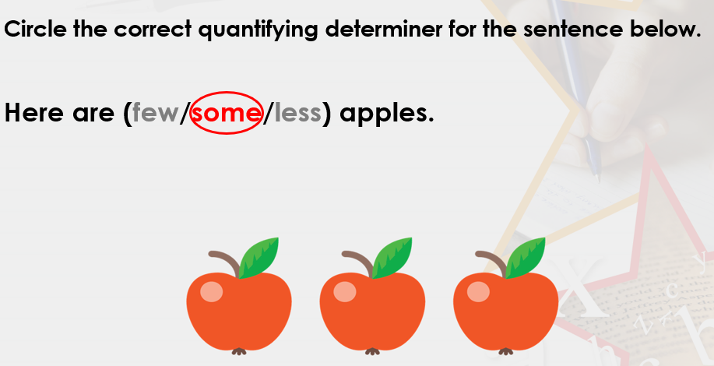

Slide 23
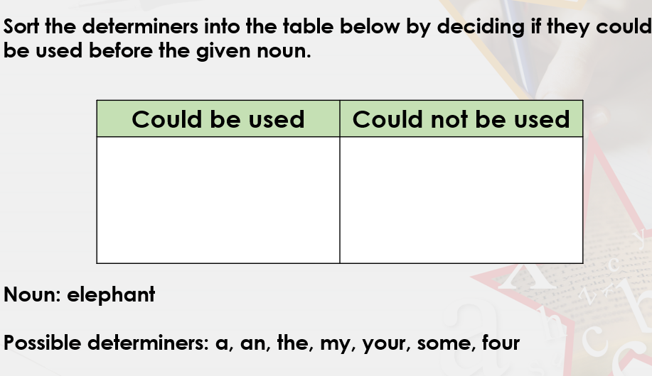

Slide 24
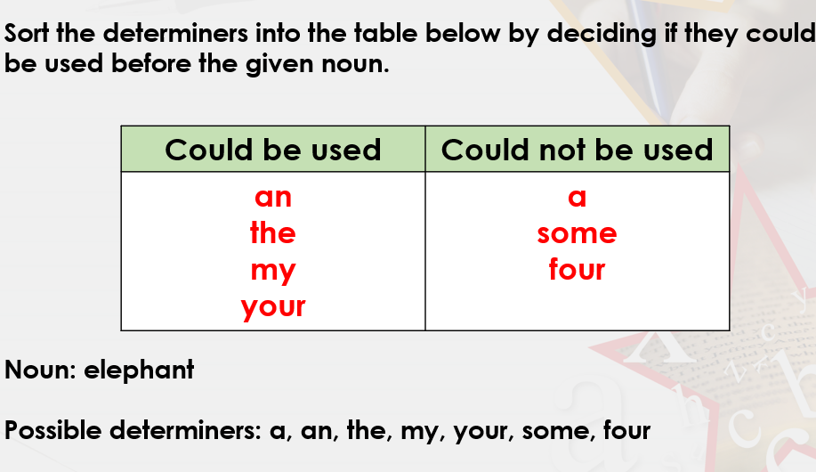
Some and four
Would need the noun to plural.. elephants.

Slide 25
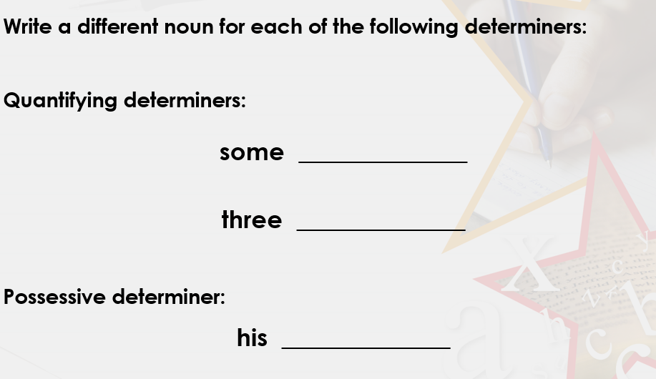

Slide 26
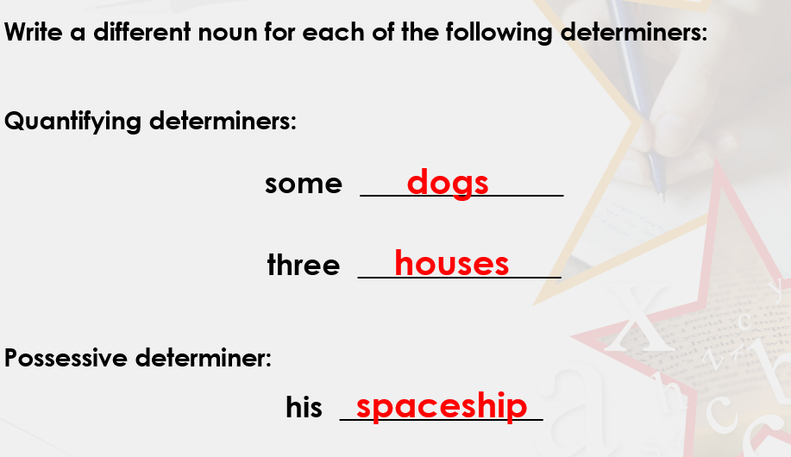
You could have used any nouns that make sense here. These are my examples.

Slide 27
Now complete today’s grammar activity.
Remember, if you can’t print them off, just complete the answers in your green work book.

