Slide 1
Year 4 Geometry
Lesson 41 Geometry review

Slide 2


Today we are going to review what we have learnt about area and perimeter.
Have a go at the questions on the work sheet now.
When you have finished go through the rest of the slides which will have the answers on.

Slide 3
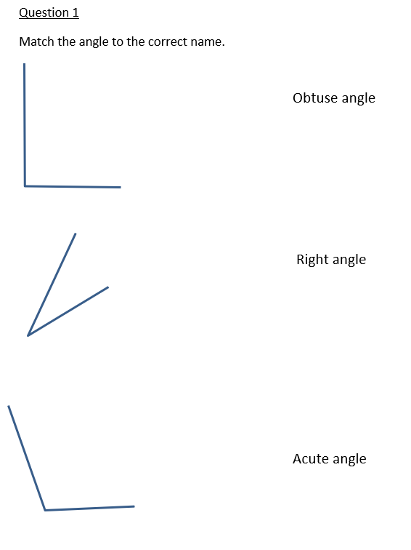

Slide 4
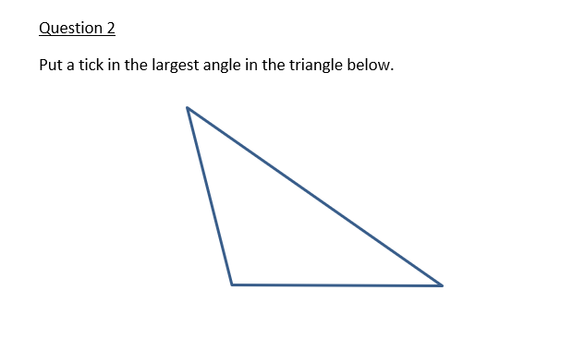

Slide 5
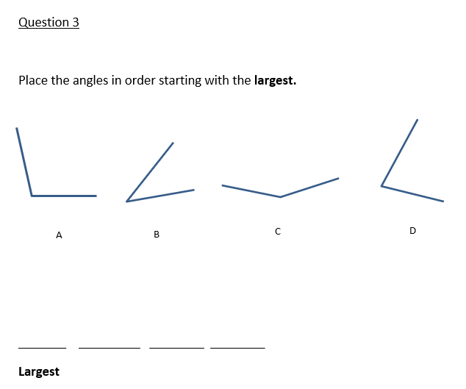
C A D B

Slide 6
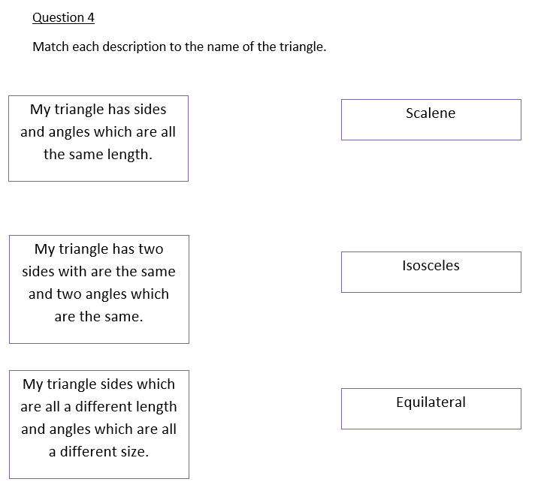

Slide 7

Jack is not correct because in an equilateral triangle all the sides are the same length.

Slide 8
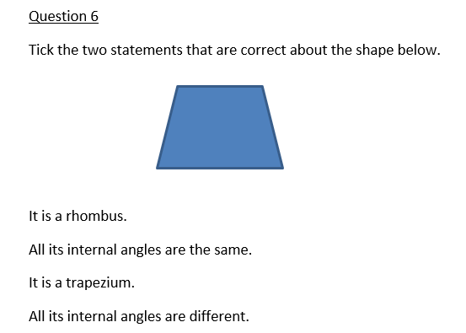
X
X note this depends on how the trapezium is drawn.
Sometimes the angles at the top are the same and the angles at the bottom are the same.

Slide 9
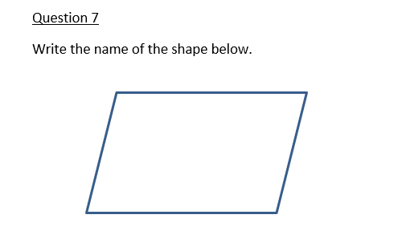
Parallelogram

Slide 10
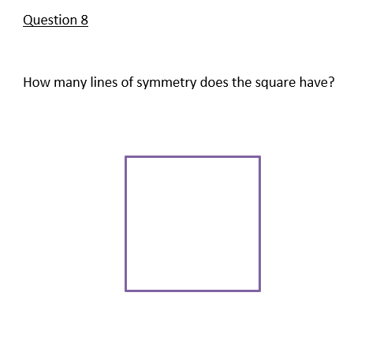

Slide 11
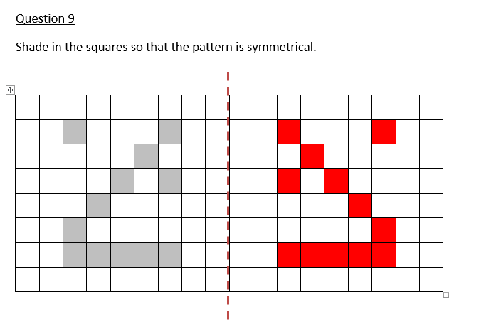

Slide 12


