Slide 1
Year 4 Geometry
Lesson 34 Geometry Lesson #6
Area and perimeter review

Slide 2


Today we are going to review what we have learnt about area and perimeter.
Have a go at the questions on the work sheet now.
When you have finished go through the rest of the slides which will have the answers on.

Slide 3
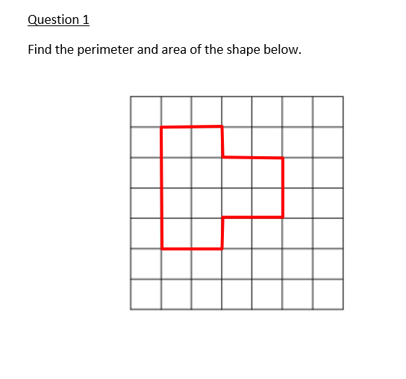
Perimeter – count the squares all the way round the edge.
Perimeter – 16cm
Area – amount of space inside the shape.
Area – 12cm ²

Slide 4

Any 2 variations of the following options.

Slide 5
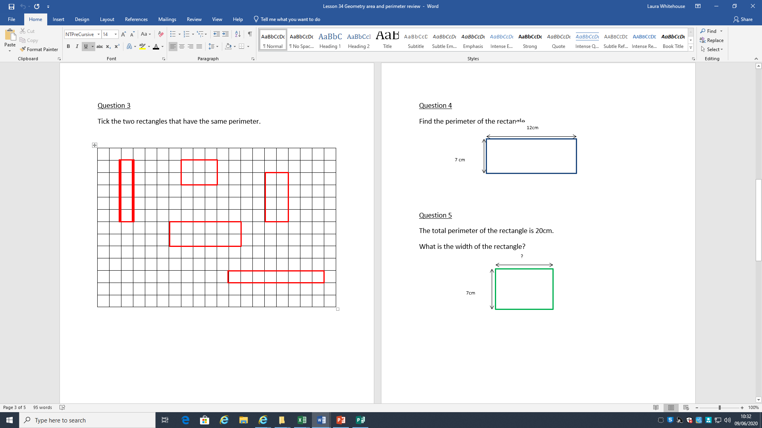
X
X

Slide 6
(7+12) x 2 =
19 x 2 = 38 cm

Slide 7
(7 + ___) x 2 = 20
The missing width is 3cm
This needs to make 10

Slide 8
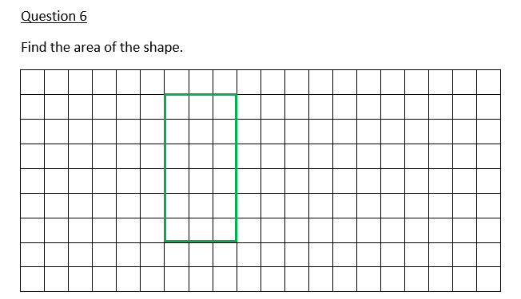
Count the squares in the rectangle – 18cm²

Slide 9
