Slide 1
Monday 6th July 2020
Designing settings

Slide 2
Today we are going to carry on adapting the story to make our own.
We are going to be focusing on
settings.

Slide 3
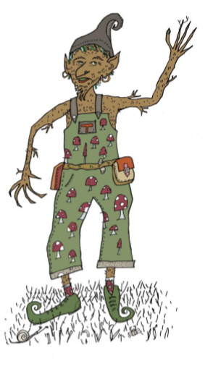
In the story, Sammy enters the Tree Goblin birthday party. Highlight all the things that Sammy can see.
In the blink of an eye, Sammy found himself inside the trunk of a large tree. Colourful balloons, bunting and banners decorated the room and loud music, that made you want to dance, filled the warm air.
All around the room small, strange-looking people, wearing brown tweed dungarees covered in toadstools, leaves and roses, danced and sang with great gusto and joy. Their large pointy ears were hidden slightly by their bushy multi-coloured hair and curly-toed velvet shoes hid their enormous, hairy feet. Around their necks each one wore a necklace covered in the most interesting of charms and trinkets.
In the middle of the room, a magnificent feast was laid out on a large woven willow table. There were pinecone truffles, sweet sap sorbets, nettle fritters and the finest pollen-puddings. In the centre was an enormous cake covered in long-grass icing and on the top over a hundred candles burned brightly.
Draw a picture of the goblin party and label all the things in it that Sammy can see.

Slide 4
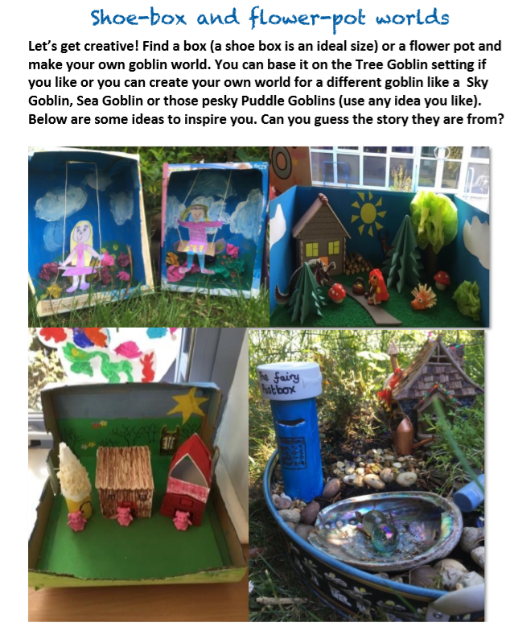
Let’s get creative! Find a box ( a shoe box ) or a flower pot to design a new magical land for your creatures from last week.
This is to help you see your setting when we write about it.
(Don’t worry if you can’t do this step… draw a picture instead).

Slide 5
Now, use your model or picture to
help you to write a description of your story
setting. Use the description we read earlier
to help you.
Remember to include:
Adverbials that show place.
Interesting adjectives.
Conjunctions.
Correct punctuation.

