Slide 1
Tuesday 14th July2020
Characters

Slide 2
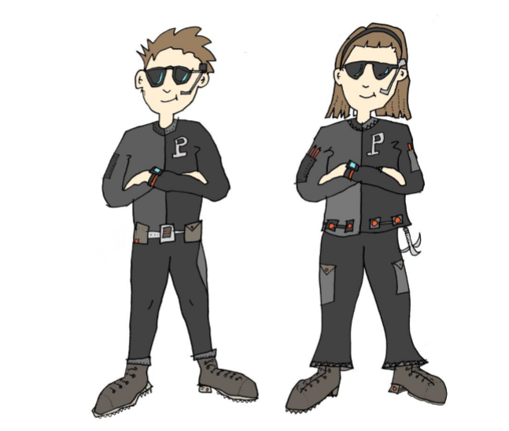
Today, we are going to think about the characters in our story.
Let’s remind ourselves of the
Story before we begin.

Slide 3
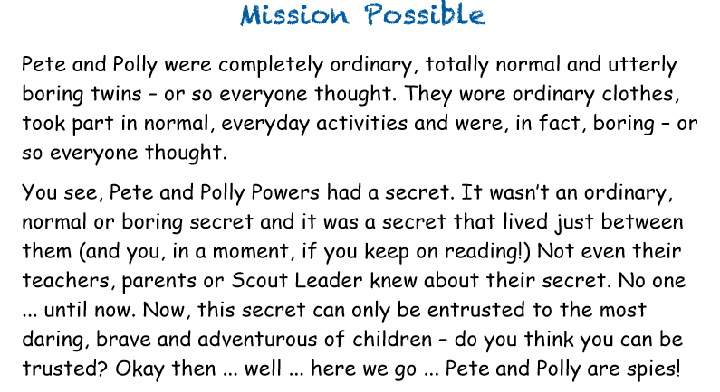

Slide 4
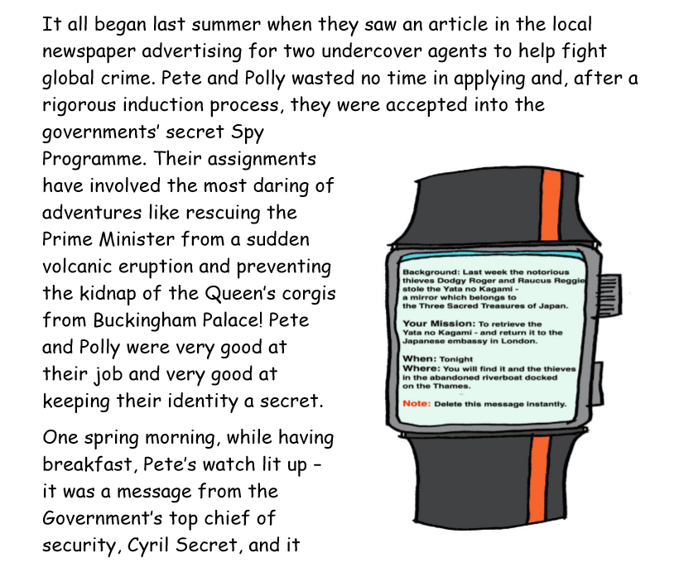
read

Slide 5
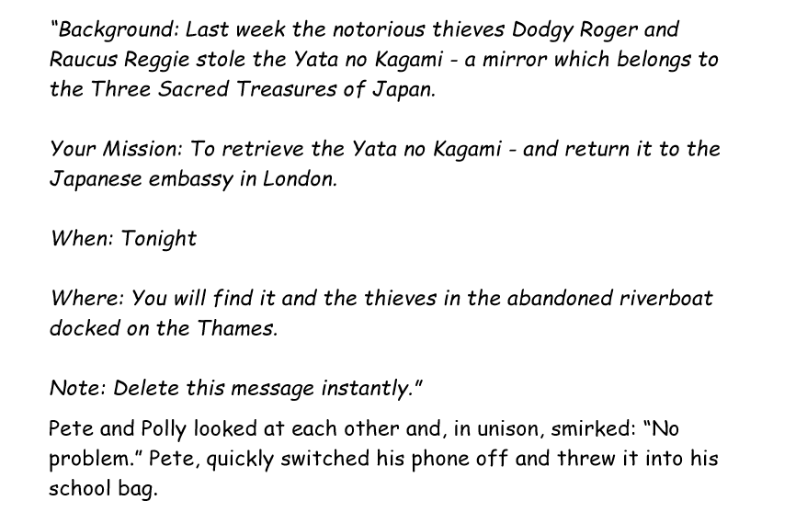

Slide 6
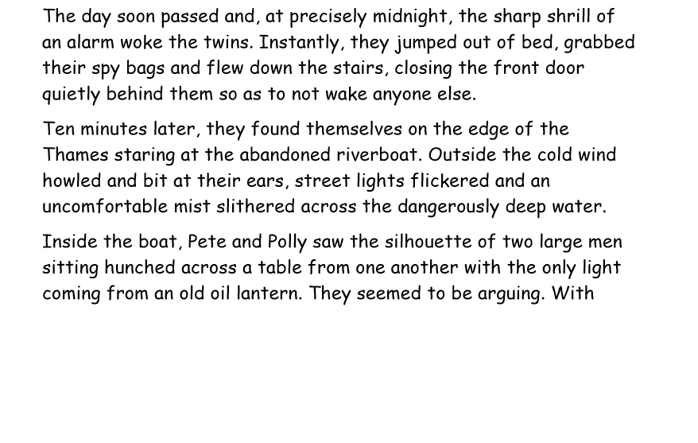

Slide 7
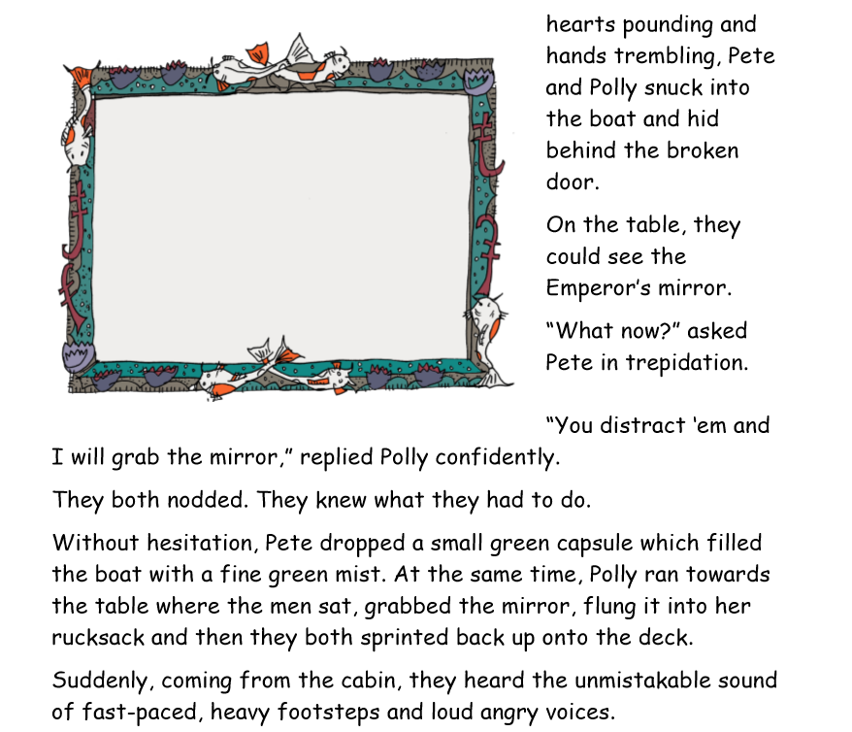
With

Slide 8
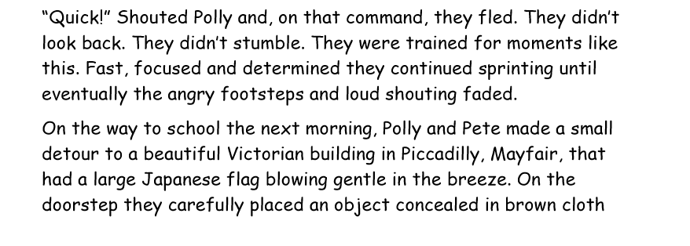
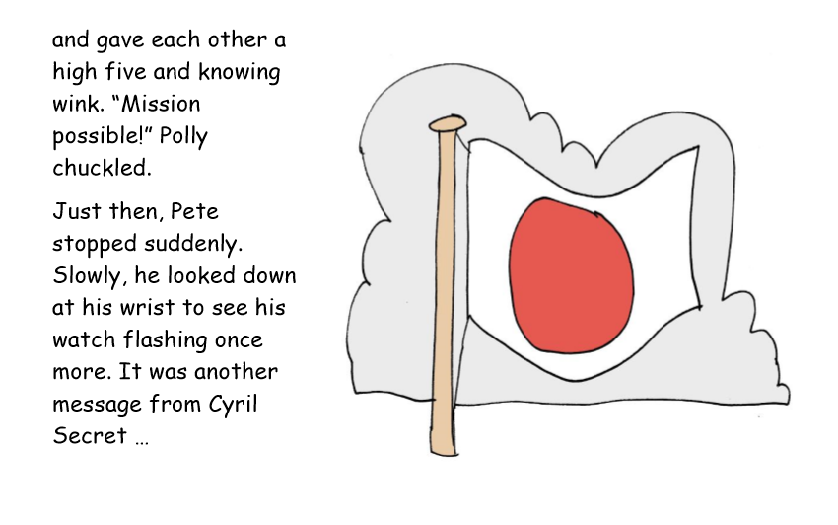

Slide 9
Who is your favourite character in the story?
What makes them your favourite character?
Draw a picture of what you think they look
Like?

Slide 10
There are lots of things that we do not know about the characters in
Mission Possible.
We are going to be using our imaginations to add extra background details to the characters by filling in character profiles about them.

Slide 11
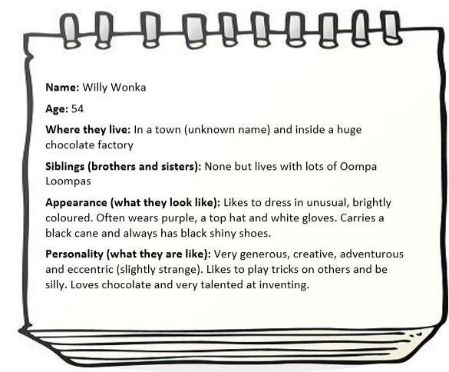
Here is an example profile to give you some help and ideas.

Slide 12
Activity : Complete the character profiles for the Mission Possible characters.

