Slide 1
Year 4 Geometry
Lesson 46 Position & Direction Review

Slide 2


Today we are going to review what we have learnt about area and perimeter.
Have a go at the questions on the work sheet now.
When you have finished go through the rest of the slides which will have the answers on.

Slide 3
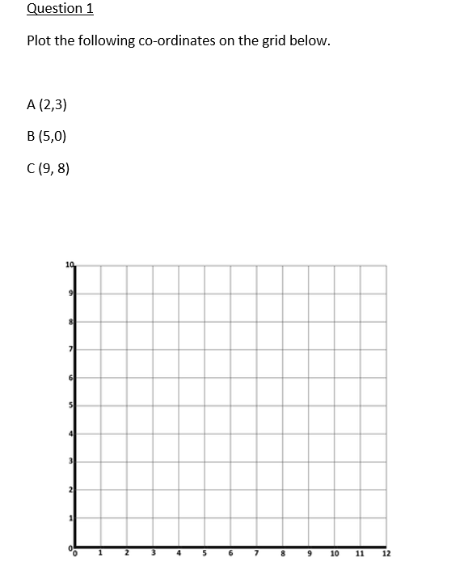
C
A
B

Slide 4
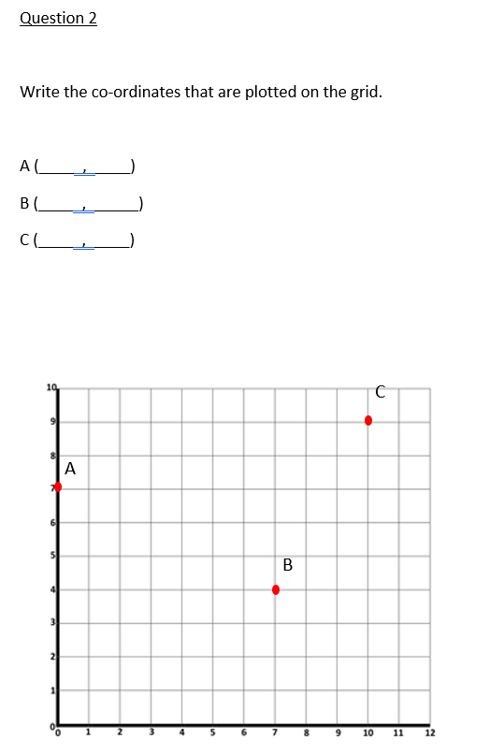
0 7
7 4
10 9

Slide 5
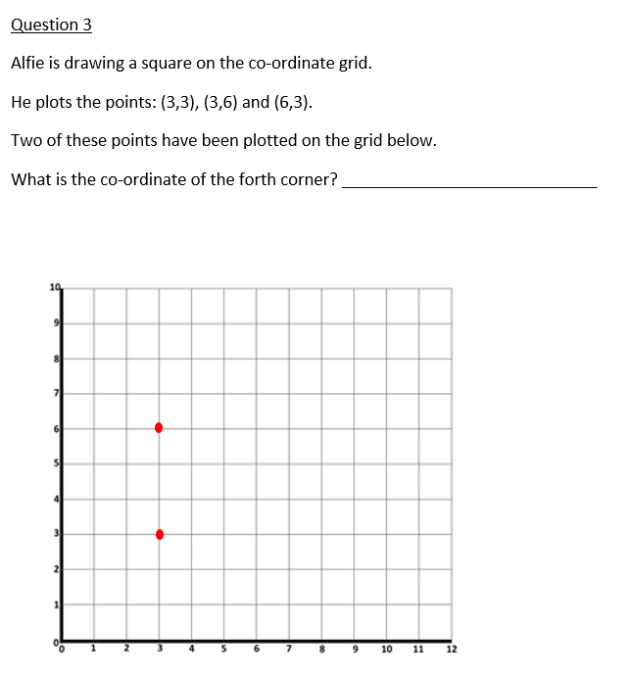
(6, 6)

Slide 6

5
4

Slide 7
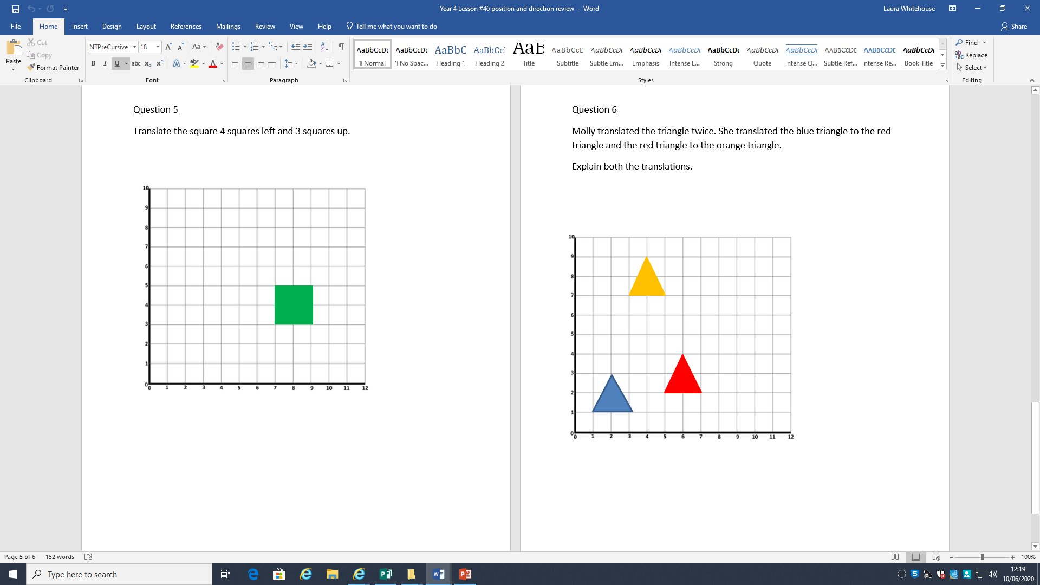

Slide 8
Blue to red – 4 squares right, 1 square up
Red to orange - 5 squares up, 2 squares left

