Slide 1
Wednesday 13th May 2020
English – Poetry skills
Notes:
© Copyright Showeet.com – Free PowerPoint Templates. Photo credits: Pixabay (CC0 Public DomainFree for commercial use No attribution required)

Slide 2
Over the next few days, we are going to be exploring a different form of poetry called Haiku.
Yesterday, we explored rhyming poems.
Notes:
© Copyright Showeet.com – Free PowerPoint Templates

Slide 3
What is a haiku?

Slide 4
Haiku is a form of poetry which originated in Japan
A haiku represents a single idea or feeling
Most haiku are about nature or natural things
What subjects could a haiku be written about?

Slide 5
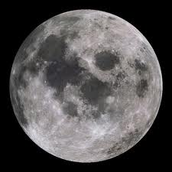
Read the following examples of Haiku. They are all written about the moon.

Slide 6
Moon Haiku
Like a bulging eye the moon seemed to stare at me in this creepy night.

Slide 7
Moon Haiku
A gentle moon shines
upon a very dark earth
sharing its sweet light.

Slide 8
Moon Haiku
Move on mighty clouds there's the goddess of the night let her brightness beam

Slide 9
Like a bulging eye the moon seemed to stare at me in this creepy night.
All three Haiku are about the moon but do they paint the same picture of the moon?
A gentle moon shines
upon a very dark earth sharing its sweet light.
Move on mighty clouds there's the goddess of the night let her brightness beam

Slide 10
Like a bulging eye the moon seemed to stare at me in this creepy night.
Haiku 1 makes the moon sound creepy and a little scary!
A gentle moon shines
upon a very dark earth sharing its sweet light.
Haiku 2 makes the moon sound calming.
Move on mighty clouds there's the goddess of the night let her brightness beam
Haiku 3 makes the moon sound strong and powerful.

Slide 11
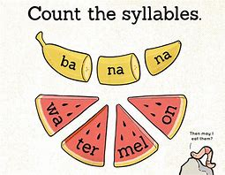
Haiku have very strict rules to follow!
They must have 3 lines.
Each line must have a given amount of syllables.
Line one = 5 syllables
Line two = 7 syllables
Line three = 5 syllables
Remember: A syllable is a single unit of
Speech.
Not sure? Put your hand under your chin.
Say a word. How many times did your chin
Go down?

Slide 12
The red dots show the syllables.
Butterflies in flight (5) Brilliant rainbow colours (7) ripple past the pond (5)
Butterflies in flight
Brilliant rainbow colours
ripple past the pond

Slide 13
Copy the Haiku below. Leave a line in between each line of the haiku. Draw a dot above each syllable.
The green leaves are gone
missing all the memories
Autumn please don't come
Leave a line so you can fit the dots in

Slide 14
Now try this one….
Winter is coming.
Snow will be arriving soon,
We should rake the leaves.
Leave a line so you can fit the dots in

Slide 15
What is wrong with this Haiku?
My two apple trees are,
So beautiful. See they flower
One now, one later.

Slide 16
Answers to our questions..

Slide 17
Copy the Haiku below. Leave a line in between each line of the haiku. Draw a dot above each syllable.
The green leaves are gone
missing all the memories
Autumn please don't come
Leave a line so you can fit the dots in

Slide 18
Now try this one….
Winter is coming.
Snow will be arriving soon,
We should rake the leaves.
Leave a line so you can fit the dots in

Slide 19
What is wrong with this Haiku?
My two apple trees are,
So beautiful. See they flower
One now, one later.
The first line has 6 syllables.
The second line has 8 syllables.
The third line has 5 syllables
This does not follow the strict Haiku pattern. It should have
Line 1 – 5
Line 2 – 7
Line 3 - 5

