Slide 2
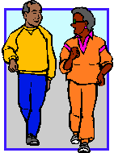
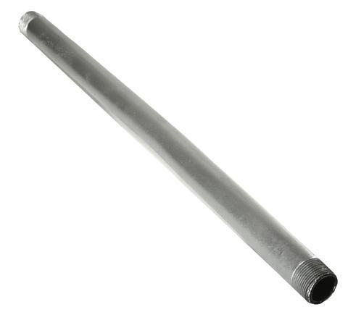
Homophones
led
lead
She led the way to the shops.
Led is the past tense of lead (to go somewhere).
Lead is a type of metal often used in pipes.

Slide 3
Be careful!
‘lead’ can also mean…
…but is pronounced differently
Notes:
Lead / lead the way

Slide 4
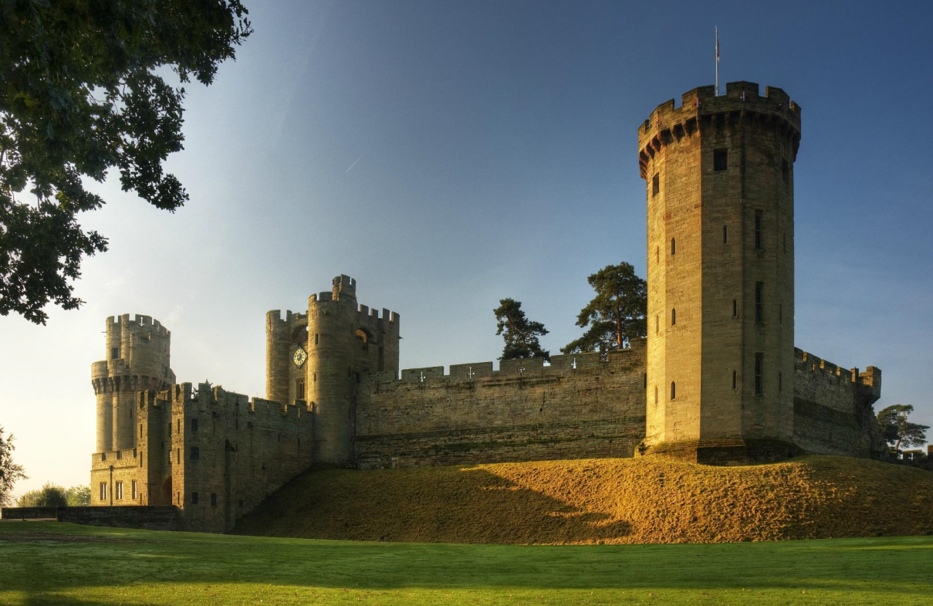
Homophones
The tour guide __________ the way around the castle.
Notes:
led

Slide 5
Homophones
“_________ is a very strong metal, good for building things,” the scientist said, “but it can be melted easily.”
Notes:
Lead

Slide 6
Homophones
morning
mourning
Notes:
Mourning – to grieve when someone has died. You are said ‘to be in mourning.’

Slide 7
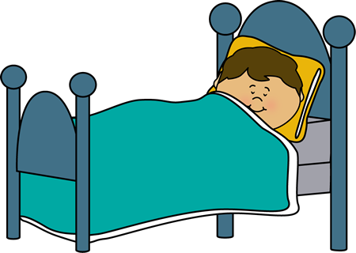
Homophones
I actually woke up quite late this _______________.
Notes:
morning

Slide 8
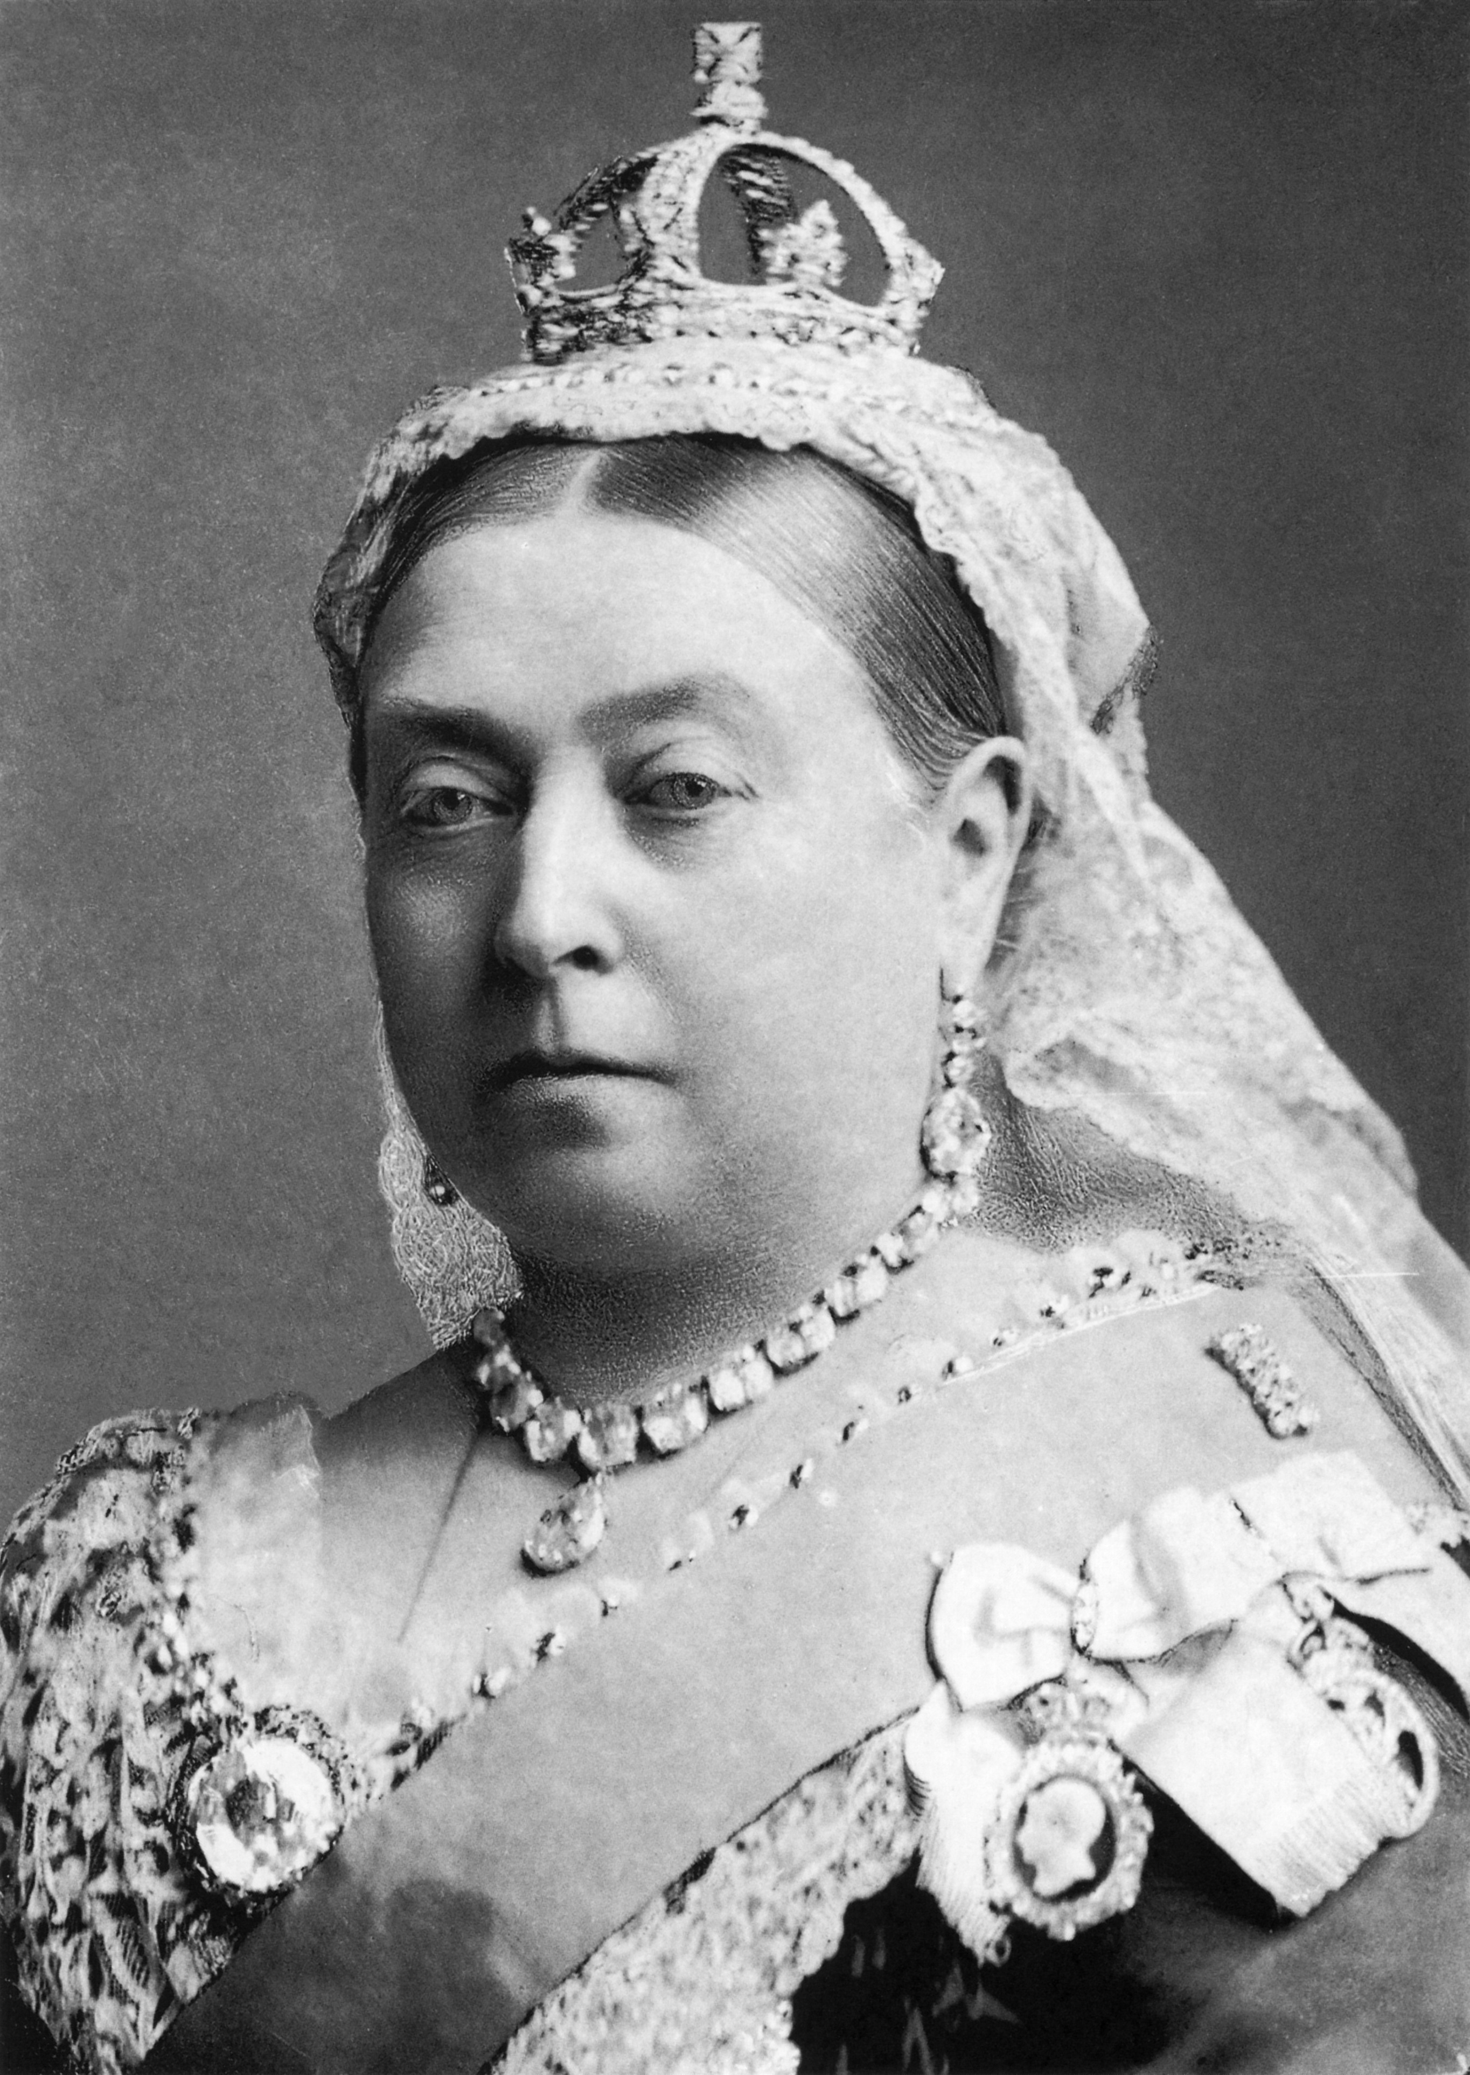
Homophones
After her husband died, Queen Victoria was in __________ for years.
Notes:
mourning

Slide 9
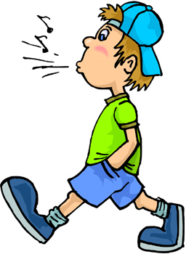
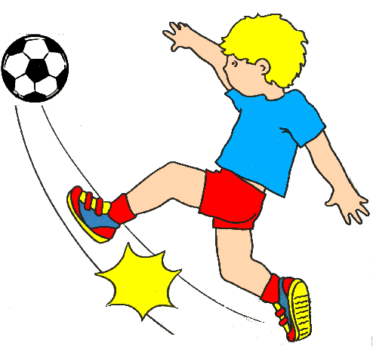
Homophones
past
passed

Slide 10
Homophones
I will not let what I did in the __________ determine what I do in the future.
Notes:
past

Slide 11
Homophones
When I asked Miss. Nicholls for a pen, she ___________ it to me straight away.
Notes:
passed

Slide 12
Apostrophes
An apostrophe is the same shape as a comma (,) but placed above the line (‘).
Apostrophes show two things:
That one thing belongs to another.
That some letters of a word have been left out to shorten the word.
Today, we are focusing on apostrophes to show possession.

Slide 13
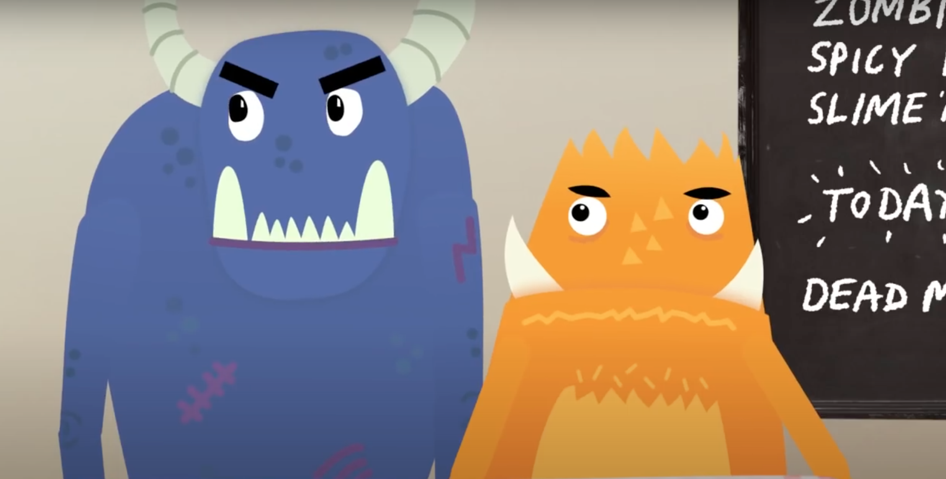
Click on the video below or paste this link into the internet.
https://www.youtube.com/watch?v=zNFPnVz7JB4
This is a short video to explain how you use apostrophes for plural possession. It will also explain how this is different to singular possession and test your knowledge at the end.
Notes:
https://www.youtube.com/watch?v=zNFPnVz7JB4

Slide 14
Showing possession
Apostrophes can be used to show that something belongs to someone or something. This is called possession.
When we are talking about one thing, we call this singular.
For example, a man or a bike.
When we need to say that something belongs to something singular, we put an apostrophe and then an ‘s’ at the end of the name it belongs to.
e.g. the man’s bike.

Slide 15
Showing possession
We also use an apostrophe and an ‘s’ to show when something belongs to a proper noun (a name that begins with a capital letter).
e.g. India’s national flag has three horizontal stripes on it.
Photo courtesy of Sanyam Bahga (@flickr.com) - granted under creative commons licence - attribution

Slide 16
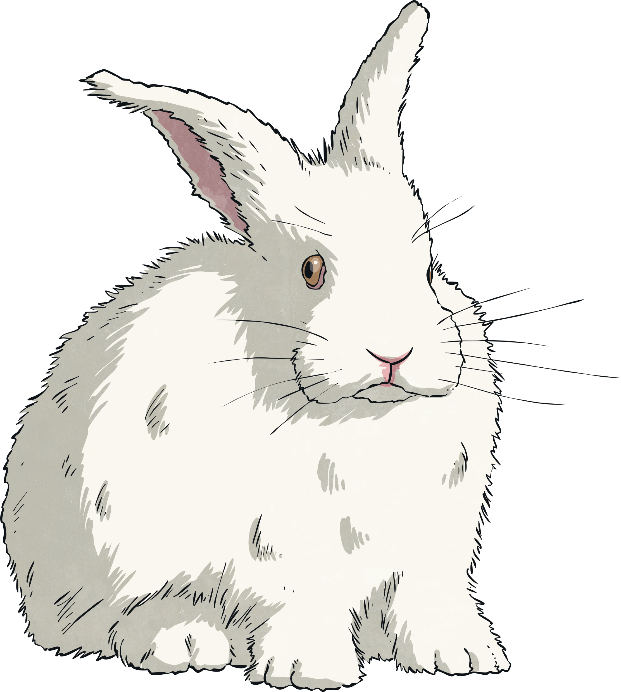
Look out for…
When you add an apostrophe to a noun, add ‘s to the end of the last word.
e.g. Buckingham Palace’s gates are painted gold and black.
Never use an apostrophe if you have already used a possessive pronoun (his, her, its).
e.g. Dave had a rabbit and its fur was white.
The only time that it’s has an apostrophe is when it is a contraction for ‘it is’ or ‘it has’.

Slide 17
Your Task

Slide 18
Notes:
On the following slides will be SATS questions based on what they have just learnt.

Slide 19
Notes:
Pupils’ coats should be hung on the pegs.

Slide 20
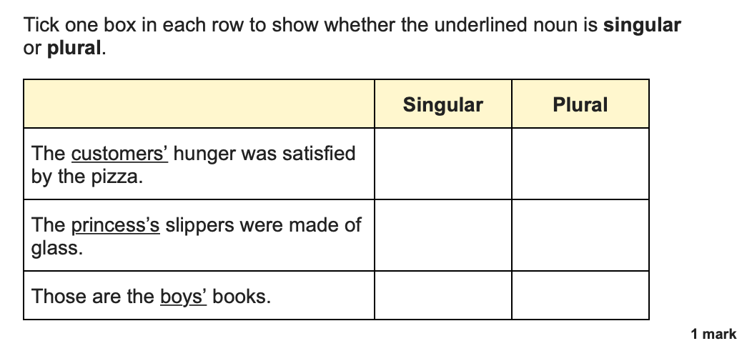
Notes:
Plural
Singular
Plural

Slide 21
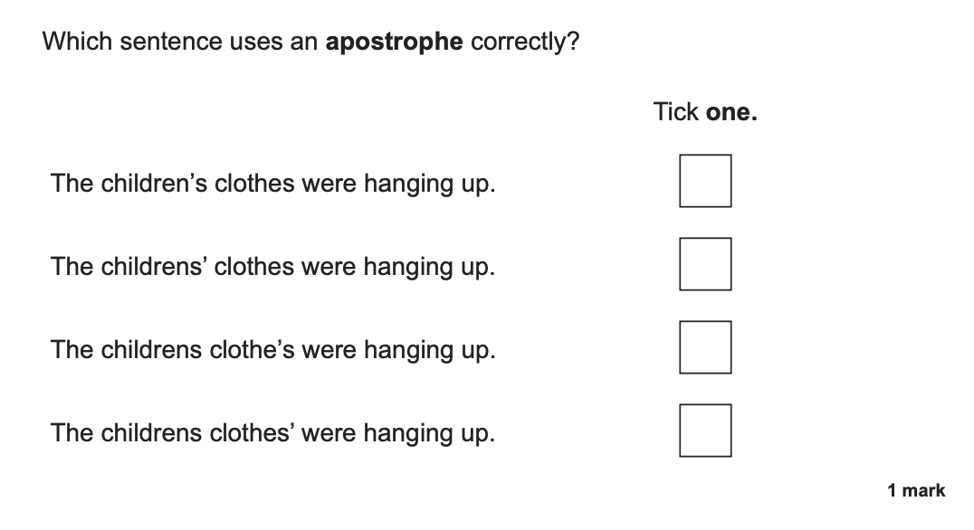
Notes:
Top answer – The children’s clothes were hanging up.

Slide 22
Notes:
Possession
Contracted form
Possession
Contracted form

