Slide 1







Writing a journey/quest

Slide 2
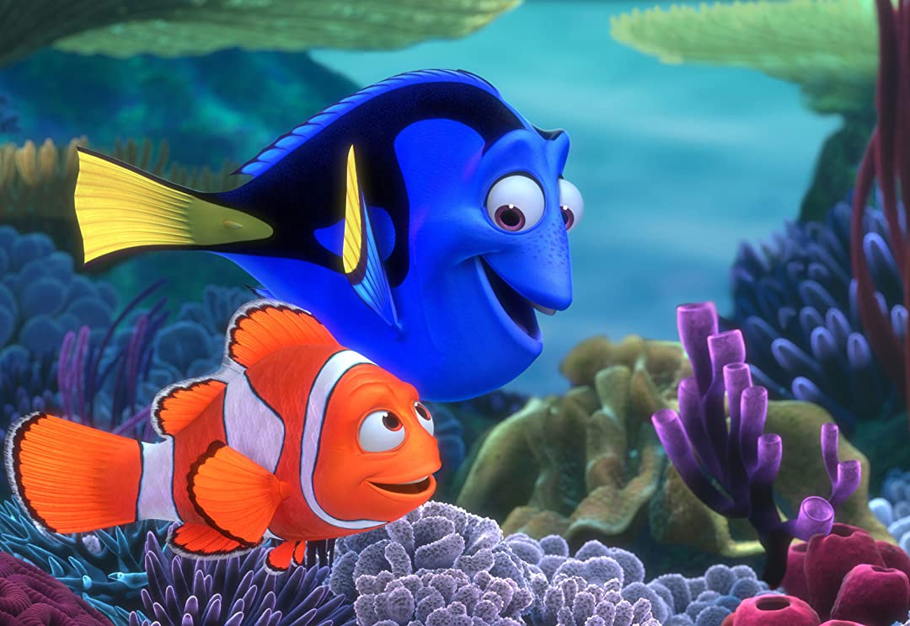
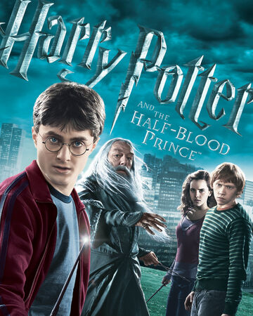
Our focus today is story plots.
When we walk about plot, we talk about what happens in the story.
Most stories follow one of these story plots:
Overcoming the monster Tragedy
Rags to Riches Comedy
Character flaw Meeting Tale
Losing Tale Warning Tale
Journey quest Wishing Tale
Rebirth Voyage and return.
Today, we will be focusing on the story plot, journey quest.
Examples include Lord of the Rings, Around the World in 80 Days, Finding Nemo.

Slide 3
The journey/quest
The journey/quest is a search for a place, item, or person that requires the hero to leave home in order to find it.
It follows a structure similar to the following:
The Call – The main character is given a task.
The journey – The main character goes on a journey and it is a difficult one. For every step forward, it seems the character takes two steps back.
Arrival and Frustration – The character arrives at the destination. There are still ordeals to overcome.
Final Ordeal – The goal is in sight. This is where the ultimate test/challenge occurs.
The Goal – The main character achieves their goal.
Notes:
https://storyempirecom.wordpress.com/2018/07/02/basic-plots-quest/

Slide 4
This is an example of a journey/quest completed based on Harry Potter to help you before you plan and write your own story.
Structure | Example
The call | Dumbledore insists Harry should have special instruction this year—by him—which will help them with their mission to defeat Voldemort. Ultimately, they seek horcruxes. The stakes are high—horcruxes are the key to defeating the Dark Lord.
The journey | Harry’s setbacks begin even before he goes to the cave. He has trouble retrieving the memory Dumbledore needs. He battles with Draco Malfoy. Ron almost dies. Often as he tries to solve one of these issues, he fails. Even when he finally does conquer the problem, another arises.
Arrival & frustration | Harry and Dumbledore reach the cave. But there are so many more trials to their ordeal. Blood must be sacrificed to open the cave mouth. Magic is needed to summon the boat.
Final ordeal | Torture and horrors await as they drain the basin. Harry must find water to help his mentor. Inferi rise from the depths of the lake to stop them.
The goal | Harry and Dumbledore take the locket back to Hogwarts. A whole other series of problems await them there. But when Harry is finally able to analyse the locket, he discovers it isn’t what’s he was looking for at all. He did, indeed, achieve his goal of retrieving the object, but it wasn’t the object he had hoped. And it comes at considerable cost.
Even though the goal is achieved, the story doesn’t always need to have a happy ending.
Notes:
https://storyempirecom.wordpress.com/2018/07/02/basic-plots-quest/

Slide 5
Use this table (or a similar style) to plan your own journey/quest. Think carefully about who your main character will be and what their personality will be like – this will be vital to your story and how they handle the obstacles/challenges they face.
Structure | Example
The call
The journey
Arrival & frustration
Final ordeal
The goal

Slide 6


Story Time!
Now you can write your story!
Some things I would like you to include:
Complex sentences (subordination)
Dashes
Parenthesis
Ambitious vocabulary
Paragraphs used appropriately
Write your story in your green book. You may want to draw lines or stick lined paper in to make sure that your writing is neat.

Slide 7

Does it make sense?
When you’re happy with it, read your story to your family. Please share your stories with us through Twitter or email!

