Slide 1



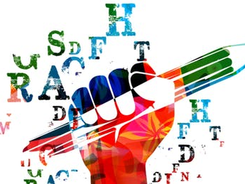



Imaginative Writing in the form of a diary entry

Slide 2
On the following slide, there is a link to a video clip. This is based on a planet called Pandora from the film Avatar. I’ve also included pictures of the planet to inspire your writing.
Your task today will be to write a diary entry as though you are an astronaut visiting Pandora for the first time.
You will need to listen closely to the description (you might want to note key words/facts down) so you can discuss your experiences, thoughts and feelings when landing on this planet.
Notes:
I would encourage the children to watch it once all the way through so they can focus on what they can see and hear and understand what is happening.
I would then watch it for a second time, this time, making notes along the way of key words/phrases/facts, things they can see/hear.
For today’s task, children will be writing in first person, pretending they are the astronaut. When watching the clip, they will need to think about how they are feeling, what they are thinking etc.

Slide 3
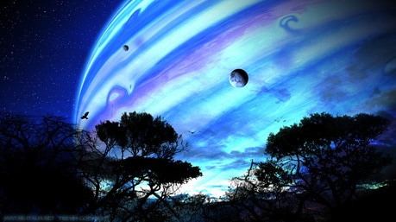
Notes:
https://www.youtube.com/watch?v=GBGDmin_38E

Slide 4
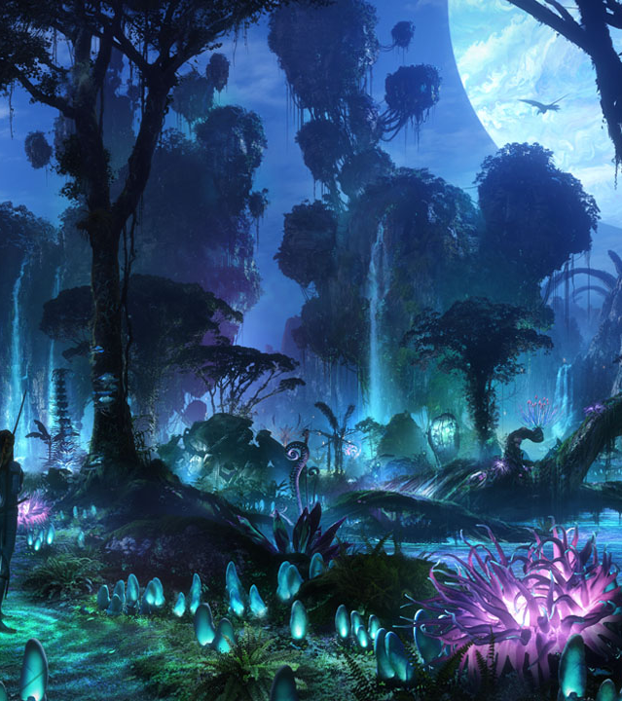
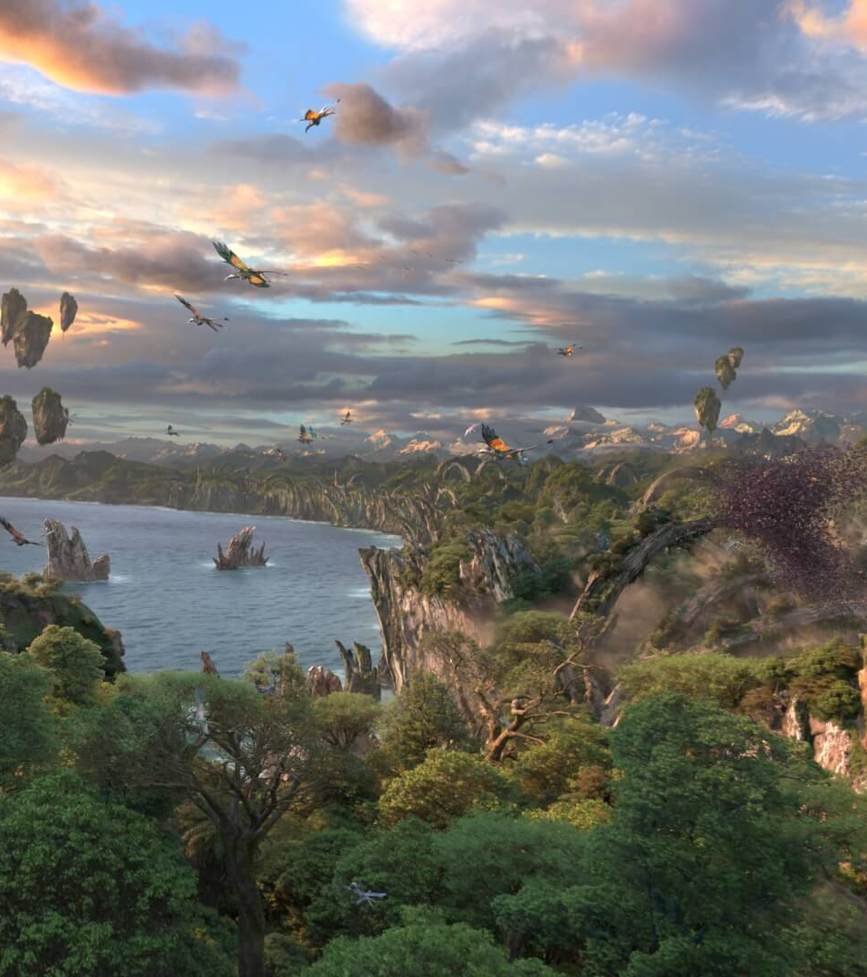

Slide 5


Slide 6


Your task today will be to write a diary entry (first person) as though you are an astronaut landing on Pandora. Before you start writing, you need to produce a small plan to help jot down your initial ideas, so you have a structure when writing. Your diary entry will need to have several paragraphs.
On the following slide will be guidelines you may wish to follow – these are just ideas that you may want to include, however, you can add more.
Your plan can be either notes or verbally to an adult or a sibling.

Slide 7

Ideas to consider including (in order):
describing the journey
landing
meeting the inhabitants
seeing Pandora at night
REMEMBER – Pandora is uninhabitable (unsuitable for living in) for humans as the atmosphere is toxic. This means you (the astronaut) MUST wear breathing masks when on Pandora at all times (this might link in with your thoughts/feelings).
Try including a range of thoughts/feelings throughout.
I would like your diary entry to also include complex sentences, parenthesis and prepositional phrases.
Write your diary entry in your green book. You may want to draw lines or stick lined paper in to make sure that your writing is neat.
Notes:
Children are quite comfortable writing a diary entry as they are writing in first person. However, children need to focus on the actual content of their sentences/work. They should ensure they are all high-quality and showcase their amazing skills. Encourage children to read their work through before moving on to the next sentence to ensure it makes sense and flows. I would LOVE to read any work that children produce so please feel free to take pictures and email them to Mr Douglas who could forward them over or upload them to Twitter.

Slide 8

Does it make sense?
When you’re happy with it, read your story to your family.

